Slide 1
New VGAE model
New VGAE model: Flawless1202/VGAE_pyG: An VGAE implementation using pytorch geometric. (github.com)
Input: 30 graphs with 10 nodes
Optimizers: Adams optimizer with learning rate 0.001
Epoches: 1000000 epoches
Latent space: 2 out-channels
--gpus
--time 4:00:00
--nodes=1
--ntasks=1
--cpus-per-task=1
--mem-per-cpu=100120

Slide 2
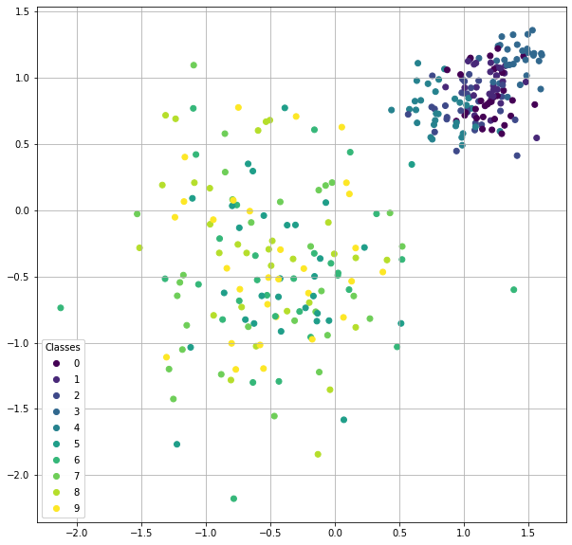
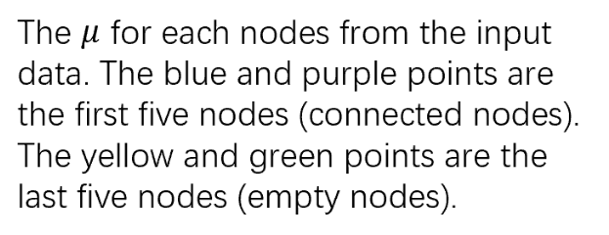

Slide 3
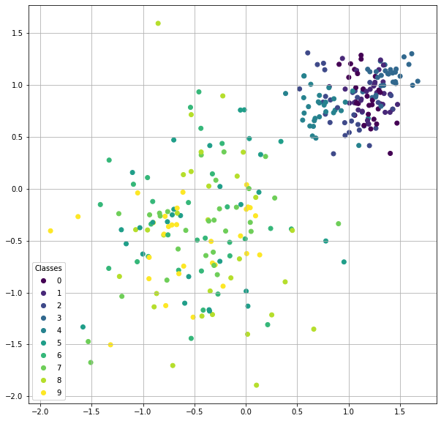
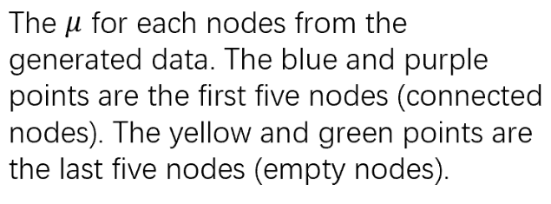

Slide 4
input
generated

Slide 5
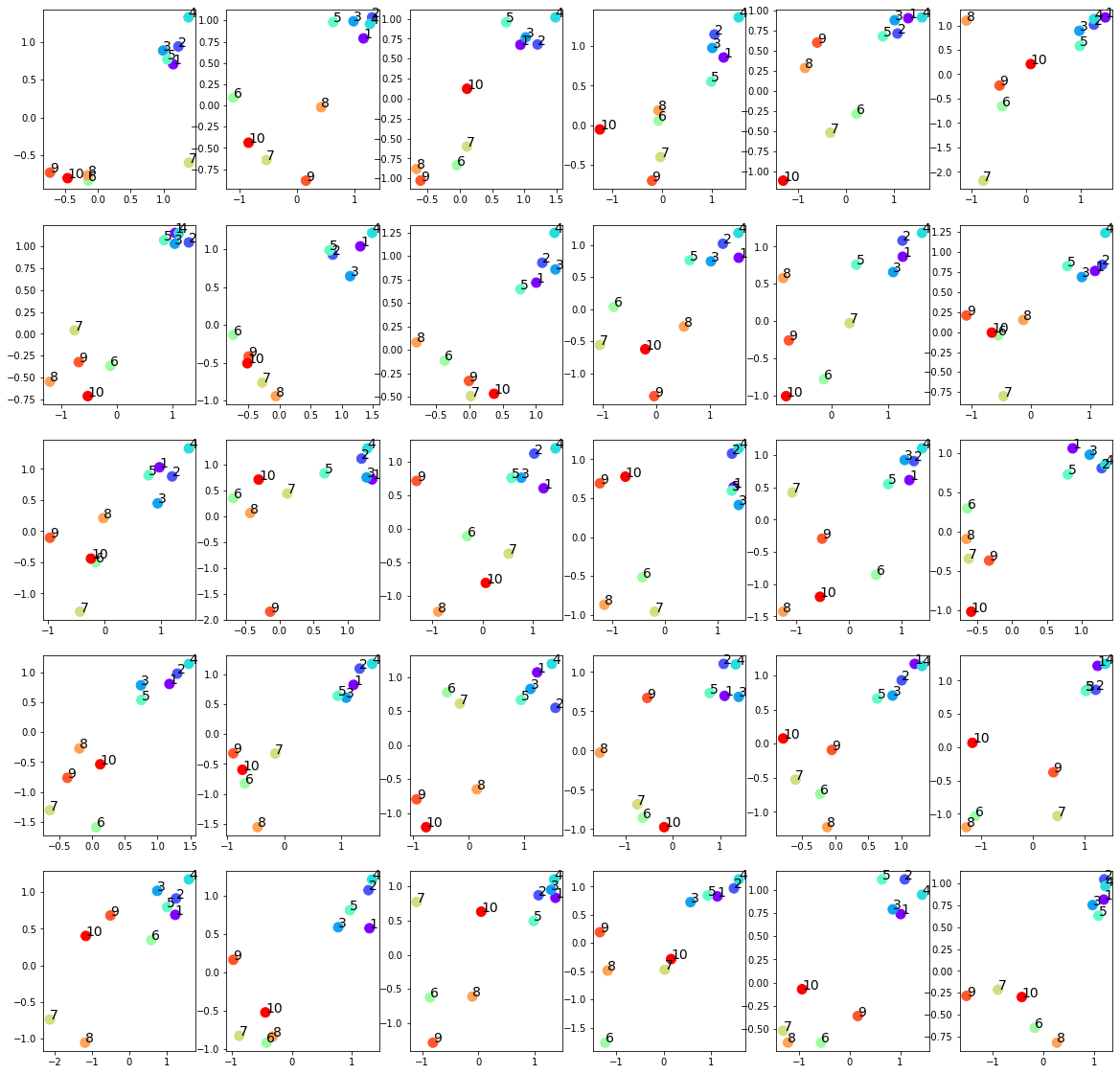
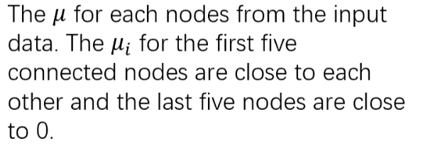

Slide 6
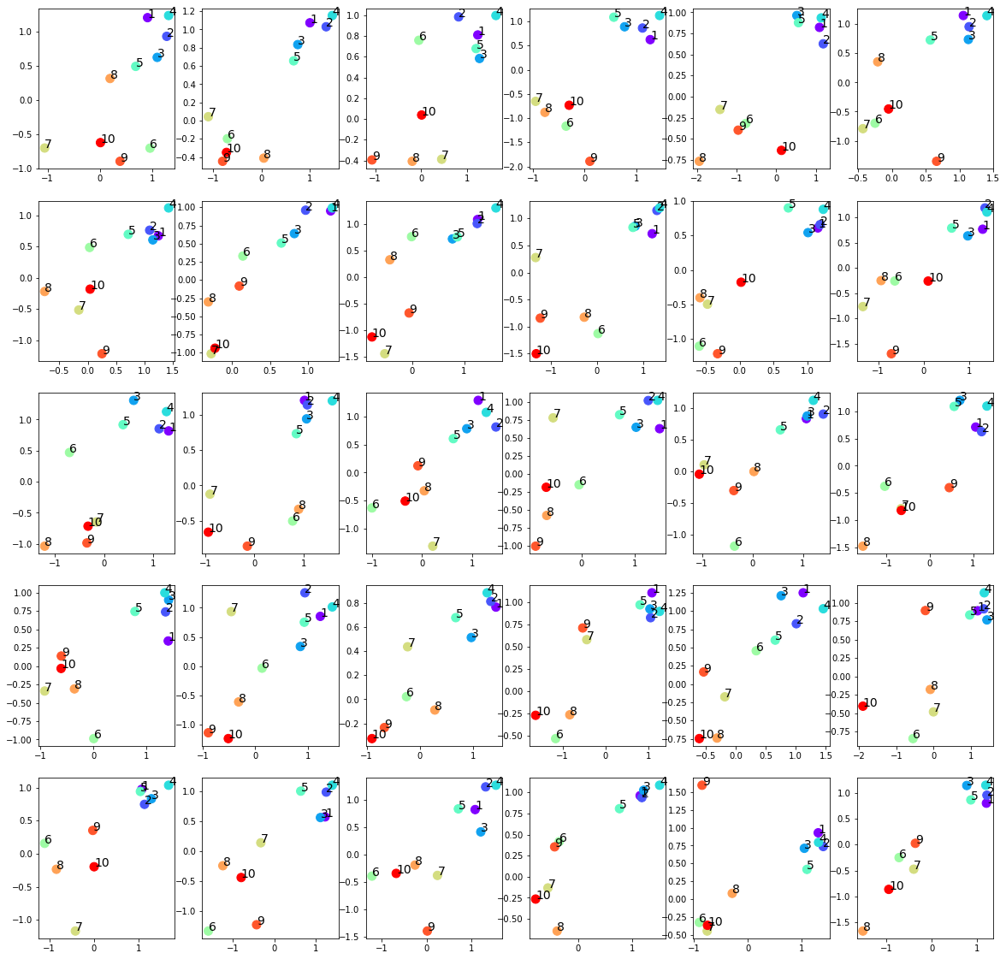


Slide 7
input
generated

Slide 8
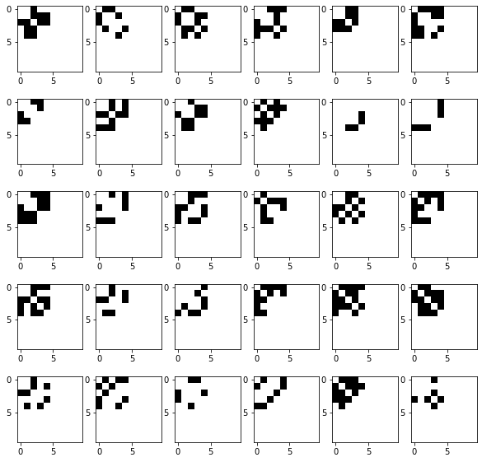
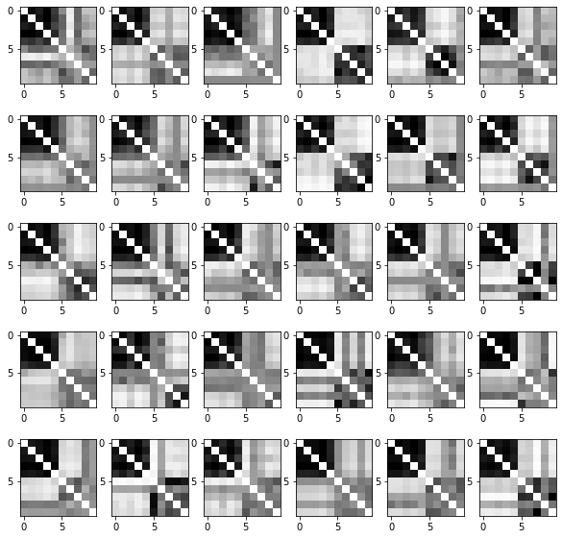
Input adjacency matrices (p=0.5)
Raw generated adjacency matrices (filter_value=0)

Slide 9
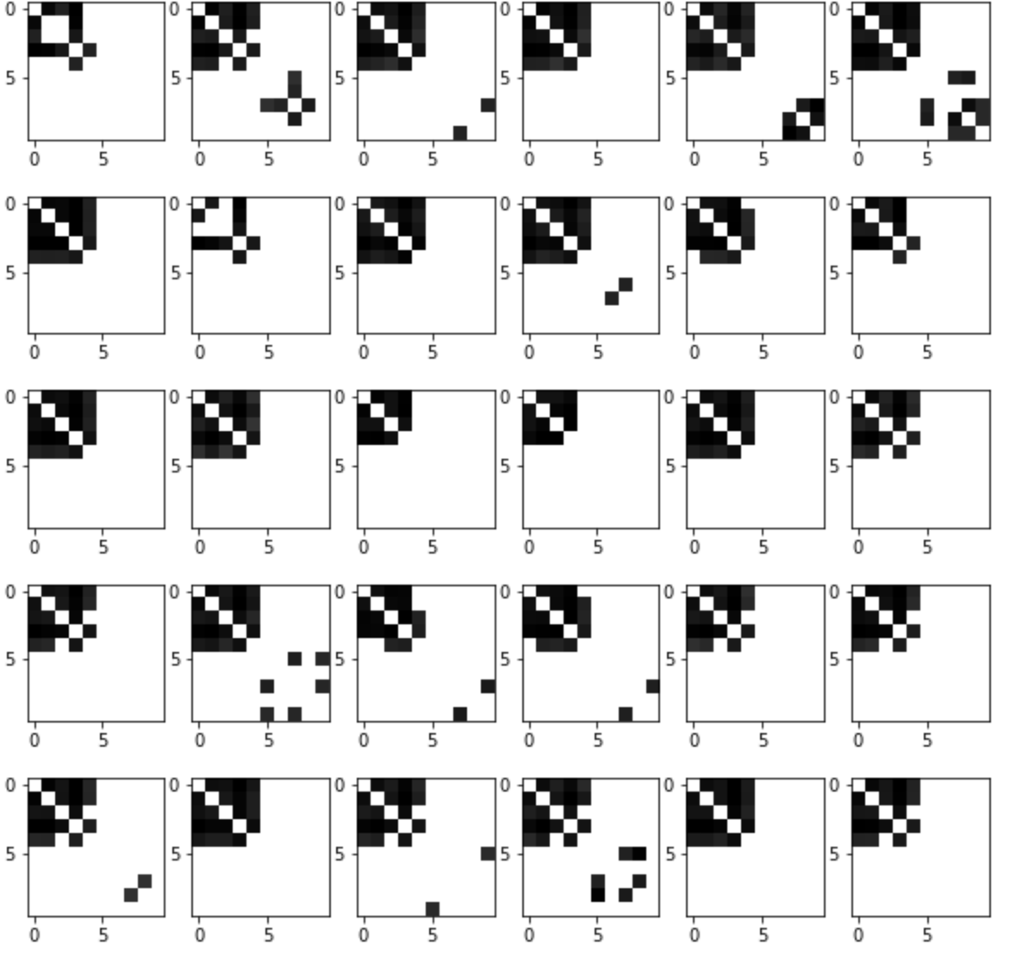
Input adjacency matrices (p=0.5)
generated adjacency matrices (filter_value=0.5)

Slide 10
Normalized Centrality
Node index | 1 | 2 | 3 | 4 | 5 | 6 | 7 | 8 | 9 | 10
Generated matrices centrality | 0.33 | 0.34 | 0.30 | 0.36 | 0.26 | 0.02 | 0.01 | 0.03 | 0.01 | 0.02
Original matrices centrality | 0.19 | 0.19 | 0.17 | 0.20 | 0.22 | 0. | 0. | 0. | 0. | 0.

Slide 11
New VGAE model
New VGAE model: Flawless1202/VGAE_pyG: An VGAE implementation using pytorch geometric. (github.com)
Input: 30 graphs with 10 nodes
Optimizers: Adams optimizer with learning rate 0.001
Epoches: 1000000 epoches
Latent space: 2 out-channels
p = 0.8 for the upper left submatrix

Slide 12
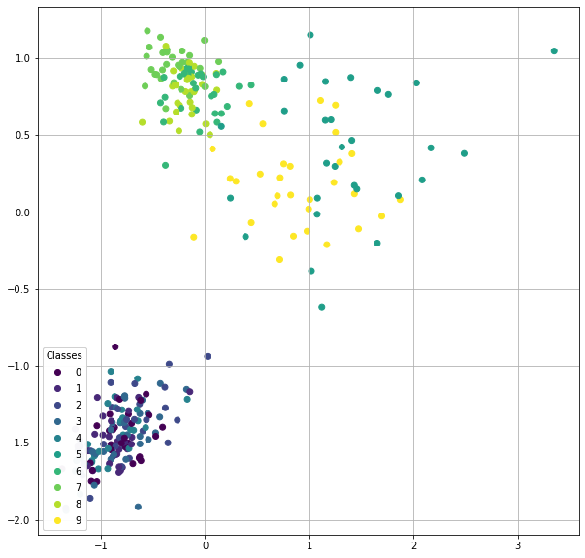

Slide 13
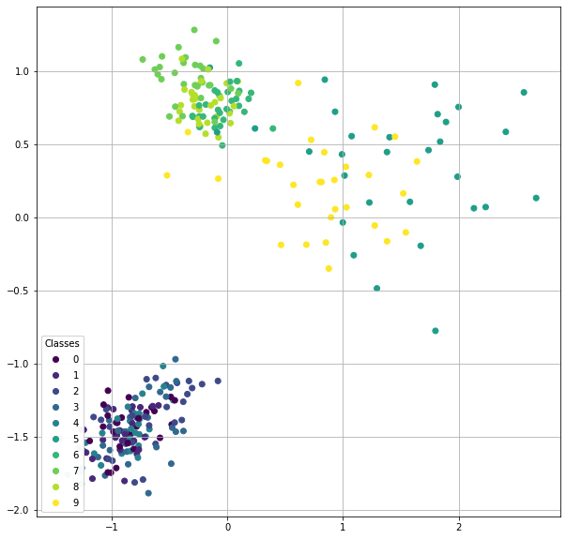

Slide 14
input
generated

Slide 15
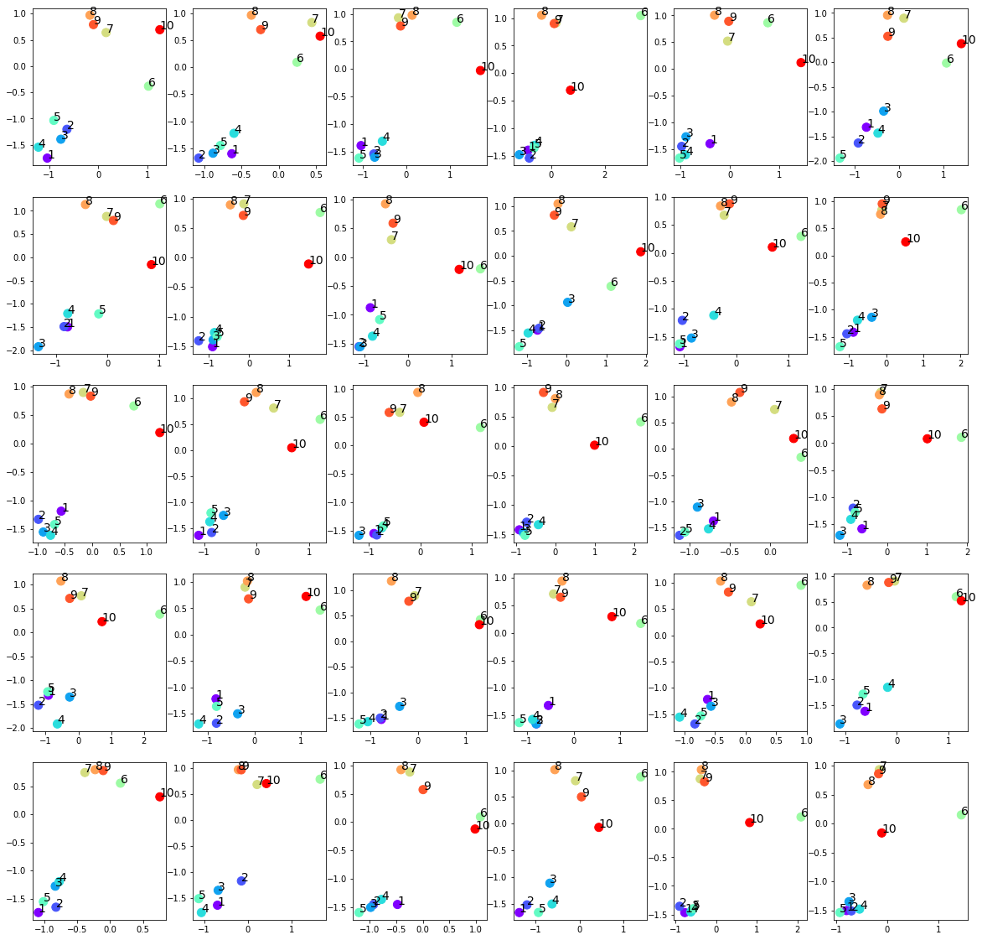

Slide 16
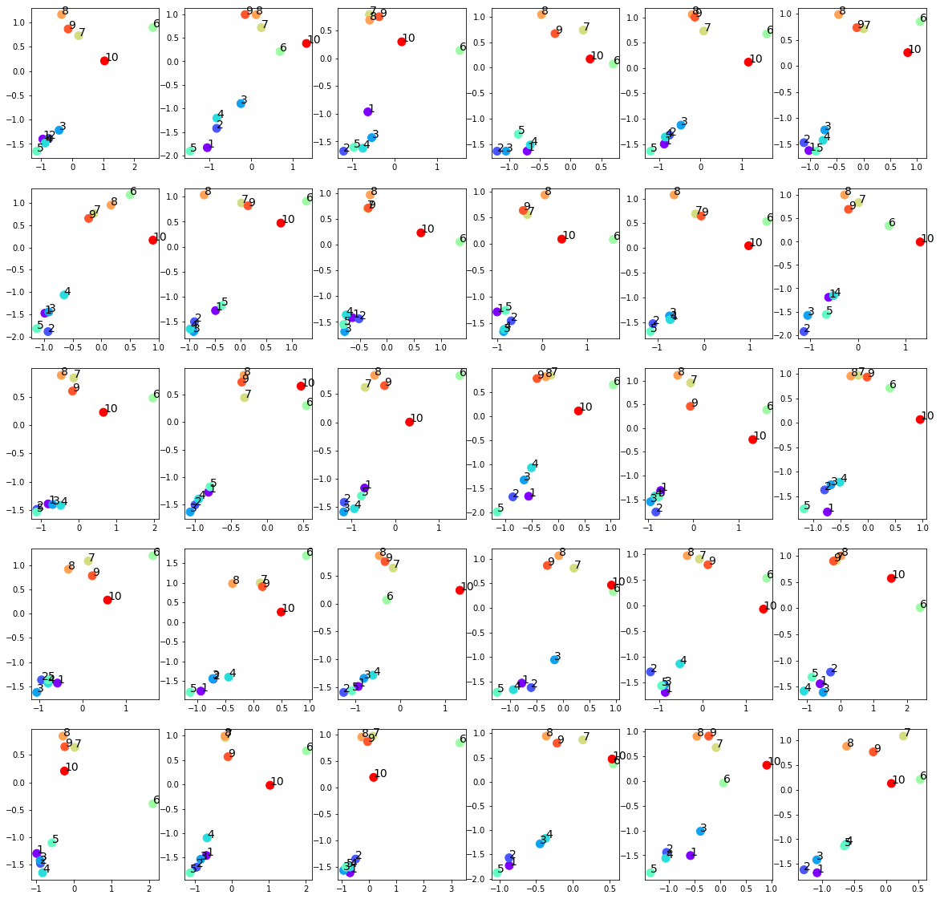

Slide 17
input
generated

Slide 18
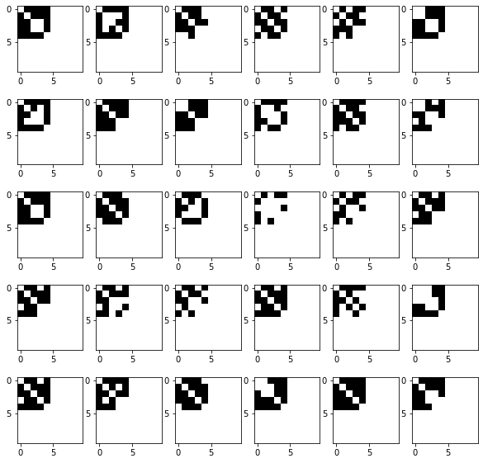
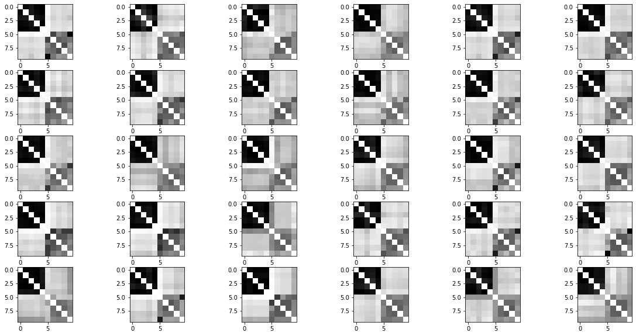
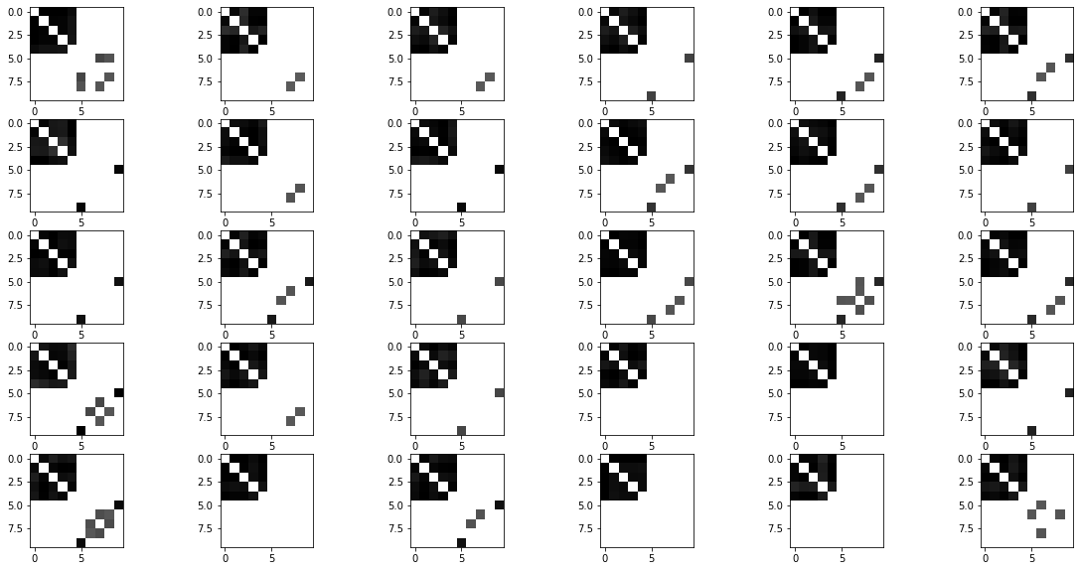
Raw generated adjacency matrices (filter_value=0)
Input adjacency matrices (p=0.8)
Generated adjacency matrices (filter_value=0.5)

Slide 19
Normalized Centrality
Node index | 1 | 2 | 3 | 4 | 5 | 6 | 7 | 8 | 9 | 10
Generated matrices centrality | 0.37 | 0.34 | 0.36 | 0.37 | 0.37 | 0.06 | 0.02 | 0.05 | 0.03 | 0.05
Original matrices centrality | 0.32 | 0.34 | 0.30 | 0.32 | 0.31 | 0. | 0. | 0. | 0. | 0.

Slide 20
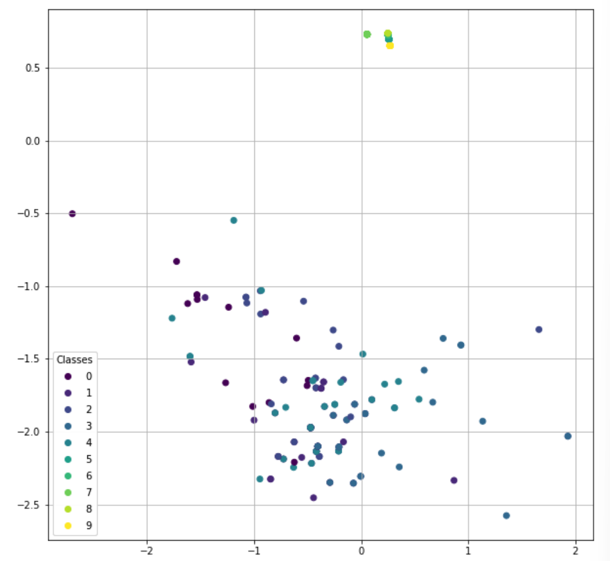
Another pattern:
The last five nodes over-concentrate around 0
No effect on the first five nodes
Easier to happen when setting lower learning rate

Slide 21
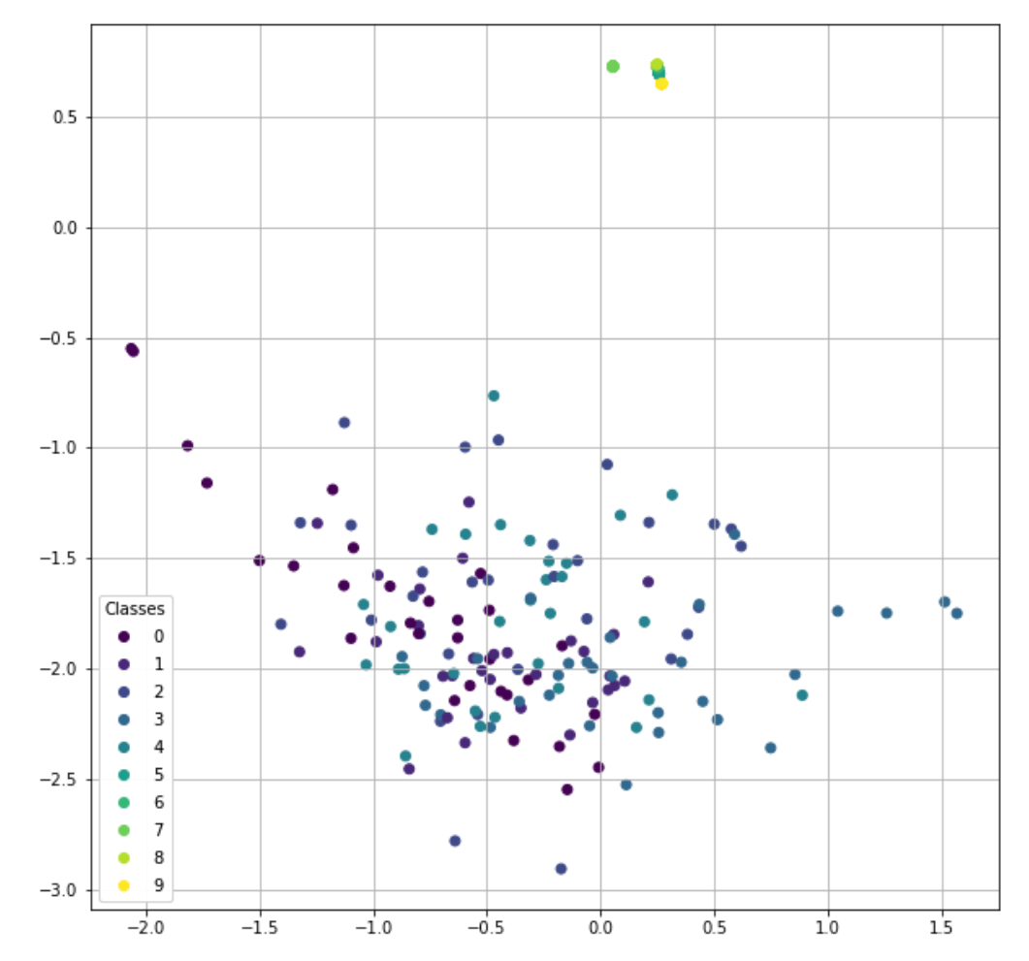

Slide 22
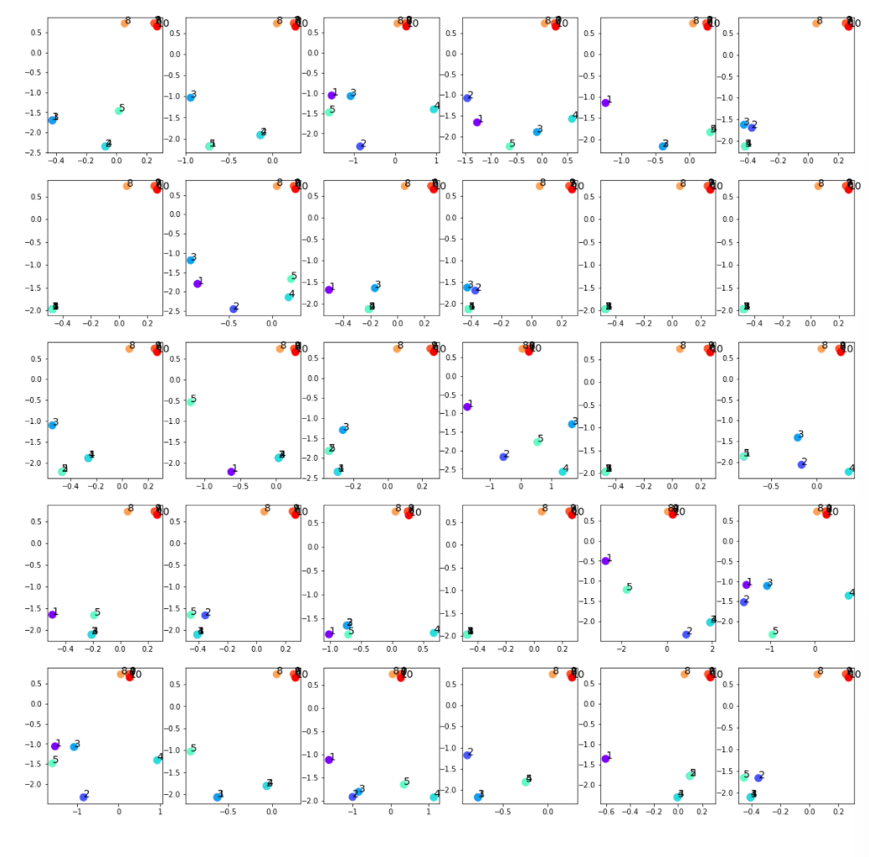

Slide 23
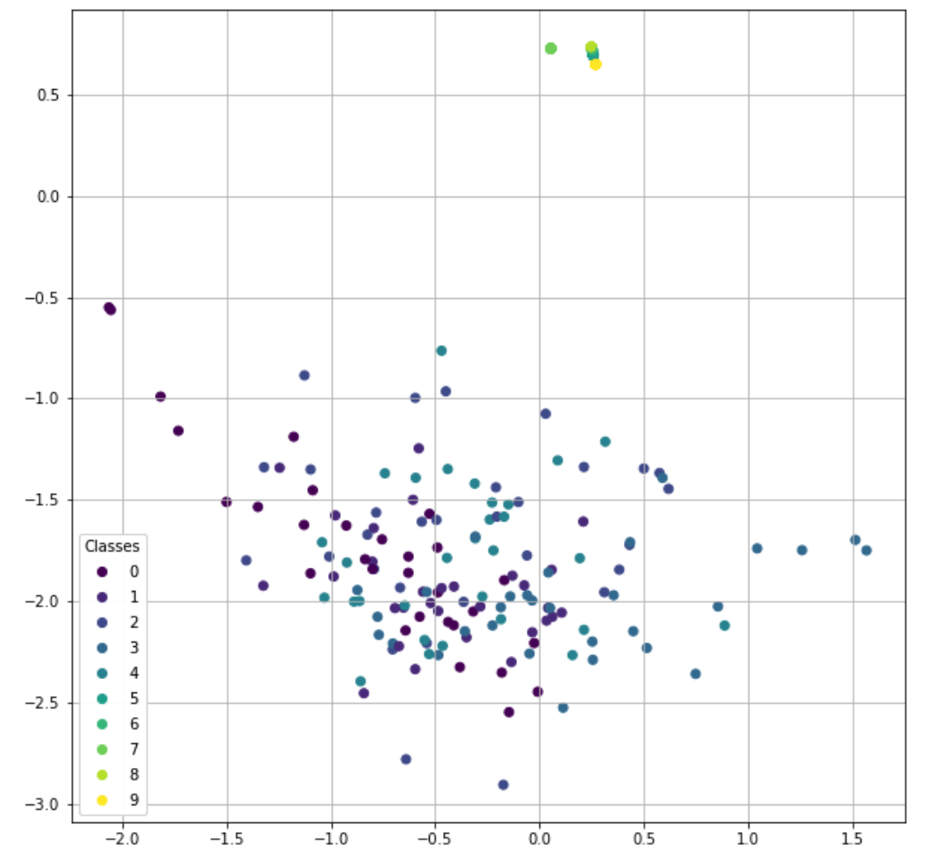

Slide 24
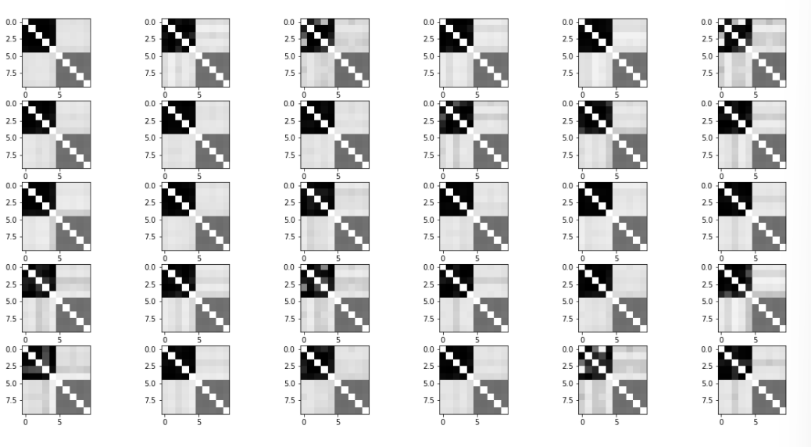
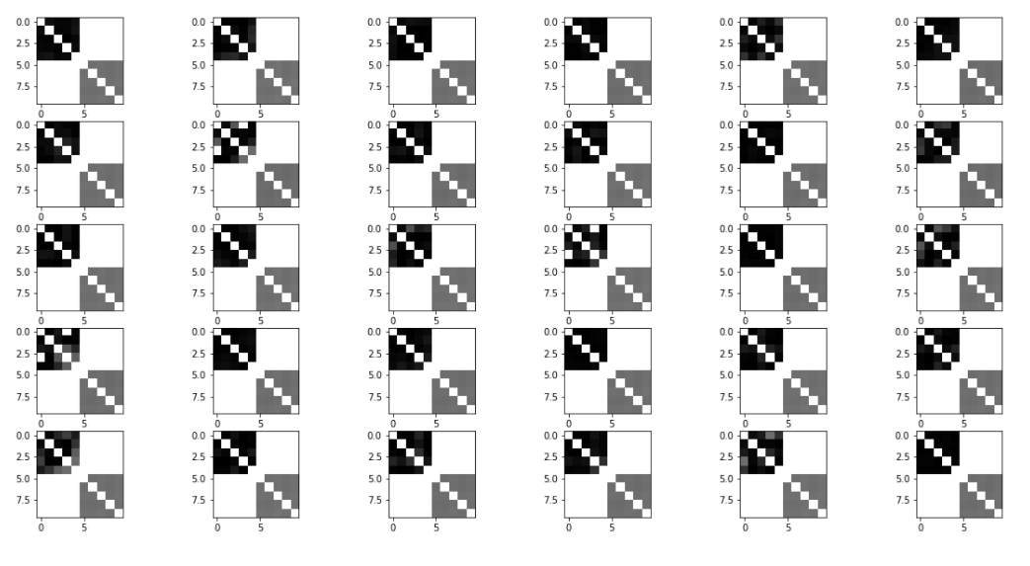
Raw generated adjacency matrices (filter_value=0)
Input adjacency matrices (p=0.8)
Generated adjacency matrices (filter_value=0.5)

Slide 25
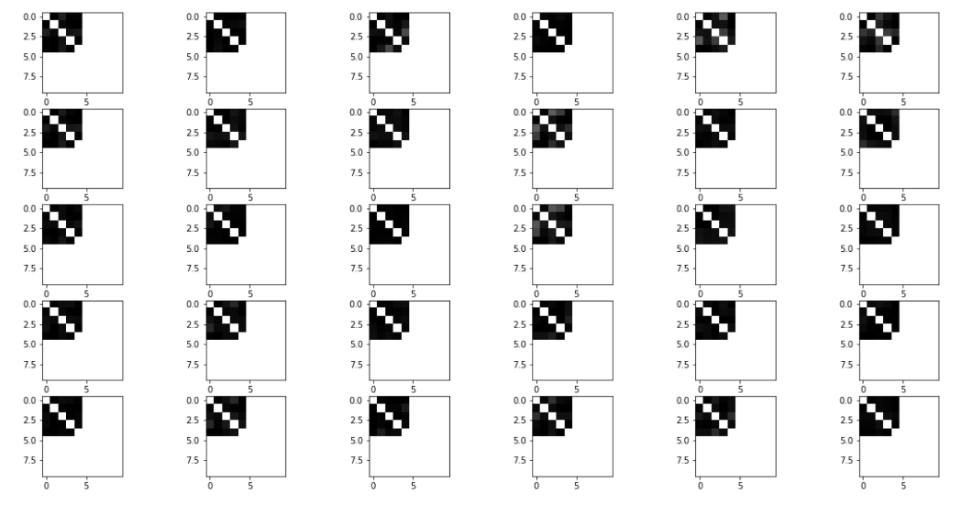
Generated adjacency matrices (filter_value=0.5)
Generated adjacency matrices (filter_value=0.7)

Slide 26
Node index | 1 | 2 | 3 | 4 | 5 | 6 | 7 | 8 | 9 | 10
Generated matrices centrality(filter_value=0.5) | 0.37 | 0.34 | 0.36 | 0.37 | 0.37 | 0.06 | 0.02 | 0.05 | 0.03 | 0.05
Original matrices centrality | 0.32 | 0.34 | 0.30 | 0.32 | 0.31 | 0. | 0. | 0. | 0. | 0.
Node index | 1 | 2 | 3 | 4 | 5 | 6 | 7 | 8 | 9 | 10
Generated matrices centrality(filter_value=0.7) | 0.38 | 0.38 | 0.37 | 0.38 | 0.38 | 0 | 0 | 0 | 0 | 0
Generated matrices centrality(filter_value=0.5) | 0.38 | 0.38 | 0.37 | 0.38 | 0.38 | 0.25 | 0.25 | 0.25 | 0.25 | 0.25
Original matrices centrality | 0.32 | 0.34 | 0.30 | 0.32 | 0.31 | 0. | 0. | 0. | 0. | 0.

Slide 27
p=0.25 simulation
Input: 30 graphs with 10 nodes
Optimizers: Adams optimizer with learning rate 0.001
Epoches: 1000000 epoches
Latent space: 2 out-channels
p = 0.25 for the upper left submatrix

Slide 28
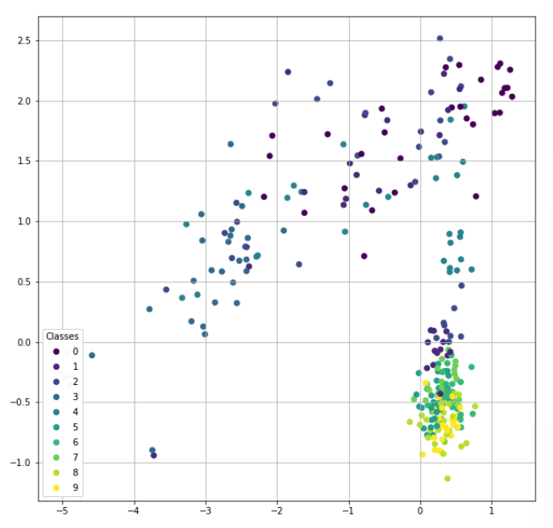

Slide 30
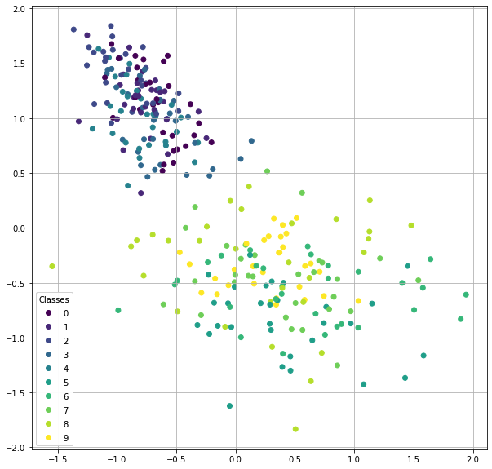
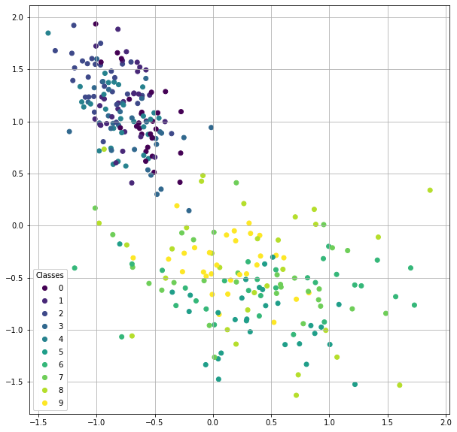
input
generated

Slide 31
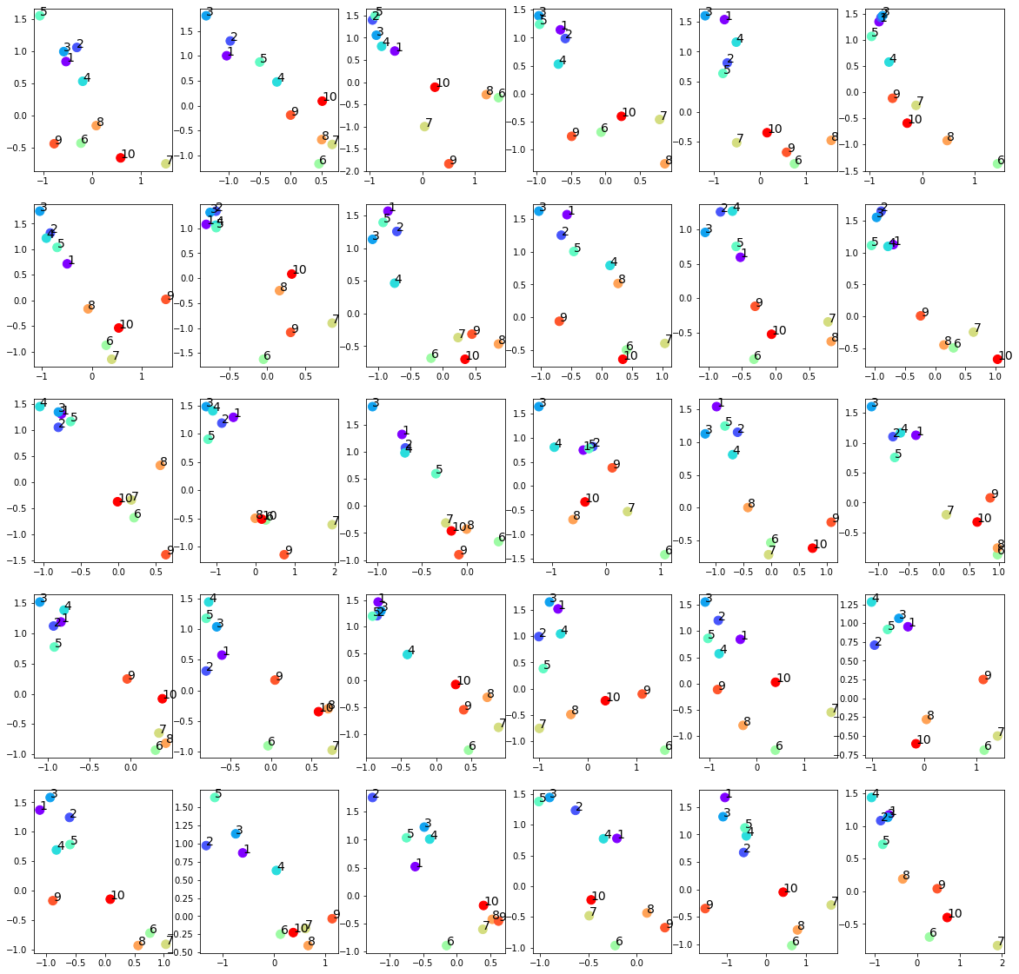

Slide 32
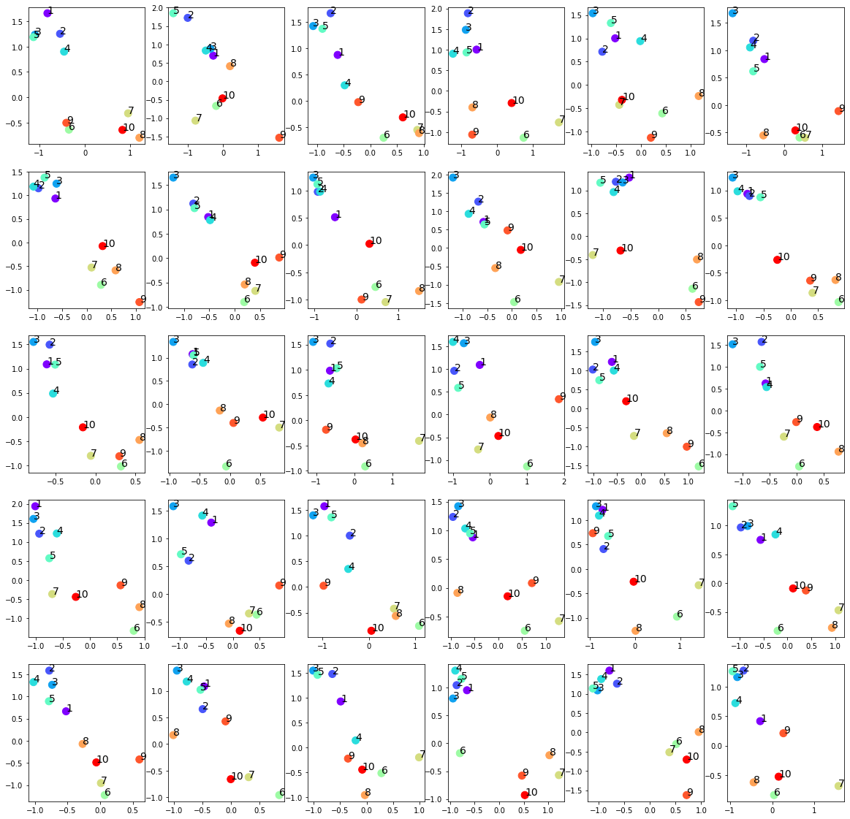

Slide 33
input
generated

Slide 34
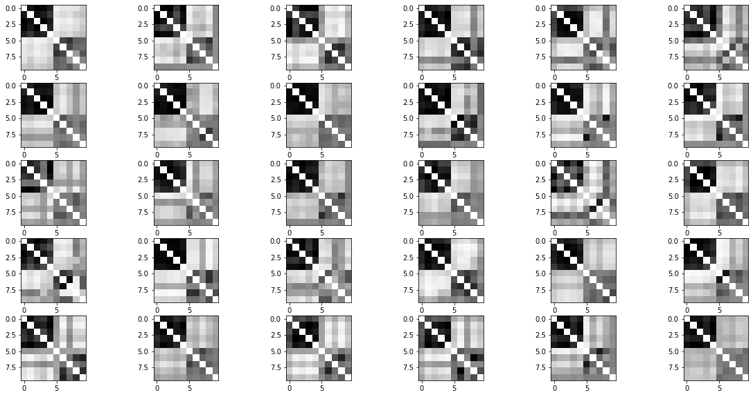
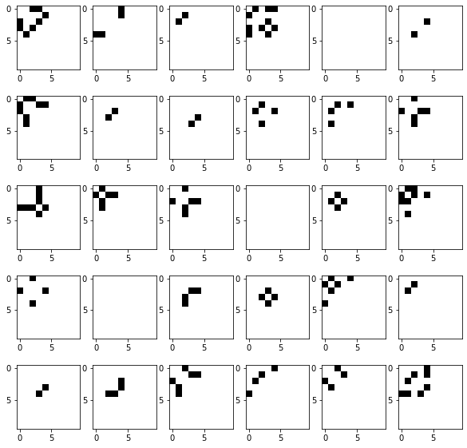
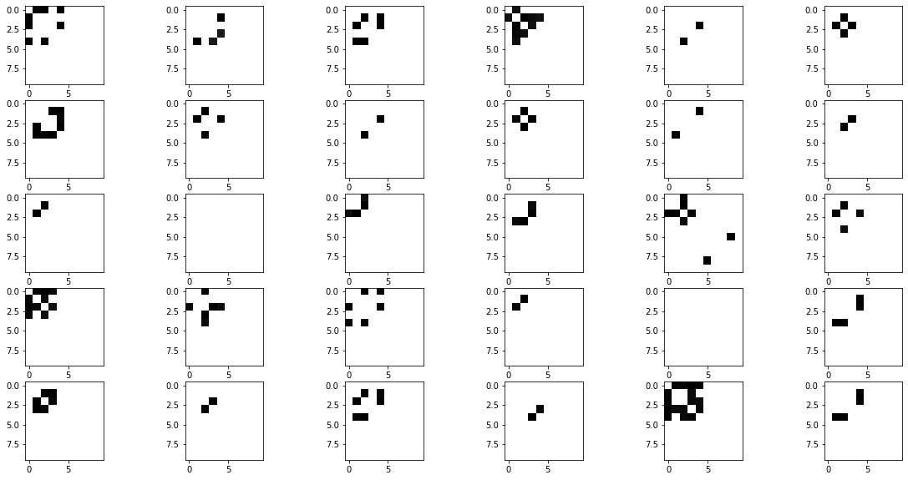
Raw generated adjacency matrices (filter_value=0)
Input adjacency matrices (p=0.25)
Generated adjacency matrices (filter_value=0.7)

Slide 35
Normalized Centrality
Node index | 1 | 2 | 3 | 4 | 5 | 6 | 7 | 8 | 9 | 10
Generated matrices centrality | 0.13 | 0.13 | 0.17 | 0.12 | 0.13 | 0.003 | 0.00 | 0.004 | 0.00 | 0.00
Original matrices centrality | 0.12 | 0.13 | 0.09 | 0.10 | 0.10 | 0.0 | 0.0 | 0.0 | 0.0 | 0.0

Slide 36
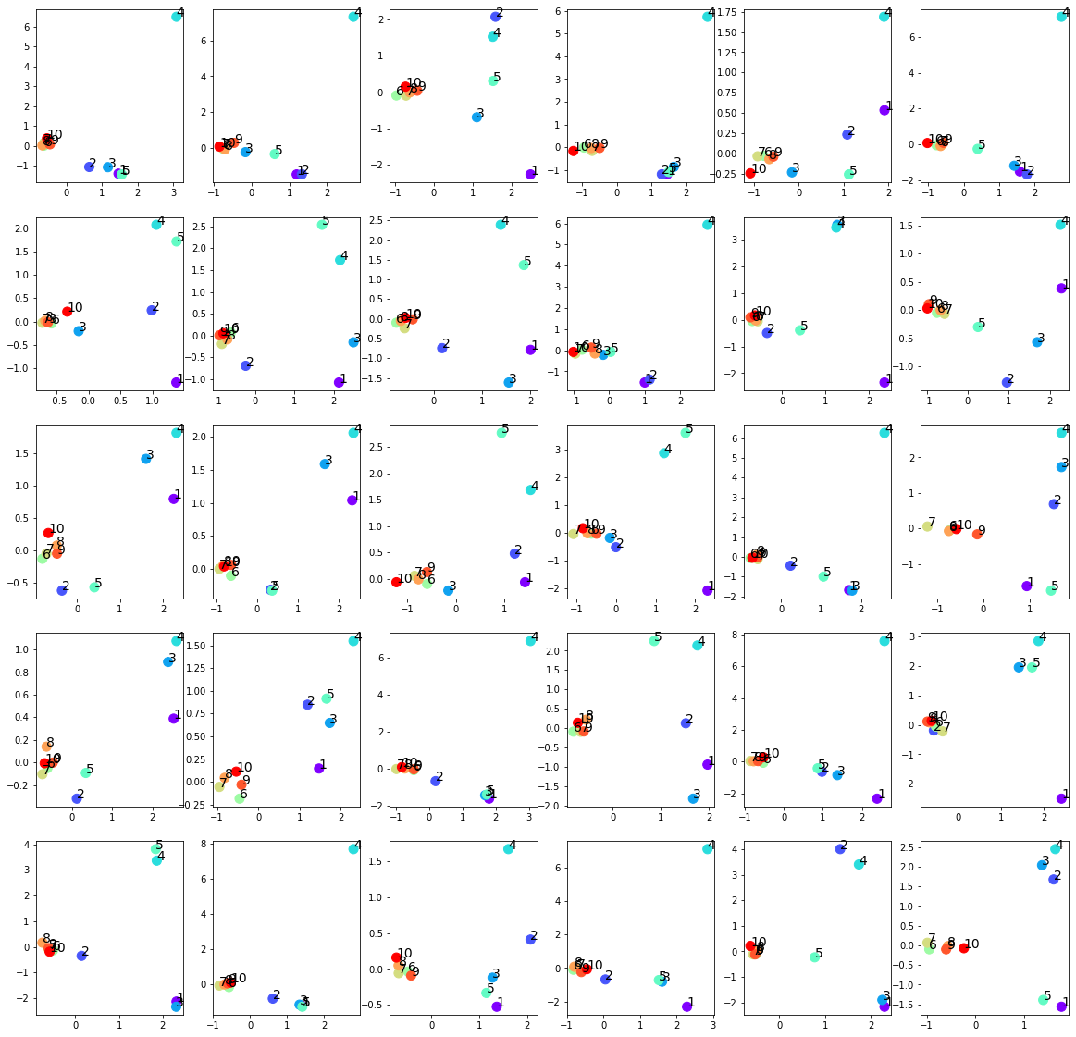
Failed trainings
Settings:
Input: 30 graphs with 10 nodes
Optimizers: Adams optimizer with learning rate 0.01
Epoches: 1000000 epoches
Latent space: 2 out-channels
p = 0.25 for the upper left submatrix
The last five nodes over-concentrate around 0
No effect on the first five nodes
Easier to happen when setting p<0.5

Slide 37
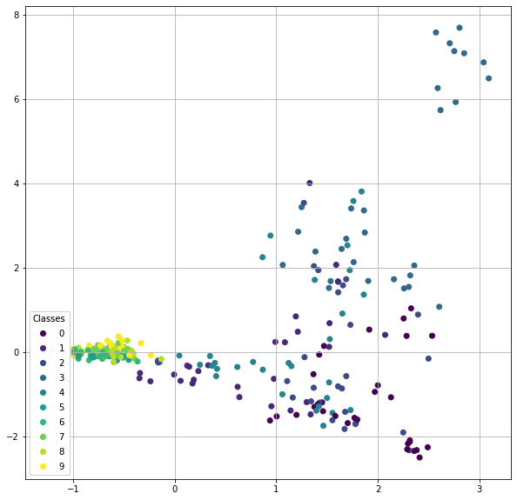
Another pattern
Settings:
Input: 30 graphs with 10 nodes
Optimizers: Adams optimizer with learning rate 0.01
Epoches: 1000000 epoches
Latent space: 2 out-channels
p = 0.25 for the upper left submatrix

Slide 38
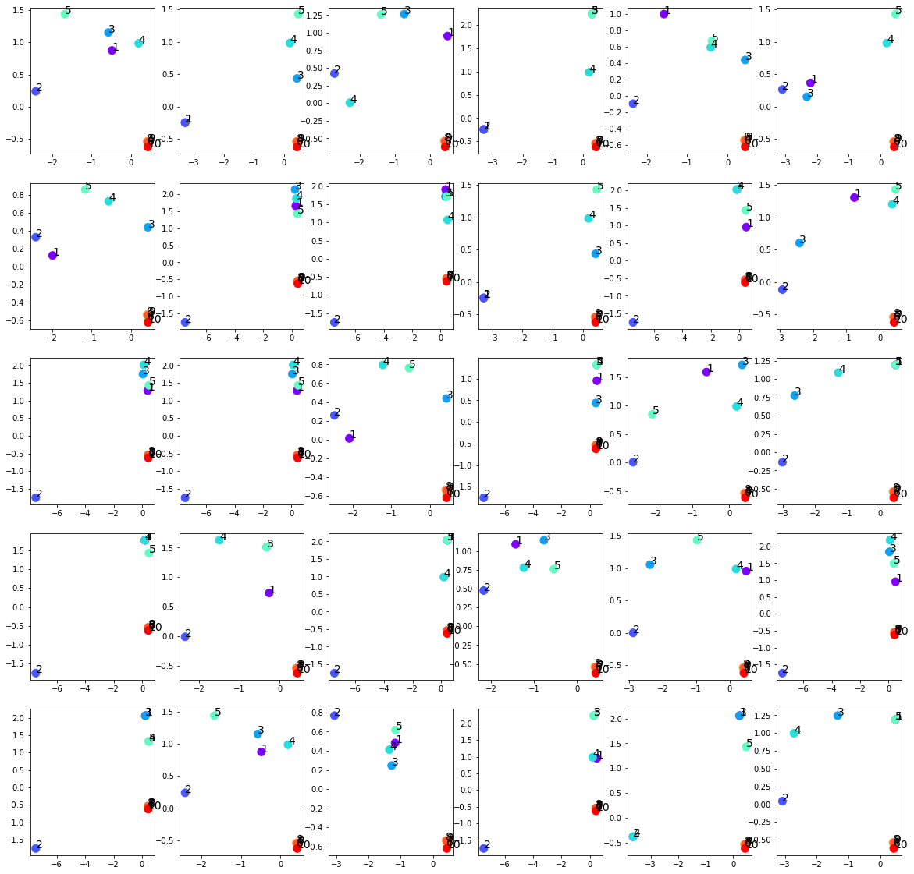

Slide 39
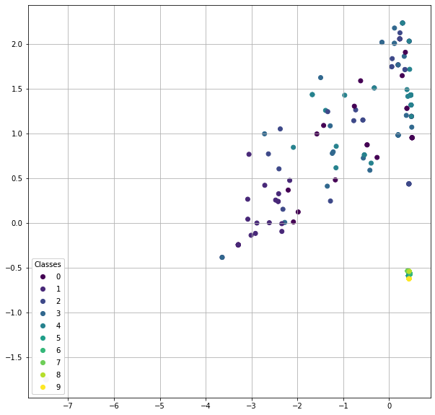

Slide 40
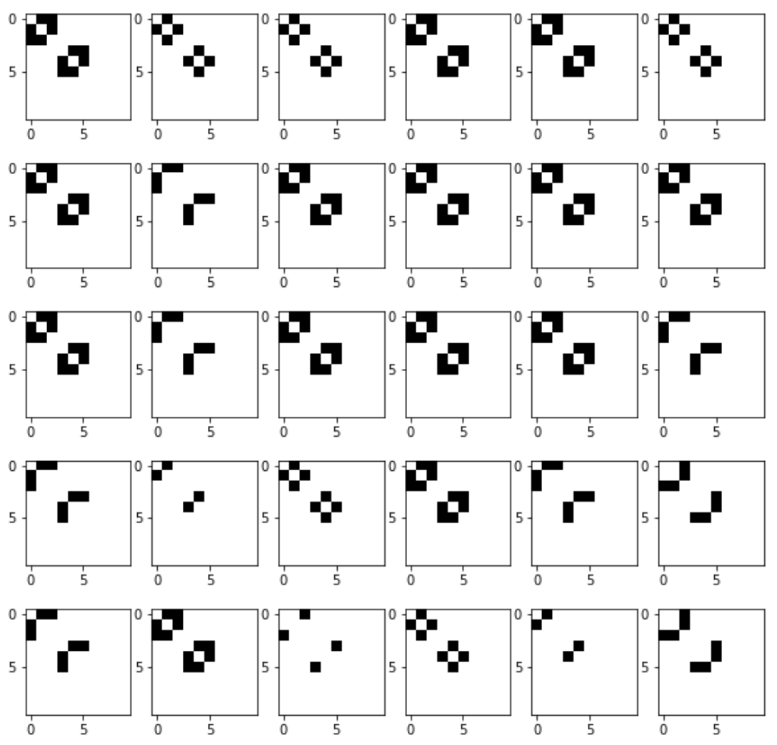



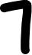





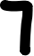

Slide 41
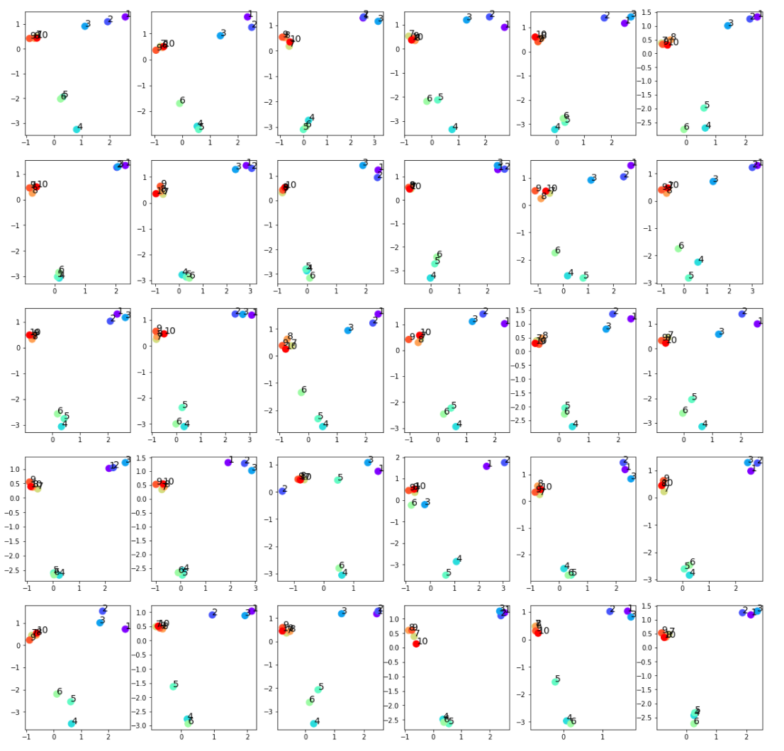
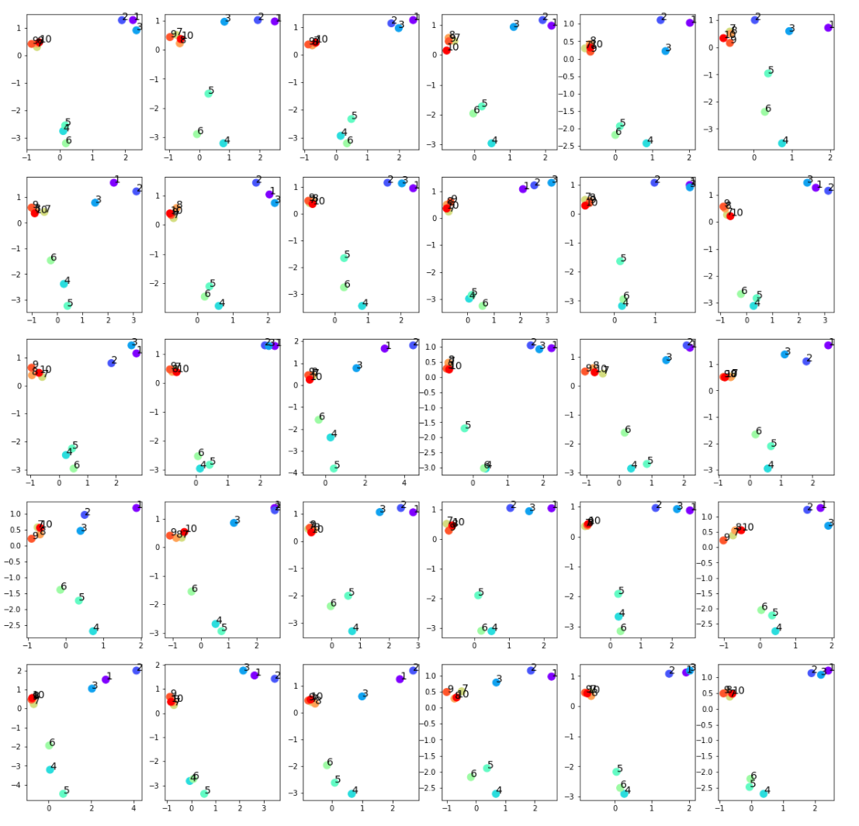
input
generated

Slide 42
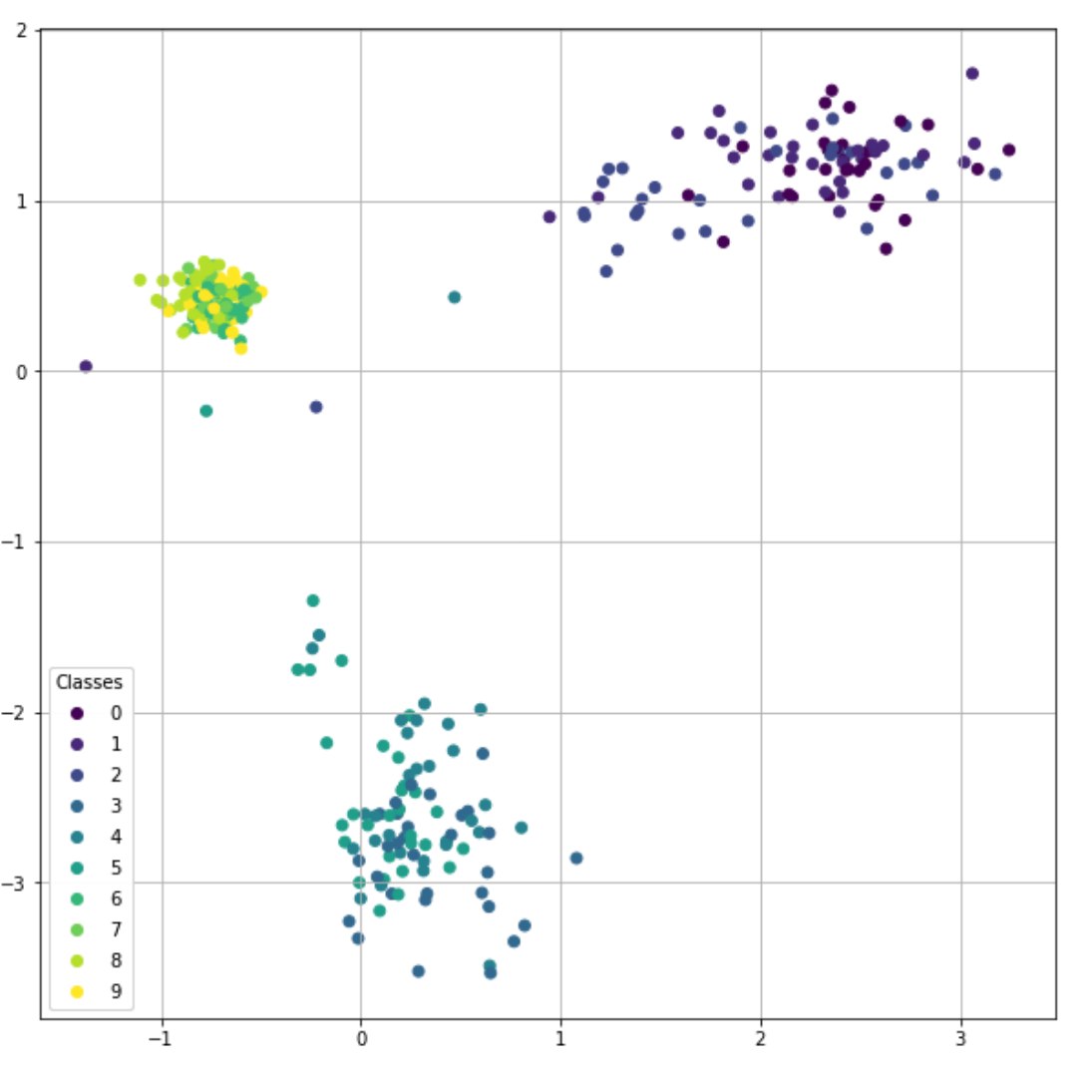
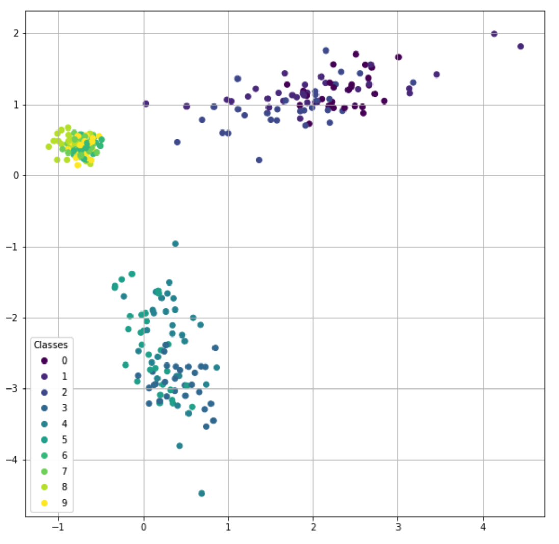
input
generated

Slide 43
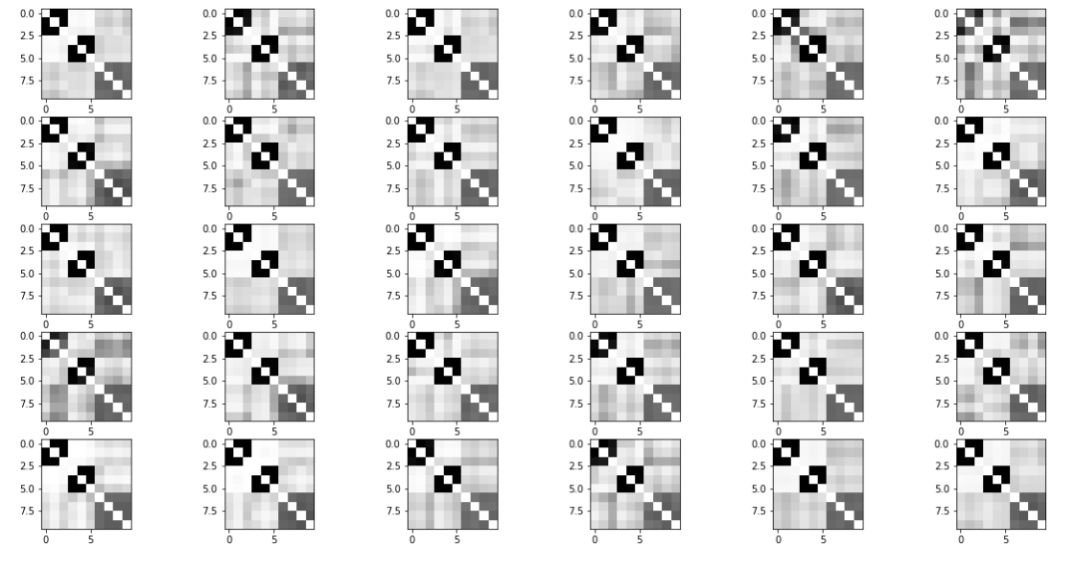
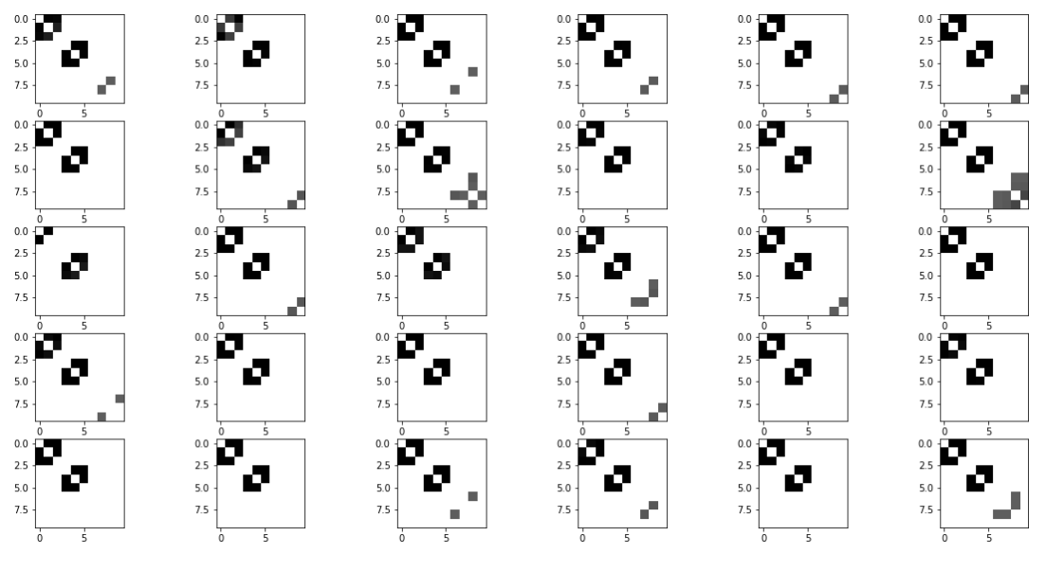
Raw generated adjacency matrices (filter_value=0)
Input adjacency matrices
Generated adjacency matrices (filter_value=0.5)

Slide 44
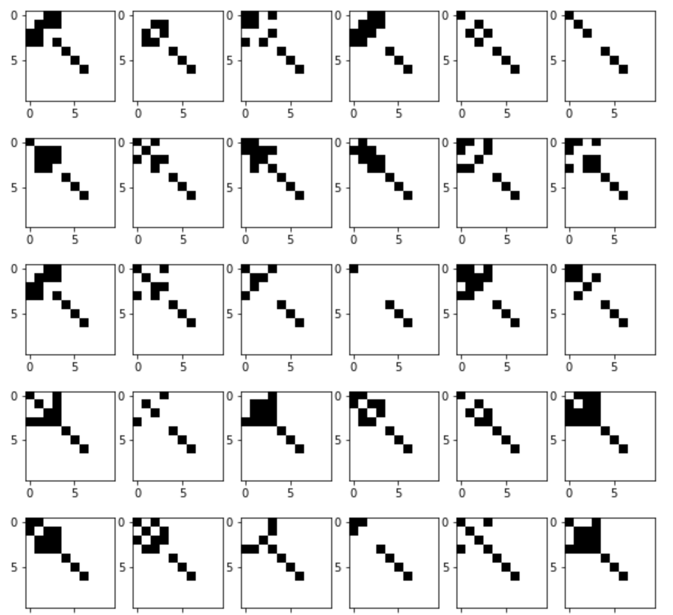


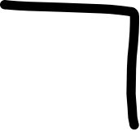





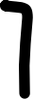
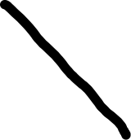








Slide 45
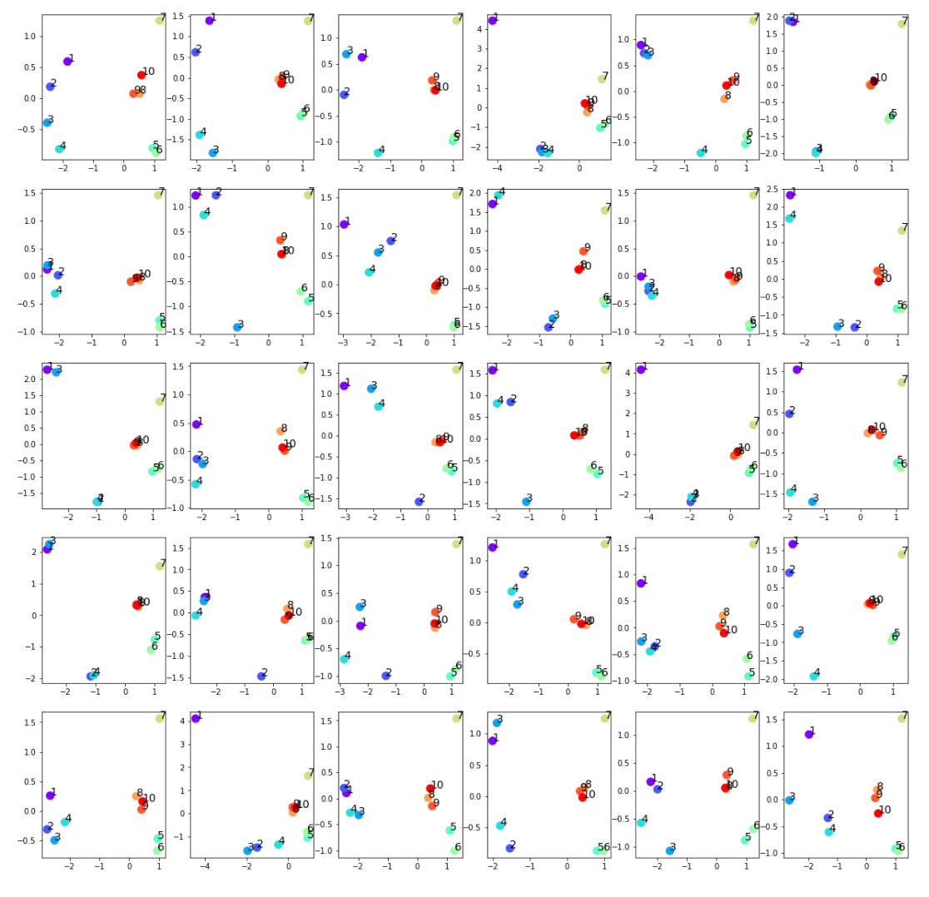

input
generated

Slide 46


input
generated

Slide 47


Raw generated adjacency matrices (filter_value=0)
Input adjacency matrices
Generated adjacency matrices (filter_value=0.5)

Slide 48








Slide 49


input
generated

Slide 50


input
generated

Slide 51


Raw generated adjacency matrices (filter_value=0)
Input adjacency matrices
Generated adjacency matrices (filter_value=0.5)

Slide 52

New sampling strategy
Fit $N$ (node number) Gaussian distribution $𝒩_{i}$ from each of $N$ rows of $\left\{μ_{i}\right\}.$
Sample $N z_{i}$ from the $N$Gaussian distribution $𝒩_{i}$.
Concatenate the $N z_{i}$ by row to get $z_{sample}$.

Slide 53




Sampled $μ$ for each nodes generated by the old sampling algorithm.
Sampled $μ$ for each nodes generated by the new sampling algorithm.

Slide 54


Sampled $μ$ for each nodes generated by the old sampling algorithm.
Sampled $μ$ for each nodes generated by the new sampling algorithm.

Slide 55


The generated adjacency matrices by the old sampling algorithm.
The generated adjacency matrices by the new sampling algorithm.

Slide 56

VGAE model for ipfdata
Input: 30 graphs with 38 nodes
Optimizers: Adams optimizer with learning rate 0.001
Epoches: 100000 epoches
Latent space: 2 out-channels

Slide 57



$μ$ of each node in the input data

Slide 58



$z$ of each node in the generated data

Slide 59


Generated adjancency matrices
Input adjancency matrices
Generated adjancency matrices (filter_value = 0.5)

Slide 60
Mean centrality in input adjacency matrices
array([0.6 , 0.7 , 0.4 , 0.74, 0.51, 0.74, 0.8 , 0.86, 0.8 , 0.74, 0.28, 0.76, 0.35, 0.77, 0.7 , 0.51, 0.76, 0.83, 0.83, 0.63, 0.38, 0.49, 0.36, 0.83, 0.41, 0.71, 0.45, 0.64, 0.48, 0.46, 0.47, 0.39, 0.44, 0.7 , 0.56, 0.8 , 0.3 , 0.1 ])
Mean centrality in generated adjacency matrices
array([0.65, 0.67, 0.59, 0.67, 0.61, 0.67, 0.69, 0.7 , 0.68, 0.67, 0.47, 0.69, 0.51, 0.68, 0.62, 0.54, 0.68, 0.7 , 0.7 , 0.6 , 0.56, 0.59, 0.52, 0.7 , 0.52, 0.62, 0.58, 0.6 , 0.62, 0.57, 0.59, 0.54, 0.55, 0.66, 0.58, 0.67, 0.47, 0.32])
mean centrality in input - mean centrality in generated
array([-0.06, 0.04, -0.19, 0.06, -0.1 , 0.07, 0.12, 0.16, 0.11, 0.06, -0.19, 0.07, -0.15, 0.1 , 0.09, -0.03, 0.08, 0.13, 0.12, 0.03, -0.18, -0.1 , -0.16, 0.13, -0.11, 0.09, -0.13, 0.04, -0.14, -0.11, -0.12, -0.15, -0.11, 0.04, -0.02, 0.13, -0.17, -0.21])

Slide 61

VGAE model for ctrldata
Input: 28 graphs with 38 nodes
Optimizers: Adams optimizer with learning rate 0.001
Epoches: 100000 epoches
Latent space: 2 out-channels

Slide 62


$μ$ of each node in the input data

Slide 63



$μ$ of each node in the generated data

Slide 64


Generated adjancency matrices
Input adjancency matrices
Generated adjancency matrices (filter_value = 0.5)

Slide 65
Mean centrality in input adjacency matrices
array([0.5 , 0.5 , 0.27, 0.55, 0.34, 0.55, 0.6 , 0.44, 0.49, 0.49, 0.2 , 0.5 , 0.24, 0.61, 0.62, 0.34, 0.49, 0.62, 0.52, 0.41, 0.29, 0.3 , 0.19, 0.42, 0.25, 0.24, 0.26, 0.28, 0.25, 0.16, 0.27, 0.06, 0.25, 0.23, 0.16, 0. , 0.06, 0.17])
Mean centrality in generated adjacency matrices
array([0.55, 0.56, 0.46, 0.58, 0.5 , 0.58, 0.59, 0.48, 0.54, 0.55, 0.3 , 0.51, 0.39, 0.58, 0.58, 0.41, 0.45, 0.59, 0.52, 0.48, 0.44, 0.47, 0.37, 0.46, 0.4 , 0.34, 0.44, 0.4 , 0.43, 0.32, 0.42, 0.22, 0.38, 0.35, 0.31, 0.2 , 0.23, 0.29])
mean centrality in input - mean centrality in generated
array([-0.05, -0.06, -0.2 , -0.03, -0.15, -0.04, 0.01, -0.04, -0.05, -0.06, -0.1 , -0.01, -0.15, 0.03, 0.05, -0.07, 0.04, 0.03, 0. , -0.07, -0.15, -0.17, -0.18, -0.04, -0.15, -0.1 , -0.17, -0.12, -0.18, -0.16, -0.15, -0.16, -0.13, -0.12, -0.15, -0.2 , -0.17, -0.12])

Slide 66
VGAE model for mixed data
Input: 60 IPF and control graphs
Optimizers: Adams optimizer with learning rate 0.001
Epoches: 100000 epoches
Latent space: 2 out-channels

Slide 67

VGAE model for mixed data
Question:
How do we distinguish embedded mu patterns of ipf_data from mu patterns of ctrl_data?
What value should we set for the out-channels for increasing number of nodes?

Slide 68
Optimization of hyperparameters
Training set: The first 28 graphs with 38 nodes in ipf_data
Test set: The last 4 graphs with 38 nodes in ipf_data
Optimizers: Adams optimizer with learning rate 0.001
out_channels = [2, 5, 10, 15, 20, 25, 30, 35, 40, 45]
Epochs: 1000000 epochs for out_channels = [2, 5, 10, 15, 20]，2500000 epochs for out_channels = [25, 30, 35, 40, 45]

Slide 69
Test creterion
Compute reconstruction loss between input matrices and generated matrices in test dataset
Reconstruction loss:
, where
Element-wise MSE

Slide 70

Optimization of hyperparameters
5-fold cross validation under out_channels=d:
Split the dataset into 5 groups
For each unique group:
Take the group as a hold out or validation data set
Take the remaining groups as a training data set
Fit a model on the training set and evaluate it on the validation set
Compute the mean KL divergence as out_channels=d
Optimizers: Adams optimizer with learning rate 0.001
Epochs: 1000000 epochs for model with out_channels $≤$ 15; 2000000 epochs for model with $30≥$out_channels $>$ 15.

Slide 71


Comparison for ipf_data
Adjacency matrices of ipf data.
First 50 generated adjacency matrices in 300 generated adjacency matrices from model with 14 out_channels.

Slide 72


Validation reconstruction loss
Model with 14 out_channels performs the best in validation dataset
Mean reconstruction loss in train dataset of cross validation
Mean reconstruction loss in validation dataset of cross validation

Slide 73
Two-sample t-test
Conduct two-sample t-test between centralities of the 32 original adjacency matrices and 300 generated adjacency matrices
p-value for each node:
Reduce the nodes with p-value < 0.05 from 12 nodes (25-channel model shown last time) to 7 nodes
 | 1 | 2 | 3 | 4 | 5 | 6 | 7 | 8 | 9 | 10
1-10 | 0.127 | 0.472 | 1.6e-03 | 0.283 | 4.6e-05 | 0.497 | 0.052 | 2.3e-11 | 0.785 | 0.709
11-20 | 0.322 | 0.906 | 0.231 | 0.458 | 0.302 | 0.13 | 0.856 | 9.7e-07 | 2.2e-11 | 0.753
21-30 | 0.168 | 1.2e-05 | 0.264 | 0.532 | 0.402 | 0.310 | 0.266 | 0.826 | 4.6e-07 | 0.481
31-40 | 0.575 | 0.721 | 0.758 | 0.176 | 0.472 | 0.105 | 0.676 | 0.588

Slide 74

Comparison for control data
Adjacency matrices of control data.
First 100 generated adjacency matrices from model with 30 out_channels.

Slide 75


Validation reconstruction loss
Model with 18 out_channels performs the best in validation dataset
Mean reconstruction loss in train dataset of cross validation
Mean reconstruction loss in validation dataset of cross validation

Slide 76
Failed result in t-test
Only 7 nodes have p-value greater than 0.05
The mean reconstruction loss jumps unstably as out_channel grows
pvalue=array([5.23276580e-09, 5.02688331e-13, 4.52106419e-30, 1.21580807e-07, 1.30492437e-35, 7.60571342e-08, 1.52690137e-03, 8.48644139e-01, 1.27702487e-04, 2.87104219e-11, 4.66723918e-06, 1.65686167e-05, 2.93944660e-04, 7.82002284e-04, 3.69434853e-02, 7.65032763e-06, 3.61717184e-06, 4.15520846e-03, 7.53489333e-03, 5.58279636e-09, 1.08746403e-20, 1.42530862e-23, 2.37410360e-07, 2.56743381e-05, 8.72525370e-25, 3.51314451e-01, 7.69291936e-17, 2.71441384e-01, 3.91813902e-14, 3.39434308e-02, 1.94009880e-18, 9.53990821e-02, 9.78904933e-09, 1.42903301e-01, 4.16167082e-03, 3.38884501e-04, 2.56464335e-01, 2.00643616e-01]

Slide 77
Last time...
Cross validation
More epochs
Generates more samples for t-test

Slide 78
Optimization of hyperparameters
7-fold cross validation under out_channels=d:
Split the 28 graphs into 7 groups
For each unique group:
Take the group as a hold out or validation data set
Take the remaining groups as a training data set
Fit a model on the training set and evaluate it on the validation set
Compute the mean reconstruction loss of validation sets

Slide 79
Optimization of hyperparameters
Optimizers: Adams optimizer with learning rate 0.0001.
Epochs: 5000000 epochs for out_channels.

Slide 80

Comparison for control data
Adjacency matrices of control data.
First 100 generated adjacency matrices in 500 generated matrices from model with 20 out_channels.

Slide 81


Validation reconstruction loss
Model with 20 out_channels performs the best in validation dataset
Mean reconstruction loss in train dataset of cross validation
Mean reconstruction loss in validation dataset of cross validation

Slide 82
Two-sample t-test
Conduct two-sample t-test between centralities of the 32 original adjacency matrices and 500 generated adjacency matrices
p-value for each node (round to 3 decimal places):
17 nodes have p-value < 0.05. Last time we have 31 nodes with p-value < 0.05.
 | 1 | 2 | 3 | 4 | 5 | 6 | 7 | 8 | 9 | 10
1-10 | 0.596 | 0. | 0. | 0.004 | 0. | 0.002 | 0.949 | 0.922 | 0.42 | 0.
11-20 | 0. | 0.589 | 0. | 0.435 | 0.28 | 0.568 | 0.644 | 0.496 | 0.444 | 0.095
21-30 | 0. | 0. | 0.009 | 0.934 | 0.001 | 0.573 | 0.056 | 0.685 | 0. | 0.005
31-40 | 0.002 | 0.147 | 0.299 | 0.039 | 0.19 | 0.007 | 0.618 | 0.289

Slide 83
Mean centrality in input adjacency matrices (nodes with p-value <0.05 are marked red)
 | 1 | 2 | 3 | 4 | 5 | 6 | 7 | 8 | 9 | 10
1-10 | 0.503 | 0.498 | 0.266 | 0.545 | 0.341 | 0.545 | 0.6 | 0.438 | 0.493 | 0.493
11-20 | 0.203 | 0.5 | 0.24 | 0.611 | 0.625 | 0.342 | 0.49 | 0.619 | 0.522 | 0.412
21-30 | 0.291 | 0.296 | 0.192 | 0.424 | 0.255 | 0.239 | 0.261 | 0.28 | 0.251 | 0.162
31-40 | 0.273 | 0.059 | 0.254 | 0.229 | 0.158 | 0. | 0.06 | 0.175
Variance of node centrality in input adjacency matrices (nodes with p-value <0.05 are marked red)
 | 1 | 2 | 3 | 4 | 5 | 6 | 7 | 8 | 9 | 10
1-10 | 0.045 | 0.029 | 0.012 | 0.029 | 0.024 | 0.027 | 0.049 | 0.13 | 0.093 | 0.042
11-20 | 0.042 | 0.032 | 0.105 | 0.026 | 0.049 | 0.05 | 0.106 | 0.095 | 0.04 | 0.102
21-30 | 0.076 | 0.031 | 0.024 | 0.028 | 0.118 | 0.03 | 0.038 | 0.044 | 0.097 | 0.032
31-40 | 0.05 | 0.037 | 0.022 | 0.044 | 0.158 | 0. | 0.047 | 0.084

Slide 84



Review: VAEs and Variational Inference
Solid lines are the generative model
Dashed lines are the variational approximation

Slide 85


Basic Idea of VAEs
Use a parametric form of Q(Z)
There are two kinds of parameters
Variational parameters
Neural network parameters
Use gradient descent to optimize it
But neural networks don’t do well with equality constraints so use an inequality to approximate it called ELBO (evidence based lower bound)
Use sampling of datapoints and variational parameters to come up with all other terms!

Slide 86



Variational Bayes
Most common form minimizes KL-divergence
Given that
KL divergence can be written as:
Since P(X) is a constant and Q(z) sums to 1 over all z’s

Slide 87
Variational Bayes Continued
This can be rewritten in terms of expectation over Q(Z):
Rearranging terms to get log P(X) on one side gives:
Here the last term is called the variational free energy
Maximizing variational free energy minimizes divergence this term because log of evidence is fixed
In this sense the variational free energy forms a bound log P(X)>L(Q)

Slide 88

Autoencoding Variational Bayes
Implements VB in an autoencoder
Log likelihood computed as sum of value for individual points for a given nnet parameter setting $θ,φ$ are parameters of Q

Slide 89



Autoencoding Variational Bayes
Can condition the whole analysis over the z, given a prior on z, p(z)
In a neural network prior p(z) corresponds to the way the latent variables are desired to be shaped
This gives:
Log $\frac{p_{θ}\left(x^{\left(i\right)}\right)}{p\left(z\right)}≥\frac{ℒ\left(θ,φ, x^{\left(i\right)}\right)}{p\left(z\right)}=E_{q\left(z | x\right)}−\frac{\log{q\left(z | x\right)}}{p\left(z\right)}+\frac{\log{p\left(x,z\right)}}{p\left(z\right)}$
Log $\frac{p_{θ}\left(x^{\left(i\right)}\right)}{p\left(z\right)}≥$

Slide 90

Autoencoding Variational Bayes
VAEs use gradient descent to maximize variational free energy
Use a parametric (neural network parameterized form) Q(Z) and sampling-based estimate of P(Z,X)

Slide 91



Autoencoding Variational Bayes
Think of the
encoder computing q(z|x)
decoder as computing p(x|z) to reobtain x
p(z) is a prior distribution on z
Maximizing the variational lower bound L(q) of a probability distribution
Two terms in the loss function
KL Divergence Term
Log Likelihood Term

Slide 92
Last time...
Correct the validation loss
Use raw probability to compute centrality
Non-parametric test

Slide 93

Validation loss
Model with 20 out_channels performs the best in validation dataset
Our following discussion is based on the best model
Mean reconstruction loss in validation dataset of cross validation
Mean total loss (reconstruction loss + KL divergence) in validation dataset of cross validation

Slide 94

Filtering value and centrality computation
Filtering rule:
adj_mat[adj_mat < filter_value] = 0
adj_mat[adj_mat >= filter_value] = 1
Then use the filtered adjacency matrices to compute the node centrality
Left figure: x-axis represents the filter_value, y-axis represents the number of nodes with p-value >= 0.05. Red horizonal line represents the t-test results using the raw probability to compute centrality
0.653 is the filter_value which maximizes the number of nodes with p-value >= 0.05

Slide 95
Filtering value and centrality computation
Using raw probability to compute the centrality
P-value of nodes when using raw probability to compute the centrality:
[0.004, 0. , 0. , 0.016, 0. , 0.013, 0.937, 0.05 , 0.052, 0. ,
0. , 0.107, 0. , 0.82 , 0.132, 0.069, 0.038, 0.557, 0.321, 0. ,
0. , 0. , 0. , 0.01 , 0. , 0.213, 0. , 0.113, 0. , 0.002,
0. , 0.001, 0. , 0.025, 0.005, 0. , 0.003, 0.001])
Index of nodes with p-value >= 0.05 when using raw probability to compute the centrality:
[ 6, 7, 8, 11, 13, 14, 15, 17, 18, 25, 27]

Slide 96
Filtering value and centrality computation
Using filter_value=0.653 to compute the centrality
P-value of nodes:
[0.603, 0.219, 0.055, 0.97 , 0.082, 0.779, 0.234, 0.242, 0.407, 0.477, 0.302, 0.217, 0.075, 0.174, 0.012, 0.204, 0.435, 0.064, 0.125, 0.786, 0.186, 0.214, 0.738, 0.355, 0.346, 0.411, 0.786, 0.09 , 0.184, 0.848, 0.651, 0.274, 0.985, 0.168, 0.345, 0.02 , 0.321, 0.898]
Index of nodes with p-value >= 0.05:
[ 0, 1, 2, 3, 4, 5, 6, 7, 8, 9, 10, 11, 12, 13, 15, 16, 17, 18, 19, 20, 21, 22, 23, 24, 25, 26, 27, 28, 29, 30, 31, 32, 33, 34, 36, 37]

Slide 97


Problem: Parametric and nonparametric test
t-test Wilcoxon rank sum test Mann-Whitney U test
Red line represents number of nodes with p-value >= 0.05 when using raw probability to compute centrality.
In nonparametric test, all nodes are not rejected when testing on raw probability centrality. However, even with the best filter_value, only a half nodes are not rejected. This is exactly the opposite to the t-test results.

Slide 98
Next...
Bonferroni correction
t-test:
control vs. generated_control; ipf vs. generated_ipf; generated_control vs. generated_ipf
Bootstrap:
bootstrap twice from generated_control and then t-test
New Measure

Slide 99


Input matrices in control group and ipf group
28 input adjacency matrices in control group
32 input adjacency matrices in ipf group

Slide 100

Hyperparameters tuning: control group model
7-fold cross validation under out_channels=d:
Split the dataset into 7 groups
For each unique group:
Take the group as a hold out or validation data set
Take the remaining groups as a training data set
Fit a model on the training set and evaluate it on the validation set
Compute the mean loss as out_channels=d
Optimizers: Adams optimizer with learning rate 0.001
Epochs: 1000000 epochs for model with out_channels $≤$ 10

Slide 101

Hyperparameters tuning: ipf group model
8-fold cross validation under out_channels=d:
Split the dataset into 8 groups
For each unique group:
Take the group as a hold out or validation data set
Take the remaining groups as a training data set
Fit a model on the training set and evaluate it on the validation set
Compute the mean loss as out_channels=d
Optimizers: Adams optimizer with learning rate 0.001
Epochs: 1000000 epochs for model with out_channels $≤$ 10

Slide 102


Hyperparameters tuning
For control group model, we use 5-dim latent space model.
For ipf group model, we use 3-dim latent space model.

Slide 103


Sampling modification
VGAE encoder generates $z_{i}$ by . The covariance matrix is diagonal. We consider to fix the covariance matrix of the Gaussian distribution for generating new latent variables to be diagonal. This means for each dimension of out_channel, we fit a Gaussian distribution individually, sample value from each Gaussian distribution, and concatenate those values into a sampled $μ$.

Slide 104

Output of ipf model
First 100 generated adjacency matrices in 500 generated matrices from ipf model.
Input adjacency matrices in ipf group.

Slide 105

Output of control model
First 100 generated adjacency matrices in 500 generated matrices from control model.
Input adjacency matrices in control group.

Slide 106

Filtering value and centrality computation: ipf model
Filtering rule:
adj_mat[adj_mat < filter_value] = 0
adj_mat[adj_mat >= filter_value] = 1
Then use the filtered adjacency matrices to compute the node centrality
Left figure: x-axis represents the filter_value, y-axis represents the number of nodes with p-value >= 0.05/38 (Bonferroni correction). Red horizonal line represents the t-test results using the raw probability to compute centrality.
0.62 is the filter_value which maximizes the number of nodes with p-value >= 0.05/38. The number of non-significant nodes is 33.
(Benjamini-Hochberg procedure?)

Slide 107

Filtering value and centrality computation: control model
Filtering rule:
adj_mat[adj_mat < filter_value] = 0
adj_mat[adj_mat >= filter_value] = 1
Then use the filtered adjacency matrices to compute the node centrality
Left figure: x-axis represents the filter_value, y-axis represents the number of nodes with p-value >= 0.05/38 (Bonferroni correction). Red horizonal line represents the t-test results using the raw probability to compute centrality.
0.63 is the filter_value which maximizes the number of nodes with p-value >= 0.05/38, The number of non-significant nodes is 35.
(Benjamini-Hochberg procedure?)

Slide 108
T-test between generated matrices of ipf model and generated matrices of control model
T-test between 500 generated matrices from ipf model and 500 generated matrices from control model
P-value: array([0.008, 0.001, 0. , 0.085, 0.003, 0. , 0.056, 0.043, 0. , 0. , 0.017, 0.049, 0.031, 0. , 0. , 0.01 , 0.016, 0. , 0.015, 0. , 0. , 0. , 0.011, 0. , 0.014, 0. , 0.085, 0.006, 0.085, 0.043, 0.063, 0.001, 0.001, 0.017, 0.043, 0.015, 0.051, 0.002])

Slide 109
T-test between two bootstrap simulations from ipf model generated matrices
From 500 generated matrices of ipf model, simulate new data in bootstrap twice. Then test between the two simulations.
P-value: array([0.31 , 0.571, 0.802, 0.141, 0.886, 0.407, 0.285, 0.34 , 0.618, 0.416, 0.31 , 0.254, 0.31 , 0.631, 0.465, 0.245, 0.302, 0.813, 0.265, 0.641, 0.338, 0.925, 0.688, 0.068, 0.417, 0.502, 0.34 , 0.254, 0.302, 0.245, 0.845, 0.892, 0.169, 0.31 , 0.302, 0.285, 0.254, 0.31 ])

Slide 110
T-test between two bootstrap simulations from control model generated matrices
From 500 generated matrices of ipf model, simulate new data in bootstrap twice. Then test between the two simulations.
P-value: array([1. , 0.462, 0.757, 0.788, 0.69 , 0.058, 0.562, 0.884, 0.705, 0.285, 0.518, 1. , 1. , 0.782, 0.95 , 0.563, 0.563, 0.795, 0.884, 0.662, 0.546, 0.985, 0.779, 0.553, 0.46 , 0.677, 0.771, 0.89 , 0.563, 0.562, 0.182, 0.416, 0.949, 0.793, 0.563, 0.562, 0.892, 0.793])

Slide 111
Next..
/ orphan nodes.
Test between original samples.
Generates n. Large size for filter-value selection.
Label figure.
Beeferroni correction for all.
Arr2tbl.

Slide 112
Delete orphan nodes
Non-orphan nodes in IPF group: 19 nodes
[ 1, 2, 3, 4, 5, 8, 9, 13, 14, 17, 19, 20, 21, 22, 23, 25, 30, 31, 32]
Delete all columns and rows of orphan nodes in IPF adjacency matrices and use 19*19 matrices to train the model. After training the model and generating new IPF adjacency matrices, we will recover the adjacency matrices by adding back zero rows and columns by orphan nodes indexes.
Non-orphan nodes in Control group: 19 nodes
[ 1, 2, 3, 4, 5, 8, 9, 13, 14, 17, 19, 20, 21, 22, 23, 25, 30, 31, 32]

Slide 113

Delete Orphan nodes
32 IPF original adjacency matrices
IPF adjacency matrices after deleting orphan nodes

Slide 114

Delete Orphan nodes
28 Control original adjacency matrices
Control adjacency matrices after deleting orphan nodes

Slide 115

Output of IPF model
First 100 generated adjacency matrices in 500 generated matrices from IPF model.
Input adjacency matrices in IPF group.

Slide 116

Output of Control model
First 100 generated adjacency matrices in 500 generated matrices from Control model.
Input adjacency matrices in IPF group.

Slide 117

Filtering value and centrality computation: IPF model
Filtering rule:
adj_mat[adj_mat < filter_value] = 0
adj_mat[adj_mat >= filter_value] = 1
Then use the filtered adjacency matrices to compute the node centrality
Left figure: x-axis represents the filter_value, y-axis represents the number of nodes with p-value >= 0.05/19 (Bonferroni correction). Red horizonal line represents the t-test results using the raw probability to compute centrality.
0.54 is the filter_value which maximizes the number of nodes with p-value >= 0.05/19. The number of non-significant nodes is 17.

Slide 118

Filtering value and centrality computation: Control model
Filtering rule:
adj_mat[adj_mat < filter_value] = 0
adj_mat[adj_mat >= filter_value] = 1
Then use the filtered adjacency matrices to compute the node centrality
Left figure: x-axis represents the filter_value, y-axis represents the number of nodes with p-value >= 0.05/19 (Bonferroni correction). Red horizonal line represents the t-test results using the raw probability to compute centrality.
0.72 is the filter_value which maximizes the number of nodes with p-value >= 0.05/19. The number of non-significant nodes is 19.

Slide 119
T-test between original IPF and Control adjacency matrices
0 | NaN
1 | 0.516
2 | 0.139
3 | 0.679
4 | 0.376
5 | 0.000
6 | NaN
7 | NaN
8 | 0.000
9 | 0.000
10 | NaN
11 | NaN
12 | NaN
13 | 0.006
14 | 0.000
15 | NaN
16 | NaN
17 | 0.008
18 | NaN
19 | 0.000
20 | 0.000
21 | 0.000
22 | 0.000
23 | 0.000
24 | NaN
25 | 0.000
26 | NaN
27 | NaN
28 | NaN
29 | NaN
30 | 0.348
31 | 0.006
32 | 0.218
33 | NaN
34 | NaN
35 | NaN
36 | NaN
37 | NaN
Significant nodes: 5, 8, 9, 14, 19, 20, 21, 22, 23, 25

Slide 120
T-test between original IPF and generated IPF adjacency matrices
0 | 0.059
1 | 0.011
2 | 0.140
3 | 0.048
4 | 0.022
5 | 0.000
6 | 0.000
7 | 0.636
8 | 0.007
9 | 0.488
10 | 0.354
11 | 0.639
12 | 0.188
13 | 0.132
14 | 0.090
15 | 0.928
16 | 0.065
17 | 0.030
18 | 0.090
Significant nodes: 5, 6

Slide 121
T-test between original Control and generated Control adjacency matrices
0 | 0.192
1 | 0.120
2 | 0.437
3 | 0.714
4 | 0.794
5 | 0.123
6 | 0.407
7 | 0.515
8 | 0.779
9 | 0.044
10 | 0.048
11 | 0.022
12 | 0.872
13 | 0.153
14 | 0.469
15 | 0.227
16 | 0.835
17 | 0.545
18 | 0.923
Significant nodes: None

Slide 122
T-test between generated IPF and generated Control adjacency matrices
Recover to 38*38 matrices by adding zero columns and rows by orphan indexes.
Significant nodes (p-value < 0.05/38): 5, 8, 9, 14, 19, 20, 21, 22, 23
Significant nodes in the original samples: 5, 8, 9, 14, 19, 20, 21, 22, 23, 25

Slide 123


Adjacency spectrum
adjacency spectral distance:
To compare two populations of graphs, we first calculate the distance $d_{A}\left(G_{0}, G_{1}\right)$for each pair of graphs, where $G_{0}$ is drawn from $G_{0}$ and $G_{1}$ is drawn from $G_{1}.$
Under the null hypothesis, the mean and variance of adjacency spectral distance can be approximated by the sample mean and sample variance of $d_{A}\left(G_{0}, G_{0}′\right)$, where $G_{0}$ and $G_{0}′$ are both drawn from $G_{0}$.

Slide 124

Adjacency spectrum in IPF group
$G_{0}$ is the original adjacency matrices, $G_{1}$ is 500 generated adjacency matrices from VGAE IPF model.
500*32 $d_{A}\left(G_{0}, G_{1}\right);{ mean(d}_{A}\left(G_{0}, G_{1}\right))=5.39$
32*32$d_{A}\left(G_{0}, G_{0}′\right); {mean(d}_{A}\left(G_{0}, G_{0}′\right))=4.86$
${var(d}_{A}\left(G_{0}, G_{0}′\right))=2.13$
W = $\frac{{[{mean(d}_{A}\left(G_{0}, G_{1}\right))\text{ − }{mean(d}_{A}\left(G_{0}, G_{0}′\right))]}^{2}}{{var(d}_{A}\left(G_{0}, G_{0}′\right))}$=0.13
What is the degree of freedom of Chi-square distribution?

Slide 125

Adjacency spectrum in Control group
$G_{0}$ is the original adjacency matrices, $G_{1}$ is 500 generated adjacency matrices from VGAE Control model.
500*28 $d_{A}\left(G_{0}, G_{1}\right);{ mean(d}_{A}\left(G_{0}, G_{1}\right))=5.32$
28*28$d_{A}\left(G_{0}, G_{0}′\right); {mean(d}_{A}\left(G_{0}, G_{0}′\right))=4.65$
${var(d}_{A}\left(G_{0}, G_{0}′\right))=1.97$
W = $\frac{{[{mean(d}_{A}\left(G_{0}, G_{1}\right))\text{ − }{mean(d}_{A}\left(G_{0}, G_{0}′\right))]}^{2}}{{var(d}_{A}\left(G_{0}, G_{0}′\right))}$=0.22

Slide 126
Next…
Talk to Linchuan
Pre manu
Plot p-value vs.

Slide 127
T-test between original IPF and generated IPF adjacency matrices
 | 10 | 60 | 110 | 160 | 210 | 260 | 310 | 360 | 410 | 460 | 510 | 560 | 610 | 660 | 710 | 760 | 810 | 860 | 910 | 960
0 | 0.108 | 0.104 | 0.026 | 0.024 | 0.022 | 0.016 | 0.014 | 0.013 | 0.014 | 0.012 | 0.012 | 0.011 | 0.010 | 0.011 | 0.011 | 0.010 | 0.010 | 0.010 | 0.010 | 0.010
1 | 0.239 | 0.025 | 0.001 | 0.001 | 0.001 | 0.001 | 0.001 | 0.005 | 0.031 | 0.003 | 0.002 | 0.004 | 0.005 | 0.007 | 0.001 | 0.002 | 0.003 | 0.006 | 0.002 | 0.002
2 | 0.403 | 0.430 | 0.122 | 0.100 | 0.080 | 0.104 | 0.072 | 0.033 | 0.028 | 0.025 | 0.022 | 0.020 | 0.020 | 0.019 | 0.018 | 0.018 | 0.018 | 0.018 | 0.017 | 0.016
3 | 0.552 | 0.200 | 0.048 | 0.087 | 0.079 | 0.101 | 0.093 | 0.111 | 0.100 | 0.098 | 0.106 | 0.098 | 0.092 | 0.085 | 0.082 | 0.085 | 0.080 | 0.082 | 0.082 | 0.076
4 | 0.133 | 0.014 | 0.002 | 0.002 | 0.001 | 0.001 | 0.001 | 0.001 | 0.001 | 0.001 | 0.001 | 0.001 | 0.001 | 0.001 | 0.001 | 0.001 | 0.001 | 0.001 | 0.001 | 0.001
5 | 0.000 | 0.000 | 0.000 | 0.000 | 0.000 | 0.000 | 0.000 | 0.000 | 0.000 | 0.000 | 0.000 | 0.000 | 0.000 | 0.000 | 0.000 | 0.000 | 0.000 | 0.000 | 0.000 | 0.000
6 | 0.000 | 0.000 | 0.000 | 0.000 | 0.000 | 0.000 | 0.000 | 0.000 | 0.000 | 0.000 | 0.000 | 0.000 | 0.000 | 0.000 | 0.000 | 0.000 | 0.000 | 0.000 | 0.000 | 0.000
7 | 0.077 | 0.935 | 0.746 | 0.942 | 0.763 | 0.863 | 0.900 | 0.888 | 0.992 | 0.995 | 0.984 | 0.997 | 0.991 | 0.982 | 0.989 | 0.960 | 0.943 | 0.950 | 0.960 | 0.944
8 | 0.202 | 0.038 | 0.013 | 0.018 | 0.016 | 0.013 | 0.015 | 0.013 | 0.013 | 0.010 | 0.010 | 0.012 | 0.012 | 0.011 | 0.010 | 0.010 | 0.010 | 0.010 | 0.010 | 0.010
9 | 0.154 | 0.387 | 0.304 | 0.370 | 0.404 | 0.380 | 0.312 | 0.276 | 0.307 | 0.255 | 0.241 | 0.234 | 0.238 | 0.258 | 0.249 | 0.243 | 0.243 | 0.247 | 0.236 | 0.248
10 | 0.207 | 0.180 | 0.052 | 0.062 | 0.054 | 0.065 | 0.053 | 0.062 | 0.059 | 0.082 | 0.078 | 0.061 | 0.060 | 0.060 | 0.059 | 0.059 | 0.059 | 0.059 | 0.060 | 0.061
11 | 0.181 | 0.039 | 0.005 | 0.012 | 0.009 | 0.011 | 0.010 | 0.013 | 0.011 | 0.018 | 0.017 | 0.014 | 0.013 | 0.014 | 0.014 | 0.016 | 0.016 | 0.016 | 0.017 | 0.018
12 | 0.698 | 0.173 | 0.649 | 0.642 | 0.631 | 0.525 | 0.587 | 0.486 | 0.500 | 0.453 | 0.431 | 0.472 | 0.476 | 0.473 | 0.483 | 0.477 | 0.449 | 0.452 | 0.437 | 0.441
13 | 0.911 | 0.374 | 0.245 | 0.181 | 0.180 | 0.174 | 0.173 | 0.164 | 0.180 | 0.167 | 0.160 | 0.163 | 0.162 | 0.154 | 0.152 | 0.153 | 0.158 | 0.149 | 0.152 | 0.148
14 | 0.071 | 0.000 | 0.000 | 0.000 | 0.000 | 0.000 | 0.000 | 0.000 | 0.000 | 0.000 | 0.000 | 0.000 | 0.000 | 0.000 | 0.000 | 0.000 | 0.000 | 0.000 | 0.000 | 0.000
15 | 0.003 | 0.679 | 0.378 | 0.449 | 0.332 | 0.290 | 0.285 | 0.344 | 0.344 | 0.384 | 0.412 | 0.424 | 0.395 | 0.417 | 0.408 | 0.428 | 0.404 | 0.421 | 0.411 | 0.400
16 | 0.089 | 0.066 | 0.029 | 0.040 | 0.023 | 0.019 | 0.018 | 0.018 | 0.019 | 0.014 | 0.018 | 0.023 | 0.019 | 0.018 | 0.016 | 0.018 | 0.015 | 0.016 | 0.015 | 0.015
17 | 0.015 | 0.003 | 0.002 | 0.009 | 0.021 | 0.029 | 0.023 | 0.023 | 0.024 | 0.024 | 0.033 | 0.035 | 0.036 | 0.033 | 0.030 | 0.030 | 0.029 | 0.032 | 0.029 | 0.028
18 | 0.049 | 0.005 | 0.011 | 0.014 | 0.005 | 0.005 | 0.016 | 0.016 | 0.017 | 0.016 | 0.017 | 0.015 | 0.015 | 0.015 | 0.017 | 0.017 | 0.019 | 0.019 | 0.019 | 0.018
P-value table generated sample size. Columns are the generated sample sizes. Rows are node indexes.

Slide 128


Sample size vs. p-value of a single node

Slide 129

Applied to our setting
Settings
Node number: N
Feature dimension: d
First hidden dimension: h
Number of out of channel: f
Sample size: n
Sample size of $z$ for compute $E\left[log\prod_{k=1}^{n}{p\left(A_{k} | Z\right)}\right]$: L
Assumptions
Each node is independent
Each graph is independent
Each out of channel is independent
Notations:
A: observation of adjacency matrix (with diagonal elements 1), representing graphs, $A_{k}, k=1,…,n$
D: degree matrix, $D_{k}, k=1,…, n$
$\tilde{A}:$ normalized adjacency matrix, $\tilde{A}=D^{−1/2}AD^{−1/2}$, ${\tilde{A}}_{k}, k=1,…,n$
$\overset{̿}{A}$: adjacency matrix without diagonal elements
Z: latent variable, $Z_{i}, i=1,…,N$
X: feature matrix, $X_{k}, k=1,…,n$

Slide 130

Inference model
$q_{φ}\left(Z|X,A\right)=\prod_{i=1}^{N}{q(Z_{i}|X,A)}$ with $q\left(Z_{i}|X,A\right)=N(μ_{i},σ_{i}^{2})$
$Z_{i}$ and $μ_{i}$ are of dimension $f$, $σ_{i}^{2}$ is a $f×f$ diagonal matrix
Prior
$p_{θ}\left(Z\right)= \prod_{i=1}^{N}{p(Z_{i})}$ with $p\left(Z_{i}\right)=N(0,I_{f})$
Generative model
$p\left(A | Z\right)= \prod_{k=1}^{n}{p(A_{k}|Z)}$
$p\left(A_{k} | Z\right)=\prod_{i=1}^{N}{\prod_{j=1}^{N}{p(A_{ijk}|Z_{i},Z_{j})}}$ with $p\left(A_{kij}=1 | Z_{i},Z_{j}\right)=sigmoid(Z_{i}^{T}Z_{j})$
Objective function
Loss = $−\frac{1}{N^{2}}ELBO\left(q\right)$
$=−\frac{1}{N^{2}}E\left[logp(A|Z)\right]+\frac{1}{N^{2}}KL(q_{φ}\left(Z\right)|\left|p_{θ}\left(Z\right)\right)$
= $−\frac{1}{L}\sum_{l=1}^{L}{\sum_{k=1}^{n}{\frac{1}{\# (A_{ijk}=1)}\sum_{i=1}^{N}{\sum_{j=1}^{N}{A_{ijk}logσ\left(Z_{il}^{T}Z_{jl}\right) \text{(}\text{postive} \text{edge} \text{recon} \text{loss}\text{)} }}}}$
$−\frac{1}{L}\sum_{l=1}^{L}{\sum_{k=1}^{n}{\frac{1}{\# (A_{ijk}=0)}\sum_{i=1}^{N}{\sum_{j=1}^{N}{\left(1−A_{ijk}\right)log⁡[1−σ(Z_{il}^{T}Z_{jl})]}}}}$ (negative edge recon loss) $− \frac{1}{2}\frac{1}{N^{2}}\sum_{i=1}^{N}{\sum_{t=1}^{f}{(1+2logσ_{it}−μ_{ij}^{2}−σ_{ij}^{2})}}$ (KL loss)

Slide 131

Input
$\left({\tilde{A}}_{k}, X_{k}\right), k=1,…, n$
${\tilde{A}}_{k}, X_{k}$ are of dimension $N×N$
1_{st} layer:
$X_{k}^{1}=ReLU\left({\tilde{A}}_{k}X_{k}W^{1}\right)$, $ReLU=max⁡(0,∙)$
$W^{1}, X_{k}^{1}$ are of dimension $N×h$
2_{nd} layer:
$X_{k}^{μ}={\tilde{A}}_{k}X_{k}^{1}W^{μ}$
$X_{k}^{logσ}={\tilde{A}}_{k}X_{k}^{1}W^{logσ}$
$W^{μ}, W^{logσ}$ are of dimension $h×f$
$X_{k}^{μ}, X_{k}^{logσ}$ are of dimension $N×f$
Sample mean layer
$X^{μ}=\frac{1}{n}\sum_{k=1}^{n}{X_{k}^{μ}}$
$X^{logσ}=\frac{1}{n}\sum_{k=1}^{n}{X_{k}^{logσ}}$
$X^{μ}, X^{logσ}$ are of dimension $N×f$
Generate Z
$Z=X^{μ}+\exp\left\{X^{logσ}\right\}×ε$
$Z$ is of dimension $N×f$

Slide 132


Objective function
$$ELBO\left(q\right)=E\left[logp(A|Z)\right]−KL\left(q\left(Z\right)||p(Z)\right)$$
$$E\left[logp\left(A | Z\right)\right]$$
$$=E\left[log\prod_{k=1}^{n}{p\left(A_{k} | Z\right)}\right]$$
$$=\sum_{k=1}^{n}{E[\log{p(A_{k}|Z_{kl})}]}=\sum_{k=1}^{n}{\frac{1}{L}\sum_{l=1}^{L}{logp(A_{k}|Z_{kl})}}$$
$$=\sum_{k=1}^{n}{\frac{1}{L}\sum_{l=1}^{L}{log\prod_{i=1}^{N}{\prod_{j=1}^{N}{p(A_{ijk}|Z_{kl})}}}}$$
$$=\sum_{k=1}^{n}{\frac{1}{L}\sum_{l=1}^{L}{log\prod_{i=1}^{N}{\prod_{j=1}^{N}{\left\{σ{\left(Z_{ikl}^{T}Z_{jkl}\right)}^{A_{ijk}}{\left[1−σ\left(Z_{ikl}^{T}Z_{jkl}\right)\right]}^{1−A_{ijk}}\right\}}}}}$$
$$=\frac{1}{L}\sum_{l=1}^{L}{\sum_{k=1}^{n}{\sum_{i=1}^{N}{\sum_{j=1}^{N}{A_{ijk}logσ\left(Z_{ikl}^{T}Z_{jkl}\right)+\left(1−A_{ijk}\right)log⁡[1−σ(Z_{ikl}^{T}Z_{jkl})]}}}}$$
(each sample is independent)
(each element of adjacency matrix is independent)
($σ\left(x\right)=\frac{1}{1+e^{−x}}$)

Slide 133


Objective function
$$ELBO\left(q\right)=E\left[logp(A|Z)\right]−KL\left(q\left(Z\right)||p(Z)\right)$$
$$\frac{1}{N^{2}}ELBO\left(q\right)=\frac{1}{N^{2}}E\left[logp(A|Z)\right]−\frac{1}{N^{2}}KL\left(q\left(Z\right)||p(Z)\right)$$
$$\frac{1}{N^{2}}E\left[logp\left(A | Z\right)\right]$$
$$=\frac{1}{L}\frac{1}{N^{2}}\sum_{l=1}^{L}{\sum_{k=1}^{n}{\sum_{i=1}^{N}{\sum_{j=1}^{N}{A_{ijk}logσ\left(Z_{il}^{T}Z_{jl}\right)+\left(1−A_{ijk}\right)log⁡[1−σ(Z_{il}^{T}Z_{jl})]}}}}$$
$=$ $\frac{1}{L}\frac{1}{N^{2}}\sum_{l=1}^{L}{\sum_{k=1}^{n}{\sum_{i=1}^{N}{\sum_{j=1}^{N}{A_{ijk}logσ\left(Z_{il}^{T}Z_{jl}\right)+}}}}$ $\frac{1}{L}\frac{1}{N^{2}}\sum_{l=1}^{L}{\sum_{k=1}^{n}{\sum_{i=1}^{N}{\sum_{j=1}^{N}{\left(1−A_{ijk}\right)log⁡[1−σ(Z_{il}^{T}Z_{jl})]}}}}$
For sparse A, it can be beneficial to re-weight terms with Aij = 1 in L or alternatively sub-sample terms with Aij = 0 to balance the weight of positive edge (Aij = 1) information and negative edge (Aij = 0) information.
In our model, we reweight $\frac{1}{N^{2}} E\left[logp\left(A | Z\right)\right]≈$
$=$ $\frac{1}{L}\sum_{l=1}^{L}{\sum_{k=1}^{n}{\frac{1}{\# (A_{ijk}=1)}\sum_{i=1}^{N}{\sum_{j=1}^{N}{A_{ijk}logσ\left(Z_{il}^{T}Z_{jl}\right)+}}}}$
$\frac{1}{L}\sum_{l=1}^{L}{\sum_{k=1}^{n}{\frac{1}{\# (A_{ijk}=0)}\sum_{i=1}^{N}{\sum_{j=1}^{N}{\left(1−A_{ijk}\right)log⁡[1−σ(Z_{il}^{T}Z_{jl})]}}}}$
= positive edge reconstruction likelihood +
negative edge reconstruction likelihood

Slide 134



For node i, j
$$E_{φ}logp_{θ}\left(Z_{i}\right)=\int{N\left(Z_{i};μ,σ^{2}\right)logN\left(Z_{i};0,I\right)dZ_{i}}=\int{\log\left\{\frac{1}{\sqrt{{\left(2π\right)}^{f}}}\exp\left[−\frac{1}{2}Z_{i}^{T}Z_{i}\right]\right\}q_{φ}\left(Z_{i}\right)d(Z_{i})}$$
$$=\int{\left\{−\frac{f}{2}log⁡(2π)−\frac{1}{2}\sum_{t=1}^{f}{Z_{it}^{2}}\right\}q_{φ}\left(Z_{i}\right)d(Z_{i})}=−\frac{f}{2}log\left(2π\right)−\frac{1}{2}\sum_{t=1}^{f}{E_{φ}\left(Z_{it}\right)}=−\frac{f}{2}log\left(2π\right)−\frac{1}{2}(σ_{it}^{2}+μ_{it}^{2})$$
$$E_{φ}logq_{φ}\left(Z_{j}\right)=E_{φ}log\left\{\frac{1}{\sqrt{{\left(2π\right)}^{f}\prod_{t=1}^{f}{σ_{jt}^{2}}}}\exp\left[−\frac{1}{2}\sum_{t=1}^{f}{\frac{{\left(Z_{jt}−μ_{jt}\right)}^{2}}{σ_{jt}^{2}}}\right]\right\}$$
$$=−\frac{f}{2}log\left(2π\right)−\frac{1}{2}\sum_{t=1}^{f}{logσ_{jt}^{2}}−\frac{1}{2}\sum_{t=1}^{f}{E_{φ}{\left(\frac{Z_{jt}−μ_{jt}}{σ_{jt}}\right)}^{2}}=−\frac{f}{2}\log\left(2π\right)−\frac{1}{2}\sum_{t=1}^{f}{(1+logσ_{jt}^{2})}$$
$$−KL(q_{φ}\left(Z\right)|\left|p_{θ}\left(Z\right)\right)=E_{φ}logp_{θ}\left(Z\right)−E_{φ}logq_{φ}\left(Z\right)$$
$$=E_{φ}\left[\log{\prod_{i=1}^{N}{p_{θ}\left(Z_{i}\right)}}\right]−E_{φ}\left[\log{\prod_{j=1}^{N}{q_{φ}\left(Z_{j}\right)}}\right]$$
$$=\sum_{i=1}^{N}{E_{φ}[logp_{θ}\left(Z_{i}\right)]}−\sum_{j=1}^{N}{E_{φ}[logq_{φ}(Z_{j})]}=\frac{1}{2}\sum_{i=1}^{N}{\sum_{t=1}^{f}{(1+2logσ_{it}−μ_{ij}^{2}−σ_{ij}^{2})}}$$
$−\frac{1}{N^{2}}KL(q_{φ}\left(Z\right)|\left|p_{θ}\left(Z\right)\right)$ = $\frac{1}{2}\frac{1}{N^{2}}\sum_{i=1}^{N}{\sum_{t=1}^{f}{(1+2logσ_{it}−μ_{ij}^{2}−σ_{ij}^{2})}}$
(each node is independent)

Slide 135

Loss function
Loss = $−\frac{1}{N^{2}}ELBO\left(q\right)$
$=−\frac{1}{N^{2}}E\left[logp(A|Z)\right]+\frac{1}{N^{2}}KL(q_{φ}\left(Z\right)|\left|p_{θ}\left(Z\right)\right)$
= $−\frac{1}{L}\sum_{l=1}^{L}{\sum_{k=1}^{n}{\frac{1}{\# (A_{ijk}=1)}\sum_{i=1}^{N}{\sum_{j=1}^{N}{A_{ijk}logσ\left(Z_{il}^{T}Z_{jl}\right) \text{(}\text{postive} \text{edge} \text{recon} \text{loss}\text{)} }}}}$
$−\frac{1}{L}\sum_{l=1}^{L}{\sum_{k=1}^{n}{\frac{1}{\# (A_{ijk}=0)}\sum_{i=1}^{N}{\sum_{j=1}^{N}{\left(1−A_{ijk}\right)log⁡[1−σ(Z_{il}^{T}Z_{jl})]}}}}$ (negative edge recon loss) $− \frac{1}{2}\frac{1}{N^{2}}\sum_{i=1}^{N}{\sum_{t=1}^{f}{(1+2logσ_{it}−μ_{ij}^{2}−σ_{ij}^{2})}}$ (KL loss)

Slide 136


A possible explanation of simulation
Input adjacency matrices (p=0.5)
Raw generated adjacency matrices (filter_value=0)
Generated adjacency matrices (filter_value=0.5)
In our model, we reweight $\frac{1}{N^{2}} E\left[logp\left(A | Z\right)\right]≈$
$=$ $\frac{1}{L}\sum_{l=1}^{L}{\sum_{k=1}^{n}{\frac{1}{\# (A_{ij}=1)}\sum_{i=1}^{N}{\sum_{j=1}^{N}{A_{ijk}logσ\left(Z_{il}^{T}Z_{jl}\right)+}}}}$
$\frac{1}{L}\sum_{l=1}^{L}{\sum_{k=1}^{n}{\frac{1}{\# (A_{ij}=0)}\sum_{i=1}^{N}{\sum_{j=1}^{N}{\left(1−A_{ijk}\right)log⁡[1−σ(Z_{il}^{T}Z_{jl})]}}}}$
= positive edge reconstruction likelihood +
negative edge reconstruction likelihood

Slide 137
A possible explanation of simulation
Input adjacency matrices (p=0.5)
Raw generated adjacency matrices (filter_value=0)
Generated adjacency matrices (filter_value=0.5)
The weights of positive edge information and negative edge information are equal. Hence, though the number of positive edges is less than the number of negative edges, the reconstruction loss considers them equally and they may generates more positive edges than the input.
With proper weights between positive edge loss and negative edge loss, we may not need a filter value.

Slide 138


A possible explanation of simulation
Input adjacency matrices (p=0.5)
Raw generated adjacency matrices (filter_value=0)
Directly computing $\frac{1}{N^{2}} E\left[logp\left(A | Z\right)\right]≈$
$=$ $\frac{1}{L}\sum_{l=1}^{L}{\sum_{k=1}^{n}{\frac{1}{N^{2}}\sum_{i=1}^{N}{\sum_{j=1}^{N}{A_{ijk}logσ\left(Z_{il}^{T}Z_{jl}\right)+}}}}$
$\frac{1}{L}\sum_{l=1}^{L}{\sum_{k=1}^{n}{\frac{1}{N^{2}}\sum_{i=1}^{N}{\sum_{j=1}^{N}{\left(1−A_{ijk}\right)log⁡[1−σ(Z_{il}^{T}Z_{jl})]}}}}$ generates matrices with all elements = 0.5.

Slide 139



A possible explanation of simulation
Input adjacency matrices (p=0.5)
Raw generated adjacency matrices (filter_value=0)
Generated adjacency matrices (filter_value=0.5)
$\frac{1}{N^{2}} E\left[logp\left(A | Z\right)\right]≈$
$=$ $\frac{1}{L}w_{1}\sum_{l=1}^{L}{\sum_{k=1}^{n}{\frac{1}{\# (A_{ij}=1)}\sum_{i=1}^{N}{\sum_{j=1}^{N}{A_{ijk}logσ\left(Z_{il}^{T}Z_{jl}\right)+}}}}$
$\frac{1}{L}w_{2}\sum_{l=1}^{L}{\sum_{k=1}^{n}{\frac{1}{\# (A_{ij}=0)}\sum_{i=1}^{N}{\sum_{j=1}^{N}{\left(1−A_{ijk}\right)log⁡[1−σ(Z_{il}^{T}Z_{jl})]}}}}$, where $w_{1}=0.5, w_{2}=2$

Slide 140

Modification of z sampling process
$\text{Node} \text{number}\text{: }\text{N}$; i := 1 to N
$\text{Number} \text{of} \text{out} \text{channel}\text{: }\text{f}$; j := 1 to f
$\text{Sample} \text{size}\text{: }\text{n}\text{; }$ k := 1 to n
For each node i, each out channel j, compute:
${\hat{μ}}_{ij}= \frac{{\sum_{k=1}^{n}{μ}}_{kij}}{n}$
${\hat{σ}}_{ij}^{2}=\frac{\sum_{k=1}^{n}{(μ_{kij}−}{{\hat{ μ}}_{ij})}^{2}}{n −1}+\frac{\sum_{k=1}^{n}{σ_{ijk}^{2}}}{n}$.
For each node i, each out channel j, sample $z_{ij}$ from $N({\hat{μ}}_{ij}$, ${\hat{σ}}_{ij}^{2})$ to form an $N×f$ vector $z$.

Slide 141
T-test between IPF and Control adjacency matrices

Slide 142

Loss function
Loss =$−\frac{1}{L}w_{1}\sum_{l=1}^{L}{\sum_{k=1}^{n}{\frac{1}{\# (A_{ijk}=1)}\sum_{i=1}^{N}{\sum_{j=1}^{N}{A_{ijk}logσ\left(Z_{il}^{T}Z_{jl}\right) \text{(}\text{postive} \text{edge} \text{recon} \text{loss}\text{)} }}}}$
$−\frac{1}{L}w_{2}\sum_{l=1}^{L}{\sum_{k=1}^{n}{\frac{1}{\# (A_{ijk}=0)}\sum_{i=1}^{N}{\sum_{j=1}^{N}{\left(1−A_{ijk}\right)log⁡[1−σ(Z_{il}^{T}Z_{jl})]}}}}$ (negative edge recon loss) $− \frac{1}{2}\frac{1}{N^{2}}\sum_{i=1}^{N}{\sum_{t=1}^{f}{(1+2logσ_{it}−μ_{ij}^{2}−σ_{ij}^{2})}}$ (KL loss)

Slide 143



Simulation
Input adjacency matrices (p=0.5)
Raw generated adjacency matrices (filter_value=0)
Generated adjacency matrices (filter_value=0.5)
Loss =$−\frac{1}{L}w_{1}\sum_{l=1}^{L}{\sum_{k=1}^{n}{\frac{1}{\# (A_{ijk}=1)}\sum_{i=1}^{N}{\sum_{j=1}^{N}{A_{ijk}logσ\left(Z_{il}^{T}Z_{jl}\right) \text{(}\text{postive} \text{edge} \text{recon} \text{loss}\text{)} }}}}$
$−\frac{1}{L}w_{2}\sum_{l=1}^{L}{\sum_{k=1}^{n}{\frac{1}{\# (A_{ijk}=0)}\sum_{i=1}^{N}{\sum_{j=1}^{N}{\left(1−A_{ijk}\right)log⁡[1−σ(Z_{kil}^{T}Z_{kjl})]}}}}$ (negative edge recon loss) $− \frac{1}{2}\frac{1}{N^{2}}\sum_{i=1}^{N}{\sum_{t=1}^{f}{(1+2logσ_{it}−μ_{ij}^{2}−σ_{ij}^{2})}}$ (KL loss)
Let $w_{1}$=1, $w_{2}=10000$, what we expect are very sparse raw generated graphs. However, the raw generated graphs are similar to the previous generated graphs.

Slide 144



Simulation
Input adjacency matrices (p=0.5)
Raw generated adjacency matrices (filter_value=0)
Loss =$−\frac{1}{L}w_{1}\sum_{l=1}^{L}{\sum_{k=1}^{n}{\frac{1}{N^{2}}\sum_{i=1}^{N}{\sum_{j=1}^{N}{A_{ijk}logσ\left(Z_{il}^{T}Z_{jl}\right) \text{(}\text{postive} \text{edge} \text{recon} \text{loss}\text{)} }}}}$
$−\frac{1}{L}w_{2}\sum_{l=1}^{L}{\sum_{k=1}^{n}{\frac{1}{N^{2}}\sum_{i=1}^{N}{\sum_{j=1}^{N}{\left(1−A_{ijk}\right)log⁡[1−σ(Z_{kil}^{T}Z_{kjl})]}}}}$ (negative edge recon loss) $− \frac{1}{2}w\frac{1}{N^{2}}\sum_{i=1}^{N}{\sum_{t=1}^{f}{(1+2logσ_{it}−μ_{ij}^{2}−σ_{ij}^{2})}}$ (KL loss)
Let $w_{1}$=1, $w_{2}=1, w=1$, the mean centrality of input graphs and generated graphs are close.

Slide 145




Simulation
Input adjacency matrices (p=0.8)
Raw generated adjacency matrices (filter_value=0)
Generated adjacency matrices (filter_value=0.7)
Loss =$−\frac{1}{L}w_{1}\sum_{l=1}^{L}{\sum_{k=1}^{n}{\frac{1}{N^{2}}\sum_{i=1}^{N}{\sum_{j=1}^{N}{A_{ijk}logσ\left(Z_{il}^{T}Z_{jl}\right) \text{(}\text{postive} \text{edge} \text{recon} \text{loss}\text{)} }}}}$
$−\frac{1}{L}w_{2}\sum_{l=1}^{L}{\sum_{k=1}^{n}{\frac{1}{N^{2}}\sum_{i=1}^{N}{\sum_{j=1}^{N}{\left(1−A_{ijk}\right)log⁡[1−σ(Z_{kil}^{T}Z_{kjl})]}}}}$ (negative edge recon loss) $− \frac{1}{2}w\frac{1}{N^{2}}\sum_{i=1}^{N}{\sum_{t=1}^{f}{(1+2logσ_{it}−μ_{ij}^{2}−σ_{ij}^{2})}}$ (KL loss)
Let $w_{1}$=1, $w_{2}=1, w=1$, the generated graphs are not similar to the inputs.

Slide 146




Simulation
Input adjacency matrices (p=0.8)
Raw generated adjacency matrices (filter_value=0)
Loss =$−\frac{1}{L}w_{1}\sum_{l=1}^{L}{\sum_{k=1}^{n}{\frac{1}{N^{2}}\sum_{i=1}^{N}{\sum_{j=1}^{N}{A_{ijk}logσ\left(Z_{il}^{T}Z_{jl}\right) \text{(}\text{postive} \text{edge} \text{recon} \text{loss}\text{)} }}}}$
$−\frac{1}{L}w_{2}\sum_{l=1}^{L}{\sum_{k=1}^{n}{\frac{1}{N^{2}}\sum_{i=1}^{N}{\sum_{j=1}^{N}{\left(1−A_{ijk}\right)log⁡[1−σ(Z_{kil}^{T}Z_{kjl})]}}}}$ (negative edge recon loss) $− \frac{1}{2}w\frac{1}{N^{2}}\sum_{i=1}^{N}{\sum_{t=1}^{f}{(1+2logσ_{it}−μ_{ij}^{2}−σ_{ij}^{2})}}$ (KL loss)
Let $w_{1}$=1, $w_{2}=1, w=0.1$, the mean centrality of input graphs and generated graphs are close.

Slide 147



Simulation
Input adjacency matrices (p=0.8)
Raw generated adjacency matrices (filter_value=0)
Loss =$−\frac{1}{L}w_{1}\sum_{l=1}^{L}{\sum_{k=1}^{n}{\frac{1}{N^{2}}\sum_{i=1}^{N}{\sum_{j=1}^{N}{A_{ijk}logσ\left(Z_{il}^{T}Z_{jl}\right) \text{(}\text{postive} \text{edge} \text{recon} \text{loss}\text{)} }}}}$
$−\frac{1}{L}w_{2}\sum_{l=1}^{L}{\sum_{k=1}^{n}{\frac{1}{N^{2}}\sum_{i=1}^{N}{\sum_{j=1}^{N}{\left(1−A_{ijk}\right)log⁡[1−σ(Z_{kil}^{T}Z_{kjl})]}}}}$ (negative edge recon loss) $− \frac{1}{2}w\frac{1}{N^{2}}\sum_{i=1}^{N}{\sum_{t=1}^{f}{(1+2logσ_{it}−μ_{ij}^{2}−σ_{ij}^{2})}}$ (KL loss)
Let $w_{1}$=1, $w_{2}=1, w=0.01$, the mean centrality of input graphs and generated graphs are quite close.
P-values of the t-tests for the first five nodes are 0.66, 0.47, 0.10, 0.33, 0.29.

Slide 148



New data under old model
New IPF input (result_sig_raw)
17 non-orphan nodes among 38 nodes
First 100 raw generated matrices among 1000 generated matrices (filter value = 0)
Old model: Loss = $−\frac{1}{N^{2}}ELBO\left(q\right)$
$$=−\frac{1}{L}\sum_{l=1}^{L}{\sum_{k=1}^{n}{\frac{1}{\# (A_{ijk}=1)}\sum_{i=1}^{N}{\sum_{j=1}^{N}{A_{ijk}logσ\left(Z_{il}^{T}Z_{jl}\right) \text{(}\text{postive} \text{edge} \text{recon} \text{loss}\text{)} }}}}$$
$−\frac{1}{L}\sum_{l=1}^{L}{\sum_{k=1}^{n}{\frac{1}{\# (A_{ijk}=0)}\sum_{i=1}^{N}{\sum_{j=1}^{N}{\left(1−A_{ijk}\right)log⁡[1−σ(Z_{il}^{T}Z_{jl})]}}}}$ (negative edge recon loss) $− \frac{1}{2}\frac{1}{N^{2}}\sum_{i=1}^{N}{\sum_{t=1}^{f}{(1+2logσ_{it}−μ_{ij}^{2}−σ_{ij}^{2})}}$ (KL loss)

Slide 149
Old model
0 | 0.404
1 | 0.000
2 | 0.000
3 | 0.000
4 | 0.000
5 | 0.000
6 | 0.000
7 | 0.000
8 | 0.000
9 | 0.000
10 | 0.000
11 | 0.000
12 | 0.003
13 | 0.000
14 | 0.000
15 | 0.000
16 | 0.000
The p-value of the t-test between inputs and raw generated matrices under old model.

Slide 150


New model with $w_{1}$=1, $w_{2}=1, w=0.01.$
x-axis represents the filter_value, y-axis represents the number of nodes with p-value >= 0.05/17 under generation size=1000.

Slide 151


New model with $w_{1}$=1, $w_{2}=1, w=0.01.$
New IPF input (result_sig_raw)
17 non-orphan nodes among 38 nodes
First 100 raw generated matrices among 1000 generated matrices (filter value = 0)
Loss =$−\frac{1}{L}w_{1}\sum_{l=1}^{L}{\sum_{k=1}^{n}{\frac{1}{N^{2}}\sum_{i=1}^{N}{\sum_{j=1}^{N}{A_{ijk}logσ\left(Z_{il}^{T}Z_{jl}\right) \text{(}\text{postive} \text{edge} \text{recon} \text{loss}\text{)} }}}}$
$−\frac{1}{L}w_{2}\sum_{l=1}^{L}{\sum_{k=1}^{n}{\frac{1}{N^{2}}\sum_{i=1}^{N}{\sum_{j=1}^{N}{\left(1−A_{ijk}\right)log⁡[1−σ(Z_{kil}^{T}Z_{kjl})]}}}}$ (negative edge recon loss) $− \frac{1}{2}w\frac{1}{N^{2}}\sum_{i=1}^{N}{\sum_{t=1}^{f}{(1+2logσ_{it}−μ_{ij}^{2}−σ_{ij}^{2})}}$ (KL loss)
$w_{1}$=1, $w_{2}=1, w=0.01.$

Slide 152


New model with $w_{1}$=1, $w_{2}=1, w=0.01.$
We tried several settings for $w_{1}$ = 1, 2, 5, 10, 20, 50, 100, $w_{2}=\text{1}\text{,} \text{2}\text{,} \text{5}\text{, }\text{10}\text{, }\text{20}\text{, }\text{50}\text{, }\text{100}, w=0.001, 0.005, 0.01, 0.05, 0.1, 0.5, 1,$and select the best model according to the number of non-significant nodes in t-test between inputs and raw generated matrices. The best setting is $w_{1}$=1, $w_{2}=1, w=0.01.$
Left is the p-value of the t-test between inputs and raw generated matrices under $w_{1}$=1, $w_{2}=1, w=0.01$.
This model overperforms than model with loss function
0 | 9.7E-01
1 | 4.1E-01
2 | 7.4E-02
3 | 6.1E-02
4 | 1.7E-07
5 | 7.5E-04
6 | 1.3E-03
7 | 1.0E-04
8 | 8.0E-01
9 | 9.1E-01
10 | 8.2E-05
11 | 1.5E-01
12 | 6.8E-04
13 | 1.1E-05
14 | 2.5E-06
15 | 3.0E-10
16 | 7.5E-03
Loss =$−\frac{1}{L}w_{1}\sum_{l=1}^{L}{\sum_{k=1}^{n}{\frac{1}{\# (A_{ijk}=1)}\sum_{i=1}^{N}{\sum_{j=1}^{N}{A_{ijk}logσ\left(Z_{il}^{T}Z_{jl}\right) \text{(}\text{postive} \text{edge} \text{recon} \text{loss}\text{)} }}}}$
$−\frac{1}{L}w_{2}\sum_{l=1}^{L}{\sum_{k=1}^{n}{\frac{1}{\# (A_{ijk}=0)}\sum_{i=1}^{N}{\sum_{j=1}^{N}{\left(1−A_{ijk}\right)log⁡[1−σ(Z_{kil}^{T}Z_{kjl})]}}}}$ (negative edge recon loss) $− \frac{1}{2}w\frac{1}{N^{2}}\sum_{i=1}^{N}{\sum_{t=1}^{f}{(1+2logσ_{it}−μ_{ij}^{2}−σ_{ij}^{2})}}$ (KL loss)

Slide 153


New model with $w_{1}$=1, $w_{2}=1, w=0.01.$
x-axis represents the filter_value, y-axis represents the number of nodes with p-value >= 0.05/17. Left figure is under generation size=100. Right figure is under generation size=1000.

Slide 154

8 cases in IPF model
Test process
Data from significant LR pairs
Delete orphan nodes
Do not delete orphan nodes
Data from all LR pairs
Delete orphan nodes
Do not delete orphan nodes
1. Use pos-neg balanced weights
2. Do not use pos-neg balanced weights
3. Use pos-neg balanced weights
4. Do not use pos-neg balanced weights
5. Use pos-neg balanced weights
6. Do not use pos-neg balanced weights
7. Use pos-neg balanced weights
8. Do not use pos-neg balanced weights
Train an optimal model that generates most similar matrices to the input matrices
2 data sources × 2 input preprocess × 2 loss weights
Criteria:
Non-significant node number in t-test between input centralities and raw generated centralities
Non-significant node number in t-test between input centralities and best-filtered generated centralities
Try $w_{1}$ = 1,2, 3, 4, 5, 10, 20, 100, $w_{2}=\text{1}\text{, }\text{2}\text{, }\text{3}\text{, }\text{4}\text{, }\text{5}\text{, }\text{10}\text{, }\text{20}\text{, }\text{100}, w=0.001, 0.005, 0.01, 0.05, 0.1, 0.5, 1$

Slide 155


Case 1: significant LR pairs, delete orphan nodes, use pos-neg balanced weights
0 | 3.5e-01
1 | 8.0e-01
2 | 3.4e-01
3 | 6.7e-02
4 | 4.1e-11
5 | 3.7e-05
6 | 1.7e-04
7 | 2.6e-06
8 | 3.6e-01
9 | 9.7e-01
10 | 8.9e-07
11 | 2.3e-03
12 | 1.3e-03
13 | 4.6e-07
14 | 5.9e-07
15 | 3.6e-07
16 | 9.0e-09
Loss =$−\frac{1}{L}w_{1}\sum_{l=1}^{L}{\sum_{k=1}^{n}{\frac{1}{\# (A_{ijk}=1)}\sum_{i=1}^{N}{\sum_{j=1}^{N}{A_{ijk}logσ\left(Z_{il}^{T}Z_{jl}\right) \text{(}\text{postive} \text{edge} \text{recon} \text{loss}\text{)} }}}}$
$−\frac{1}{L}w_{2}\sum_{l=1}^{L}{\sum_{k=1}^{n}{\frac{1}{\# (A_{ijk}=0)}\sum_{i=1}^{N}{\sum_{j=1}^{N}{\left(1−A_{ijk}\right)log⁡[1−σ(Z_{kil}^{T}Z_{kjl})]}}}}$ (negative edge recon loss) $− \frac{1}{2}w\frac{1}{N^{2}}\sum_{i=1}^{N}{\sum_{t=1}^{f}{(1+2logσ_{it}−μ_{ij}^{2}−σ_{ij}^{2})}}$ (KL loss)
$w_{1}=1, w_{2}=2, w=0.1$.
Left is the p-value of the t-test between inputs and raw generated matrices under $w_{1}$=1, $w_{2}=2, w=0.1$.
Below is the non-significant node number vs. filter value.

Slide 156

Case 2: significant LR pairs, delete orphan nodes, do not use pos-neg balanced weights
0 | 9.7E-01
1 | 4.1E-01
2 | 7.4E-02
3 | 6.1E-02
4 | 1.7E-07
5 | 7.5E-04
6 | 1.3E-03
7 | 1.0E-04
8 | 8.0E-01
9 | 9.1E-01
10 | 8.2E-05
11 | 1.5E-01
12 | 6.8E-04
13 | 1.1E-05
14 | 2.5E-06
15 | 3.0E-10
16 | 7.5E-03
Loss =$−\frac{1}{L}w_{1}\sum_{l=1}^{L}{\sum_{k=1}^{n}{\frac{1}{N^{2}}\sum_{i=1}^{N}{\sum_{j=1}^{N}{A_{ijk}logσ\left(Z_{il}^{T}Z_{jl}\right) }}}}$
$−\frac{1}{L}w_{2}\sum_{l=1}^{L}{\sum_{k=1}^{n}{\frac{1}{N^{2}}\sum_{i=1}^{N}{\sum_{j=1}^{N}{\left(1−A_{ijk}\right)log⁡[1−σ(Z_{kil}^{T}Z_{kjl})]}}}}$ $− \frac{1}{2}w\frac{1}{N^{2}}\sum_{i=1}^{N}{\sum_{t=1}^{f}{(1+2logσ_{it}−μ_{ij}^{2}−σ_{ij}^{2})}}$
$w_{1}$=1, $w_{2}=1, w=0.01.$
Left is the p-value of the t-test between inputs and raw generated matrices under $w_{1}$=1, $w_{2}=1, w=0.01$.
Below is the non-significant node number vs. filter value.

Slide 157

Case 5: all LR pairs, delete orphan nodes, use pos-neg balanced weights
0 | 3.2e-01
1 | 4.4e-02
2 | 7.1e-02
3 | 3.3e-11
4 | 2.5e-07
5 | 7.0e-04
6 | 6.2e-22
7 | 1.5e-06
8 | 4.3e-06
9 | 3.1e-07
10 | 7.8e-08
11 | 7.1e-06
12 | 5.3e-01
13 | 5.1e-09
14 | 6.7e-05
15 | 1.4e-05
16 | 8.2e-08
Loss =$−\frac{1}{L}w_{1}\sum_{l=1}^{L}{\sum_{k=1}^{n}{\frac{1}{\# (A_{ijk}=1)}\sum_{i=1}^{N}{\sum_{j=1}^{N}{A_{ijk}logσ\left(Z_{il}^{T}Z_{jl}\right) \text{(}\text{postive} \text{edge} \text{recon} \text{loss}\text{)} }}}}$
$−\frac{1}{L}w_{2}\sum_{l=1}^{L}{\sum_{k=1}^{n}{\frac{1}{\# (A_{ijk}=0)}\sum_{i=1}^{N}{\sum_{j=1}^{N}{\left(1−A_{ijk}\right)log⁡[1−σ(Z_{kil}^{T}Z_{kjl})]}}}}$ (negative edge recon loss) $− \frac{1}{2}w\frac{1}{N^{2}}\sum_{i=1}^{N}{\sum_{t=1}^{f}{(1+2logσ_{it}−μ_{ij}^{2}−σ_{ij}^{2})}}$ (KL loss)
$w_{1}$=3, $w_{2}=5, w=0.1.$
Left is the p-value of the t-test between inputs and raw generated matrices. Below is the non-significant node number vs. filter value.

Slide 158


Case 6: all LR pairs, delete orphan nodes, do not use pos-neg balanced weights
0 | 2.2e-01
1 | 3.3e-02
2 | 1.7e-01
3 | 3.9e-06
4 | 2.5e-09
5 | 1.4e-02
6 | 1.2e-17
7 | 4.5e-11
8 | 4.2e-03
9 | 2.4e-07
10 | 1.9e-08
11 | 2.7e-06
12 | 8.2e-01
13 | 5.7e-16
14 | 3.9e-04
15 | 9.4e-07
16 | 5.1e-05
Loss =$−\frac{1}{L}w_{1}\sum_{l=1}^{L}{\sum_{k=1}^{n}{\frac{1}{N^{2}}\sum_{i=1}^{N}{\sum_{j=1}^{N}{A_{ijk}logσ\left(Z_{il}^{T}Z_{jl}\right) }}}}$
$−\frac{1}{L}w_{2}\sum_{l=1}^{L}{\sum_{k=1}^{n}{\frac{1}{N^{2}}\sum_{i=1}^{N}{\sum_{j=1}^{N}{\left(1−A_{ijk}\right)log⁡[1−σ(Z_{kil}^{T}Z_{kjl})]}}}}$ $− \frac{1}{2}w\frac{1}{N^{2}}\sum_{i=1}^{N}{\sum_{t=1}^{f}{(1+2logσ_{it}−μ_{ij}^{2}−σ_{ij}^{2})}}$
$w_{1}$=2, $w_{2}=5, w=0.05.$
Left is the p-value of the t-test between inputs and raw generated matrices under $w_{1}$=2, $w_{2}=5, w=0.05$.
Below is the non-significant node number vs. filter value.

Slide 159


Case 3: significant LR pairs, do not delete orphan nodes, do not use pos-neg balanced weights
0 | 6.23E-55
1 | 1.57E-129
3 | 1.84E-189
4 | 2.11E-210
5 | 8.56E-79
6 | 3.75E-73
12 | 0.00E+00
13 | 3.05E-232
18 | 7.35E-90
19 | 2.50E-202
20 | 1.703318e-311
21 | 5.79E-248
24 | 2.52E-118
27 | 0.00E+00
30 | 0.00E+00
31 | 8.06E-13
32 | 1.91E-251
Loss =$−\frac{1}{L}w_{1}\sum_{l=1}^{L}{\sum_{k=1}^{n}{\frac{1}{N^{2}}\sum_{i=1}^{N}{\sum_{j=1}^{N}{A_{ijk}logσ\left(Z_{il}^{T}Z_{jl}\right) }}}}$
$−\frac{1}{L}w_{2}\sum_{l=1}^{L}{\sum_{k=1}^{n}{\frac{1}{N^{2}}\sum_{i=1}^{N}{\sum_{j=1}^{N}{\left(1−A_{ijk}\right)log⁡[1−σ(Z_{kil}^{T}Z_{kjl})]}}}}$ $− \frac{1}{2}w\frac{1}{N^{2}}\sum_{i=1}^{N}{\sum_{t=1}^{f}{(1+2logσ_{it}−μ_{ij}^{2}−σ_{ij}^{2})}}$
$w_{1}$=1, $w_{2}=1, w=0.01.$
Left is the p-value of the non-orphan nodes t-test between inputs and raw generated matrices under $w_{1}$=1, $w_{2}=1, w=0.01$.
Below is the non-significant node number vs. filter value.

Slide 160


Case 4: significant LR pairs, do not delete orphan nodes, use pos-neg balanced weights
0 | 5.9e-42
1 | 4.9e-55
2 | 1.0e-61
3 | 6.4e-28
4 | 4.9e-22
5 | 3.4e-95
6 | 2.5e-73
7 | 3.9e-26
8 | 1.0e-69
9 | 1.4e-90
10 | 8.1e-69
11 | 9.8e-32
12 | 2.6e-105
13 | 9.0e-117
14 | 3.1e-07
15 | 4.9e-78
16 | 5.9e-42
Loss =$−\frac{1}{L}w_{1}\sum_{l=1}^{L}{\sum_{k=1}^{n}{\frac{1}{\# (A_{ijk}=1)}\sum_{i=1}^{N}{\sum_{j=1}^{N}{A_{ijk}logσ\left(Z_{il}^{T}Z_{jl}\right) \text{(}\text{postive} \text{edge} \text{recon} \text{loss}\text{)} }}}}$
$−\frac{1}{L}w_{2}\sum_{l=1}^{L}{\sum_{k=1}^{n}{\frac{1}{\# (A_{ijk}=0)}\sum_{i=1}^{N}{\sum_{j=1}^{N}{\left(1−A_{ijk}\right)log⁡[1−σ(Z_{kil}^{T}Z_{kjl})]}}}}$ (negative edge recon loss) $− \frac{1}{2}w\frac{1}{N^{2}}\sum_{i=1}^{N}{\sum_{t=1}^{f}{(1+2logσ_{it}−μ_{ij}^{2}−σ_{ij}^{2})}}$ (KL loss)
Left is the p-value of the non-orphan nodes t-test between inputs and raw generated matrices under $w_{1}$=1, $w_{2}=5, w=0.001$.
Below is the non-significant node number vs. filter value.

Slide 161


Case 7: all LR pairs, do not delete orphan nodes, do not use pos-neg balanced weights
0 | 2.77E-19
1 | 1.48E-44
3 | 2.88E-61
4 | 1.50E-67
5 | 1.53E-35
6 | 6.91E-29
12 | 2.56E-97
13 | 6.04E-83
18 | 2.67E-49
19 | 3.58E-70
20 | 4.26E-94
21 | 5.52E-77
24 | 1.26E-38
27 | 3.58E-104
30 | 3.38E-124
31 | 8.02E-12
32 | 1.39E-87
Loss =$−\frac{1}{L}w_{1}\sum_{l=1}^{L}{\sum_{k=1}^{n}{\frac{1}{N^{2}}\sum_{i=1}^{N}{\sum_{j=1}^{N}{A_{ijk}logσ\left(Z_{il}^{T}Z_{jl}\right) }}}}$
$−\frac{1}{L}w_{2}\sum_{l=1}^{L}{\sum_{k=1}^{n}{\frac{1}{N^{2}}\sum_{i=1}^{N}{\sum_{j=1}^{N}{\left(1−A_{ijk}\right)log⁡[1−σ(Z_{kil}^{T}Z_{kjl})]}}}}$ $− \frac{1}{2}w\frac{1}{N^{2}}\sum_{i=1}^{N}{\sum_{t=1}^{f}{(1+2logσ_{it}−μ_{ij}^{2}−σ_{ij}^{2})}}$
$w_{1}$=1, $w_{2}=2, w=0.01.$
Left is the p-value of the non-orphan nodes t-test between inputs and raw generated matrices under $w_{1}$=1, $w_{2}=2, w=0.05$.
Below is the non-significant node number vs. filter value.

Slide 162

Case 8: all LR pairs, do not delete orphan nodes, use pos-neg balanced weights
0 | 5.9e-42
1 | 4.9e-55
2 | 1.0e-61
3 | 6.4e-28
4 | 4.9e-22
5 | 3.4e-95
6 | 2.5e-73
7 | 3.9e-26
8 | 1.0e-69
9 | 1.4e-90
10 | 8.1e-69
11 | 9.8e-32
12 | 2.6e-105
13 | 9.0e-117
14 | 3.1e-07
15 | 4.9e-78
16 | 5.9e-42
17 | 3.3e-33
18 | 2.3e-12
19 | 7.3e-45
20 | 6.0e-41
Loss =$−\frac{1}{L}w_{1}\sum_{l=1}^{L}{\sum_{k=1}^{n}{\frac{1}{\# (A_{ijk}=1)}\sum_{i=1}^{N}{\sum_{j=1}^{N}{A_{ijk}logσ\left(Z_{il}^{T}Z_{jl}\right) \text{(}\text{postive} \text{edge} \text{recon} \text{loss}\text{)} }}}}$
$−\frac{1}{L}w_{2}\sum_{l=1}^{L}{\sum_{k=1}^{n}{\frac{1}{\# (A_{ijk}=0)}\sum_{i=1}^{N}{\sum_{j=1}^{N}{\left(1−A_{ijk}\right)log⁡[1−σ(Z_{kil}^{T}Z_{kjl})]}}}}$ (negative edge recon loss) $− \frac{1}{2}w\frac{1}{N^{2}}\sum_{i=1}^{N}{\sum_{t=1}^{f}{(1+2logσ_{it}−μ_{ij}^{2}−σ_{ij}^{2})}}$ (KL loss)
Left is the p-value of the non-orphan nodes t-test between inputs and raw generated matrices under $w_{1}$=1, $w_{2}=5, w=0.001$.
Below is the non-significant node number vs. filter value.

Slide 163
8 cases in Control model
Test process
Data from significant LR pairs
Delete orphan nodes
Do not delete orphan nodes
Data from all LR pairs
Delete orphan nodes
Do not delete orphan nodes
1. Use pos-neg balanced weights
2. Do not use pos-neg balanced weights
3. Use pos-neg balanced weights
4. Do not use pos-neg balanced weights
5. Use pos-neg balanced weights
6. Do not use pos-neg balanced weights
7. Use pos-neg balanced weights
8. Do not use pos-neg balanced weights
Train an optimal model that generates most similar matrices to the input matrices
2 data sources × 2 input preprocess × 2 loss weights
Criteria:
Non-significant node number in t-test between input centralities and raw generated centralities
Non-significant node number in t-test between input centralities and best-filtered generated centralities
Try $w_{1}$ = 1,2, 3, 4, 5, 10, 20, 100, $w_{2}=\text{1}\text{, }\text{2}\text{, }\text{3}\text{, }\text{4}\text{, }\text{5}\text{, }\text{10}\text{, }\text{20}\text{, }\text{100}, w=0.001, 0.005, 0.01, 0.05, 0.1, 0.5, 1$

Slide 164

Case 2: significant LR pairs, delete orphan nodes, do not use pos-neg balanced weights
0 | 9.02E-01
1 | 3.33E-08
2 | 8.60E-04
3 | 2.72E-03
4 | 4.52E-01
5 | 3.25E-01
6 | 5.30E-28
7 | 4.21E-03
8 | 1.51E-19
9 | 3.44E-25
10 | 2.00E-07
11 | 3.11E-02
12 | 1.87E-02
13 | 1.11E-27
14 | 9.59E-04
15 | 9.48E-05
16 | 6.01E-05
Loss =$−\frac{1}{L}w_{1}\sum_{l=1}^{L}{\sum_{k=1}^{n}{\frac{1}{N^{2}}\sum_{i=1}^{N}{\sum_{j=1}^{N}{A_{ijk}logσ\left(Z_{il}^{T}Z_{jl}\right) }}}}$
$−\frac{1}{L}w_{2}\sum_{l=1}^{L}{\sum_{k=1}^{n}{\frac{1}{N^{2}}\sum_{i=1}^{N}{\sum_{j=1}^{N}{\left(1−A_{ijk}\right)log⁡[1−σ(Z_{kil}^{T}Z_{kjl})]}}}}$ $− \frac{1}{2}w\frac{1}{N^{2}}\sum_{i=1}^{N}{\sum_{t=1}^{f}{(1+2logσ_{it}−μ_{ij}^{2}−σ_{ij}^{2})}}$
$w_{1}$=1, $w_{2}=1, w=0.01.$
Left is the p-value of the t-test between inputs and raw generated matrices under $w_{1}$=1, $w_{2}=1, w=0.01$.
Below is the non-significant node number vs. filter value.

Slide 165


Case 6: all LR pairs, delete orphan nodes, do not use pos-neg balanced weights
0 | 4.70E-02
1 | 1.20E-02
2 | 4.62E-13
3 | 2.01E-12
4 | 3.62E-03
5 | 6.66E-03
6 | 6.31E-03
7 | 3.20E-09
8 | 1.84E-12
9 | 2.90E-11
10 | 1.12E-03
11 | 1.04E-03
12 | 3.01E-03
13 | 2.39E-03
14 | 1.85E-17
15 | 1.38E-13
16 | 4.14E-03
17 | 1.92E-18
18 | 2.50E-09
19 | 4.39E-12
20 | 1.81E-12
21 | 1.31E-03
22 | 4.98E-09
23 | 8.34E-07
24 | 6.54E-04
25 | 3.62E-04
26 | 1.50E-40
27 | 6.88E-06
28 | 3.81E-03
29 | 5.33E-15
30 | 9.75E-13
31 | 8.47E-15
32 | 4.71E-03
33 | 2.36E-06
34 | 6.17E-03
35 | 6.43E-06
36 | 4.09E-08
Loss =$−\frac{1}{L}w_{1}\sum_{l=1}^{L}{\sum_{k=1}^{n}{\frac{1}{N^{2}}\sum_{i=1}^{N}{\sum_{j=1}^{N}{A_{ijk}logσ\left(Z_{il}^{T}Z_{jl}\right) }}}}$
$−\frac{1}{L}w_{2}\sum_{l=1}^{L}{\sum_{k=1}^{n}{\frac{1}{N^{2}}\sum_{i=1}^{N}{\sum_{j=1}^{N}{\left(1−A_{ijk}\right)log⁡[1−σ(Z_{kil}^{T}Z_{kjl})]}}}}$ $− \frac{1}{2}w\frac{1}{N^{2}}\sum_{i=1}^{N}{\sum_{t=1}^{f}{(1+2logσ_{it}−μ_{ij}^{2}−σ_{ij}^{2})}}$
$w_{1}$=2, $w_{2}=4, w=0.5.$
Left is the p-value of the t-test between inputs and raw generated matrices under $w_{1}$=2, $w_{2}=4, w=0.5$.
Below is the non-significant node number vs. filter value.

Slide 166












































Summary
What we already have: best models for generating IPF and control adjacency matrices from significant LR pairs and all LR pairs, based on the input-output centrality t-test criteria.
Next:

Slide 167

Plan for next week
Matrices from all LR pairs and significant pairs
P-value vs. generated size
Use adjacency spectrum distance

Slide 168
Summary
Weights setting verification
Based on our best models (delete orphan nodes and then recover, equal pos-neg weights) on data from all LR pairs:
P-value vs. generated size
Adjacency spectrum distance

Slide 169

Weights setting verification
Loss =$−\frac{1}{L}w_{1}\sum_{l=1}^{L}{\sum_{k=1}^{n}{\frac{1}{N^{2}}\sum_{i=1}^{N}{\sum_{j=1}^{N}{A_{ijk}logσ\left(Z_{il}^{T}Z_{jl}\right) }}}}$
$−\frac{1}{L}w_{2}\sum_{l=1}^{L}{\sum_{k=1}^{n}{\frac{1}{N^{2}}\sum_{i=1}^{N}{\sum_{j=1}^{N}{\left(1−A_{ijk}\right)log⁡[1−σ(Z_{kil}^{T}Z_{kjl})]}}}}$ $− \frac{1}{2}w\frac{1}{N^{2}}\sum_{i=1}^{N}{\sum_{t=1}^{f}{(1+2logσ_{it}−μ_{ij}^{2}−σ_{ij}^{2})}}$
Our best setting for training IPF model on all_LR_pairs data is $w_{1}$=$100$, $w_{2}=150, w=1$, out channel=10, lr=0.005, epoch=1million. We train IPF model1 with this setting and generate 1000 IPF matrices from model1. We call the matrices set $G_{1}.$
Train IPF model2 with setting $w_{1}$=$2$, $w_{2}=3, w=0.02,\text{out} \text{channel}\text{=}\text{10}\text{, }\text{lr}\text{=}\text{0}\text{.}\text{005}\text{, }\text{epoch}\text{=}\text{1}\text{million}$. Then we generate 1000 IPF matrices from model2. We call the matrices set $G_{2}$.
T-test between centralities of each node in $G_{1}$ and $G_{2.}$

Slide 170

IPF model1 and model2 verification
0 | 0.60257
1 | 0.96028
2 | 0.30497
3 | 0.7183
4 | 0.80133
5 | 0.90615
6 | 0.48771
7 | 0.61375
8 | 0.98749
9 | 0.12034
10 | 0.47091
11 | 0.78875
12 | 0.18905
13 | 0.19617
14 | 0.62394
15 | 0.82385
16 | 0.10412
17 | 0.53934
18 | 0.44998
19 | 0.48363
20 | 0.85092
21 | 0.97321
22 | 0.96282
23 | 0.89534
24 | 0.41294
25 | 0.83662
26 | 0.34615
27 | 0.97766
28 | 0.97871
29 | 0.83236
30 | 0.25145
31 | 0.73984
32 | 0.97877
33 | 0.13145
34 | 0.83284
35 | 0.89118
36 | 0.39116
37 | 0.71913
P-value of the t-test between centralities of each node in $G_{1}$ and $G_{2.}$
We cannot reject the hypothesis that their centralities between $G_{1}$ and $G_{2}$ are different for all the 38 nodes.

Slide 171

Control model1 and model2 verification
0 | 0.67348
1 | 0.92892
2 | 0.13473
3 | 0.93005
4 | 0.61663
5 | 0.91242
6 | 0.26848
7 | 0.02007
8 | 0.98187
9 | 0.3502
10 | 0.8944
11 | 0.87992
12 | 0.71494
13 | 0.21501
14 | 0.37552
15 | 0.53459
16 | 0.38267
17 | 0.97807
18 | 0.2936
19 | 0.7176
20 | 0.79977
21 | 0.42807
22 | 0.19616
23 | 0.50744
24 | 0.84399
25 | 0.7076
26 | 0.82354
27 | 0.95505
28 | 0.62096
29 | 0.47844
30 | 0.05424
31 | 0.58728
32 | 0.6988
33 | 0.20942
34 | 0.32207
35 | 0.56182
36 | 0.65576
37 | 0.8333
For control group in data from all_LR_pairs, the best setting is $w_{1}$=$90$, $w_{2}=120, w=1$, out channel=8, lr=0.005, epoch=1million. We train IPF model1 with this setting and generate 1000 IPF matrices from model1. We call the matrices set $G_{1}.$ Train IPF model2 with setting $w_{1}$=$0.9$, $w_{2}=1.2, w=0.01,\text{out} \text{channel}\text{=}\text{8}\text{, }\text{lr}\text{=}\text{0}\text{.}\text{005}\text{, }\text{epoch}\text{=}\text{1}\text{million}$. Then we generate 1000 IPF matrices from model2. We call the matrices set $G_{2}$.
P-value of the t-test between centralities of each node in $G_{1}$ and $G_{2.}$
We cannot reject the hypothesis that their centralities between $G_{1}$ and $G_{2}$ are different for all the 38 nodes.

Slide 172
T-test with generation size grows
 | Original | 200 | 400 | 600 | 800 | 1000 | 1200 | 1400 | 1600 | 1800 | 2000
0 | 2.25E-01 | 5.3E-03 | 1.0E-04 | 9.6E-08 | 9.3E-11 | 1.5E-11 | 3.8E-12 | 1.7E-13 | 4.9E-14 | 1.1E-16 | 1.1E-14
1 | 8.31E-03 | 6.1E-07 | 3.4E-14 | 5.4E-20 | 3.5E-28 | 4.1E-38 | 1.1E-41 | 8.1E-48 | 9.5E-56 | 1.6E-66 | 4.8E-68
2 | 1.09E-01 | 1.1E-06 | 4.6E-08 | 2.0E-08 | 7.3E-10 | 1.1E-13 | 2.2E-15 | 4.3E-17 | 3.8E-19 | 3.9E-20 | 2.9E-21
3 | 5.87E-02 | 1.8E-06 | 2.3E-07 | 1.4E-09 | 5.1E-11 | 3.4E-14 | 1.4E-14 | 5.8E-16 | 6.2E-18 | 2.1E-18 | 2.9E-19
4 | 2.49E-08 | 9.6E-42 | 8.0E-61 | 2.4E-82 | 2.0E-103 | 7.8E-126 | 2.3E-138 | 1.7E-155 | 6.2E-174 | 1.5E-197 | 6.4E-214
5 | 4.34E-07 | 1.7E-33 | 2.0E-48 | 2.7E-65 | 7.6E-83 | 2.6E-100 | 1.8E-109 | 1.3E-125 | 1.3E-141 | 5.3E-164 | 3.1E-175
6 | 2.31E-06 | 1.2E-33 | 2.1E-49 | 1.2E-67 | 3.3E-86 | 9.2E-105 | 5.2E-116 | 1.1E-129 | 5.7E-146 | 1.9E-165 | 1.2E-178
7 | 1.10E-07 | 1.4E-36 | 1.0E-53 | 3.5E-74 | 8.8E-93 | 6.6E-110 | 3.7E-116 | 4.0E-131 | 2.5E-145 | 3.2E-160 | 4.8E-172
8 | 1.10E-06 | 2.3E-26 | 5.4E-38 | 2.4E-51 | 1.7E-72 | 5.4E-92 | 6.7E-102 | 5.5E-115 | 9.8E-130 | 4.0E-152 | 8.4E-159
9 | 6.65E-04 | 3.2E-03 | 3.1E-04 | 1.3E-08 | 3.5E-08 | 1.2E-10 | 1.7E-11 | 2.1E-14 | 6.1E-15 | 2.7E-16 | 9.2E-17
10 | 9.60E-07 | 8.1E-46 | 2.8E-63 | 2.9E-87 | 9.0E-102 | 2.0E-126 | 2.3E-139 | 2.2E-158 | 1.8E-176 | 9.6E-199 | 1.1E-204
11 | 1.91E-10 | 1.2E-25 | 2.2E-40 | 7.8E-49 | 2.8E-63 | 1.2E-80 | 5.6E-94 | 1.8E-105 | 4.7E-120 | 1.1E-132 | 3.1E-136
12 | 1.02E-04 | 3.0E-18 | 2.0E-18 | 1.8E-25 | 3.0E-36 | 7.5E-45 | 2.1E-49 | 2.2E-53 | 1.2E-57 | 2.2E-68 | 1.7E-75
13 | 4.61E-08 | 3.5E-39 | 8.7E-57 | 3.2E-78 | 5.3E-97 | 2.8E-119 | 1.1E-134 | 1.1E-150 | 7.9E-169 | 2.0E-190 | 8.7E-206
14 | 3.57E-05 | 7.3E-07 | 9.1E-11 | 7.1E-16 | 1.4E-19 | 1.3E-24 | 2.1E-28 | 3.5E-33 | 1.7E-38 | 1.6E-40 | 3.2E-41
15 | 2.07E-04 | 2.4E-09 | 2.8E-16 | 5.4E-20 | 1.8E-28 | 4.2E-36 | 3.5E-39 | 1.6E-44 | 8.2E-51 | 6.7E-57 | 2.2E-57
16 | 1.18E-02 | 1.7E-01 | 1.9E-01 | 1.4E-01 | 1.1E-01 | 1.2E-01 | 4.6E-02 | 9.3E-02 | 2.6E-02 | 3.6E-02 | 8.5E-02
17 | 1.17E-05 | 6.0E-01 | 3.9E-01 | 3.3E-01 | 1.1E-01 | 1.2E-02 | 4.7E-03 | 1.1E-02 | 9.5E-03 | 5.6E-03 | 3.4E-03
18 | 1.38E-07 | 5.0E-40 | 1.0E-54 | 1.2E-74 | 1.9E-97 | 8.3E-116 | 8.2E-125 | 8.4E-144 | 2.9E-159 | 7.1E-181 | 1.6E-191
19 | 8.14E-07 | 1.3E-32 | 9.6E-44 | 5.5E-57 | 5.7E-70 | 3.9E-83 | 1.8E-88 | 2.9E-102 | 2.1E-112 | 1.2E-129 | 2.9E-139
20 | 5.60E-05 | 2.6E-06 | 7.5E-11 | 1.4E-14 | 1.0E-19 | 9.3E-24 | 3.1E-26 | 1.2E-28 | 3.9E-32 | 1.5E-35 | 5.2E-36
21 | 1.40E-06 | 7.5E-49 | 1.1E-69 | 3.3E-100 | 9.4E-128 | 2.2E-153 | 6.0E-168 | 5.8E-182 | 7.9E-203 | 1.6E-229 | 7.5E-245
22 | 8.61E-07 | 1.8E-38 | 5.0E-53 | 1.6E-71 | 3.5E-90 | 1.0E-108 | 1.8E-117 | 5.0E-134 | 1.1E-149 | 1.3E-170 | 3.2E-181
23 | 3.77E-02 | 5.8E-09 | 4.4E-12 | 3.9E-15 | 1.6E-18 | 1.7E-23 | 4.9E-24 | 5.5E-27 | 1.1E-29 | 3.6E-32 | 9.8E-33
24 | 8.94E-06 | 1.4E-30 | 4.4E-46 | 5.0E-65 | 3.7E-79 | 7.9E-96 | 1.5E-109 | 2.8E-126 | 1.4E-140 | 8.5E-161 | 2.2E-172
25 | 1.35E-26 | 1.8E-252 | 0.0E+00 | 0.0E+00 | 0.0E+00 | 0.0E+00 | 0.0E+00 | 0.0E+00 | 0.0E+00 | 0.0E+00 | 0.0E+00
26 | 2.93E-01 | 1.7E-05 | 2.6E-07 | 3.0E-09 | 9.3E-11 | 2.3E-12 | 9.9E-13 | 8.0E-16 | 1.6E-17 | 8.3E-20 | 6.1E-21
27 | 1.36E-06 | 2.1E-24 | 2.2E-36 | 2.0E-47 | 1.2E-61 | 4.0E-76 | 5.4E-86 | 7.0E-100 | 2.8E-116 | 2.5E-130 | 8.1E-141
28 | 2.43E-06 | 1.3E-60 | 1.3E-78 | 1.7E-108 | 4.1E-142 | 1.8E-167 | 2.2E-188 | 5.4E-214 | 8.8E-236 | 2.0E-267 | 2.0E-286
29 | 2.06E-05 | 9.8E-46 | 1.1E-58 | 2.1E-73 | 4.9E-87 | 5.7E-102 | 3.5E-110 | 2.2E-125 | 9.4E-139 | 2.3E-158 | 3.0E-168
30 | 5.03E-03 | 7.1E-15 | 5.6E-16 | 1.2E-15 | 1.4E-21 | 1.9E-27 | 2.7E-29 | 5.9E-34 | 3.8E-39 | 3.6E-44 | 3.0E-46
31 | 6.33E-04 | 1.7E-12 | 2.8E-16 | 4.4E-20 | 4.1E-24 | 6.5E-30 | 1.4E-33 | 3.1E-39 | 2.5E-45 | 2.4E-51 | 1.6E-52
32 | 5.48E-04 | 7.6E-12 | 1.8E-17 | 3.7E-24 | 8.8E-29 | 2.8E-34 | 1.9E-36 | 3.5E-43 | 1.4E-46 | 2.9E-52 | 1.7E-54
33 | 2.09E-04 | 6.4E-26 | 4.9E-38 | 3.8E-53 | 1.4E-65 | 2.7E-80 | 5.4E-89 | 9.8E-102 | 3.5E-114 | 7.1E-125 | 4.0E-133
34 | 6.41E-03 | 1.0E-11 | 9.4E-17 | 6.7E-22 | 4.2E-26 | 2.3E-31 | 1.2E-33 | 4.7E-37 | 7.9E-44 | 1.3E-51 | 9.5E-52
35 | 2.10E-04 | 2.8E-30 | 6.7E-42 | 9.9E-56 | 1.5E-69 | 1.7E-86 | 4.0E-96 | 7.3E-104 | 3.6E-114 | 5.7E-127 | 5.4E-137
36 | 3.79E-02 | 4.7E-06 | 1.1E-08 | 3.7E-12 | 4.0E-15 | 1.2E-17 | 6.3E-19 | 1.3E-21 | 2.4E-23 | 9.8E-29 | 4.1E-30
37 | 1.17E-09 | 2.9E-59 | 6.3E-83 | 5.6E-112 | 8.6E-144 | 7.7E-173 | 1.4E-195 | 1.7E-217 | 7.2E-237 | 1.8E-263 | 9.7E-284
Rows are nodes index. The first column is the p-value of t-test between original centralities of matrices, and other columns are p-values of t-test between centralities of generated IPF and control matrices under given generation size.
Most p-values decrease as generation size grows.

Slide 173

Adjacency spectrum
adjacency spectral distance:
To compare two populations of graphs, we first calculate the distance $d_{A}\left(G_{0}, G_{1}\right)$for each pair of graphs, where $G_{0}$ is drawn from $G_{0}$ and $G_{1}$ is drawn from $G_{1}.$
Under the null hypothesis, the mean and variance of adjacency spectral distance can be approximated by the sample mean and sample variance of $d_{A}\left(G_{0}, G_{0}′\right)$, where $G_{0}$ and $G_{0}′$ are both drawn from $G_{0}$.

Slide 174

Adjacency spectrum in IPF group
$G_{0}$ is the original adjacency matrices, $G_{1}$ is 1000 generated adjacency matrices from VGAE IPF model.
1000*32 $d_{A}\left(G_{0}, G_{1}\right);{ mean(d}_{A}\left(G_{0}, G_{1}\right))=5.39$
32*32$d_{A}\left(G_{0}, G_{0}′\right); {mean(d}_{A}\left(G_{0}, G_{0}′\right))=4.86$
${var(d}_{A}\left(G_{0}, G_{0}′\right))=2.13$
W = $\frac{{[{mean(d}_{A}\left(G_{0}, G_{1}\right))\text{ − }{mean(d}_{A}\left(G_{0}, G_{0}′\right))]}^{2}}{{var(d}_{A}\left(G_{0}, G_{0}′\right))}$=0.13.
$χ^{2}\left(0.05, df=1\right)<W<χ^{2}\left(0.95, df=1\right)$. Hence, we cannot reject $d_{A}\left(G_{0}, G_{1}\right)$= $d_{A}\left(G_{0}, G_{0}′\right)$.

Slide 175

Adjacency spectrum in Control group
$G_{0}$ is the original adjacency matrices, $G_{1}$ is 1000 generated adjacency matrices from VGAE Control model.
1000*28 $d_{A}\left(G_{0}, G_{1}\right);{ mean(d}_{A}\left(G_{0}, G_{1}\right))=5.32$
28*28$d_{A}\left(G_{0}, G_{0}′\right); {mean(d}_{A}\left(G_{0}, G_{0}′\right))=4.65$
${var(d}_{A}\left(G_{0}, G_{0}′\right))=1.97$
W = $\frac{{[{mean(d}_{A}\left(G_{0}, G_{1}\right))\text{ − }{mean(d}_{A}\left(G_{0}, G_{0}′\right))]}^{2}}{{var(d}_{A}\left(G_{0}, G_{0}′\right))}$=0.22
$χ^{2}\left(0.05, df=1\right)<W<χ^{2}\left(0.95, df=1\right)$. Hence, we cannot reject $d_{A}\left(G_{0}, G_{1}\right)$= $d_{A}\left(G_{0}, G_{0}′\right)$.

Slide 176

Adjacency spectrum in IPF vs. Control
$G_{0}$ is 1000 generated IPF adjacency matrices, $G_{1}$ is 1000 generated Control adjacency matrices.
1000*1000 $d_{A}\left(G_{0}, G_{1}\right);{ mean(d}_{A}\left(G_{0}, G_{1}\right))=9.04.$
1000*1000$d_{A}\left(G_{0}, G_{0}′\right); {mean(d}_{A}\left(G_{0}, G_{0}′\right))=5.25.$
${var(d}_{A}\left(G_{0}, G_{0}′\right))=2.17$
W = $\frac{{[{mean(d}_{A}\left(G_{0}, G_{1}\right))\text{ − }{mean(d}_{A}\left(G_{0}, G_{0}′\right))]}^{2}}{{var(d}_{A}\left(G_{0}, G_{0}′\right))}$=6.61
$W>χ^{2}\left(0.95, df=1\right)$. Hence, we can reject $d_{A}\left(G_{0}, G_{1}\right)$= $d_{A}\left(G_{0}, G_{0}′\right)$.

Slide 177

Adjacency spectrum in IPF vs. Control
$G_{0}$ is 1000 generated Control adjacency matrices, $G_{1}$ is 1000 generated lPF adjacency matrices.
1000*1000 $d_{A}\left(G_{0}, G_{1}\right);{ mean(d}_{A}\left(G_{0}, G_{1}\right))=9.04.$
1000*1000$d_{A}\left(G_{0}, G_{0}′\right); {mean(d}_{A}\left(G_{0}, G_{0}′\right))=4.83.$
${var(d}_{A}\left(G_{0}, G_{0}′\right))=1.98$
W = $\frac{{[{mean(d}_{A}\left(G_{0}, G_{1}\right))\text{ − }{mean(d}_{A}\left(G_{0}, G_{0}′\right))]}^{2}}{{var(d}_{A}\left(G_{0}, G_{0}′\right))}$=8.95.
$W>χ^{2}\left(0.95, df=1\right)$. We should reject $d_{A}\left(G_{0}, G_{1}\right)$= $d_{A}\left(G_{0}, G_{0}′\right)$.

Slide 178
Summary
Wald test statistic vs. generation size
T-test p-value vs. generation size

Slide 179


Wald test statistic vs. generation size
W-Statistic of Wald test between generated IPF and Control group.
W = $\frac{{[{mean(d}_{A}\left(G_{0}, G_{1}\right))\text{ − }{mean(d}_{A}\left(G_{0}, G_{0}′\right))]}^{2}}{{var(d}_{A}\left(G_{0}, G_{0}′\right))}$
Blue line represents the case that $G_{0}$ is generated Control group, $G_{1}$ is generated lPF group.
Orange line represents the case that $G_{1}$ is generated Control group, $G_{0}$ is generated lPF group.
Size=0 represents W-statistic of Wald test between the original IPF and Control group.
original | 200 | 400 | 600 | 800 | 1000 | 1200 | 1400 | 1600 | 1800 | 2000
2.03 | 4.17 | 4.92 | 5.44 | 6.21 | 6.61 | 8.04 | 9.12 | 9.98 | 10.45 | 11.33
3.01 | 5.23 | 6.02 | 7.04 | 7.97 | 8.95 | 10.03 | 11.84 | 13.23 | 14.74 | 15.23

Slide 180

Y-axis: Log (ln) of p-values in t-test between generated control centralities and IPF centralities.
X-axis: generation size per group. Size =0 represents original p-value in t-test between control centralities and IPF centralities.
Solid lines represent celltypes with p-value>e^-200 under size=2000. Dotted lines represent celltypes with p-value<=e^-200 under size=2000.

Slide 181

Weight Verification
Linchuan uses normal SGD. If $L:=cL$, the SGD update rule becomes $w_{t}$=$w_{t−1}−\left(cη\right)\frac{∂L}{∂w_{t−1}},$which is equivalent to increasing the learning rate.
Hence if the epoch number not enough or the learning rate step too big, the training may miss the optimal point.
We use Adagrad (lr shrinkage optimizer). If $L:=cL$, the Adagrad update rule is still $w_{t}$=$w_{t−1}−{η_{t}}^{′}\frac{∂L}{∂w_{t−1}}\left(ignore small ε\right).$
In addition, our epoch number (1 million) is enough for convergence.

Slide 182

Y-axis: Log (10) of p-values in t-test between generated control centralities and IPF centralities.
X-axis: generation size per group. Size =0 represents original p-value in t-test between control centralities and IPF centralities.
Solid lines represent celltypes with p-value<0.05/38 in original data t-test. Dotted lines represent celltypes with p-value>=0.05/38 in original data t-test.

Slide 183


$G_{1}$: w1=100,w2=150,w=1 | $G_{2}$:w1=2, w2=3, w=0.02 | $G_{2}$:w1=20, w2=30, w=0.2 | $G_{2}$:w1=50, w2=75, w=0.5 | $G_{2}$:w1=200, w2=300, w=2
0 | 0.60 | 0.13 | 0.37 | 0.53
1 | 0.96 | 0.59 | 0.34 | 0.29
2 | 0.30 | 0.96 | 0.16 | 0.90
3 | 0.72 | 0.43 | 0.51 | 0.97
4 | 0.80 | 0.74 | 0.24 | 0.35
5 | 0.91 | 0.88 | 0.29 | 0.45
6 | 0.49 | 0.97 | 0.24 | 0.50
7 | 0.61 | 0.40 | 0.40 | 0.15
8 | 0.99 | 0.44 | 0.11 | 0.63
9 | 0.12 | 0.29 | 0.41 | 0.25
10 | 0.47 | 0.96 | 0.73 | 0.59
11 | 0.79 | 0.63 | 0.67 | 0.81
12 | 0.19 | 0.97 | 0.17 | 0.40
13 | 0.20 | 0.32 | 0.24 | 0.46
14 | 0.62 | 0.31 | 0.85 | 0.28
15 | 0.82 | 0.31 | 0.04 | 0.58
16 | 0.10 | 0.23 | 0.09 | 0.59
17 | 0.54 | 0.88 | 0.32 | 0.82
18 | 0.45 | 0.45 | 0.37 | 0.20
19 | 0.48 | 0.53 | 0.31 | 0.43
20 | 0.85 | 0.09 | 0.34 | 0.79
21 | 0.97 | 0.94 | 0.98 | 0.99
22 | 0.96 | 0.42 | 0.49 | 0.22
23 | 0.90 | 0.82 | 0.03 | 0.41
24 | 0.41 | 0.94 | 0.38 | 0.46
25 | 0.84 | 0.45 | 0.68 | 0.97
26 | 0.35 | 0.06 | 0.65 | 0.07
27 | 0.98 | 0.97 | 0.07 | 0.44
28 | 0.98 | 0.93 | 0.86 | 0.44
29 | 0.83 | 0.91 | 0.41 | 0.90
30 | 0.25 | 0.20 | 0.46 | 0.09
31 | 0.74 | 0.59 | 0.26 | 0.46
32 | 0.98 | 0.77 | 0.22 | 0.20
33 | 0.13 | 0.05 | 0.27 | 0.66
34 | 0.83 | 0.82 | 0.96 | 0.79
35 | 0.89 | 0.97 | 0.85 | 0.63
36 | 0.39 | 0.76 | 0.71 | 0.41
37 | 0.72 | 0.76 | 0.88 | 0.61
Our best setting for training IPF model on all_LR_pairs data is $w_{1}$=$100$, $w_{2}=150, w=1$, out channel=10, lr=0.005, epoch=1million. We train IPF model1 with this setting and generate 1000 IPF matrices from model1. We call the matrices set $G_{1}.$
Train IPF model2 with different settings. Then we generate 1000 IPF matrices from model2. We call the matrices set $G_{2}$.
T-test between centralities of each node in $G_{1}$ and $G_{2.}$

Slide 184


W-Statistic of Wald test between generated IPF and Control group.
W = $\frac{{[{mean(d}_{A}\left(g_{0}, g_{1}\right))\text{ − }{mean(d}_{A}\left(g, g′\right))]}^{2}}{{var(d}_{A}\left(g, g′\right))}$
$G_{0}$ is generated Control group. $G_{1}$ is generated lPF group. $G=G_{0}∪G_{1}.$ $g_{0}∈G_{0},{ g}_{1}∈G_{1}, g,g^{′}∈G. \left|G_{0}\right|=\left|G_{1}\right|=n.$
Size=0 represents W-statistic of Wald test between the original IPF and Control group.
$${mean(d}_{A}\left(g_{0}, g_{1}\right))=\frac{\sum_{g_{0}∈G_{0}}^{ }{\sum_{g_{1}∈G_{1}}^{ }{{ d}_{A}\left(g_{0}, g_{1}\right)}}}{n^{2}}$$
$${mean(d}_{A}\left(g, g′\right))=\frac{\sum_{g∈G}^{ }{\sum_{g′∈G}^{ }{{ d}_{A}\left(g,g′\right)}}}{{4n}^{2}}$$
$${var(d}_{A}\left(g, g′\right))=\frac{\sum_{g∈G}^{ }{\sum_{g′∈G}^{ }{{{ (d}_{A}\left(g,g′\right)−{mean(d}_{A}\left(g, g^{′}\right)))}^{2}}}}{{4n}^{2}}$$

Slide 185
July 15 Summary
Correction of spectrum distance test
Mystery Disease Epithelial: the orphan node in control group
Mixed group model training

Slide 186


W-Statistic of Wald test between generated IPF and Control group.
W = $\frac{{[{mean(d}_{A}\left(g_{0}, g_{1}\right))\text{ − }{mean(d}_{A}\left(g, g′\right))]}^{2}}{{var(d}_{A}\left(g, g′\right))}$
$G_{0}$ is generated Control group. $G_{1}$ is generated lPF group. $G=G_{0}∪G_{1}.$ $g_{0}∈G_{0},{ g}_{1}∈G_{1}, g,g^{′}∈G. \left|G_{0}\right|=n_{0},\left|G_{1}\right|=n_{1},\left|G\right|=n_{1}+n_{2}=n.$
Size=0 represents W-statistic of Wald test between the original IPF and Control group.
$${mean(d}_{A}\left(g_{0}, g_{1}\right))=\frac{\sum_{g_{0}∈G_{0}}^{ }{\sum_{g_{1}∈G_{1}}^{ }{{ d}_{A}\left(g_{0}, g_{1}\right)}}}{n_{0}n_{1}}$$
$${mean(d}_{A}\left(g, g′\right))=\frac{\sum_{g∈G}^{ }{\sum_{g^{′}∈G,g′∉G}^{ }{{ d}_{A}\left(g,g′\right)}}}{n(n−1)/2}$$
$${var(d}_{A}\left(g, g′\right))=\frac{\sum_{g∈G}^{ }{\sum_{g′∈G,g′∉G}^{ }{{{ (d}_{A}\left(g,g′\right)−{mean(d}_{A}\left(g, g^{′}\right)))}^{2}}}}{\frac{n\left(n−1\right)}{2}−1}$$

Slide 187

Y-axis: - log (10) of p-values in t-test between generated control centralities and IPF centralities.
X-axis: generation size per group. Size =0 represents original p-value in t-test between control centralities and IPF centralities.
Solid lines represent celltypes with p-value<0.05/38 in original data t-test. Dotted lines represent celltypes with p-value>=0.05/38 in original data t-test.

Slide 188

Cell type Mystery Disease Epithelial
Cell type “Mystery_Disease_Epithelial” is an orphan node in control group data from all LR pairs, but not an orphan node in IPF group. The mean centrality of this node is 0.78 in original IPF group, and 0 in original control group. In generated IPF group (size=2000), the mean centrality of this node is 0.763. In generated control group (size=2000), the mean centrality of this node is 0.

Slide 189
Mixed group model training
Randomly shuffle all 60 graphs for 50 times. Each time we designate the first 32 graphs as IPF group, and the others as control group.
For each shuffle, we find the best hyperparameters and filter values for IPF model and control model. Then we generates graphs from IPF model and control model.
For every celltype, we plot t-test figures containing 50 curves from 50 shuffles.

Slide 190
Summary
Spectrum test result
Bootstrap result

Slide 191

Spectrum test result
X-axis represents the generated sample size of each group from 100 to 2000.
Y-axis represents log10 of W statistic.
Red horizonal line represents the W statistic of Wald test between input IPF group and input control group.
P-value: array([-inf, -inf, -inf, -inf, -inf, -inf, -inf, -inf, -inf, -inf, -inf, -inf, -inf, -inf, -inf, -inf, -inf, -inf, -inf])

Slide 192

Spectrum test result
X-axis represents the generated sample size of each group from 0 to 200.
Y-axis represents W statistic.
Red horizonal line represents the W statistic of Wald test between input IPF group and input control group.
Log 10 of P value array: array([-1.08027456, -7.65790486, -inf, -inf, -inf, -inf, -inf, -inf, -inf, -inf, -inf, -inf, -inf, -inf, -inf, -inf, -inf, -inf, -inf])

Slide 193
Bootstrap from IPF group
Choose 28 matrices with replacement from original IPF group as bootstrap control group. Choose 32 matrices with replacement from original IPF group as bootstrap IPF group.
Find the best hyperparameters for these two bootstrap groups. Train a model for each group. Generate 2000 matrices from each model. Do t-test for each celltype.

Slide 194

Y-axis: - log (10) of p-values in t-test between generated control centralities and IPF centralities.
X-axis: generation size per group. Size =0 represents original p-value in t-test between control centralities and IPF centralities.
Solid lines represent celltypes with p-value<0.05/38 in original data t-test. Dotted lines represent celltypes with p-value>=0.05/38 in original data t-test.

Slide 195
Bootstrap from Control group
Choose 28 matrices with replacement from original control group as bootstrap control group. Choose 32 matrices with replacement from original control group as bootstrap IPF group.
Find the best hyperparameters for these two bootstrap groups. Train a model for each group. Generate 2000 matrices from each model. Do t-test for each celltype.

Slide 196

Y-axis: - log (10) of p-values in t-test between generated control centralities and IPF centralities.
X-axis: generation size per group. Size =0 represents original p-value in t-test between control centralities and IPF centralities.
Solid lines represent celltypes with p-value<0.05/38 in original data t-test. Dotted lines represent celltypes with p-value>=0.05/38 in original data t-test.

Slide 197

Bootstrap from IPF group
Original
Bootstrap from Control group

Slide 198
Bootstrap from Control group
Choose 28 matrices with replacement from original control group as bootstrap control group. Choose 32 matrices with replacement from original control group as bootstrap IPF group.
Find the best hyperparameters for these two bootstrap groups. Train a model for each group. Generate 2000 matrices from each model. Do t-test for each celltype.

Slide 199
Last time…
Update figures that deletes No. 25 cell type
Other graph distance metrics
Bootstrap computational resources

Slide 200

Spectrum distance

Slide 201

Spectrum distance

Slide 202
Questions
Difference between these three spectrum distances? Which is the best in our area?
Interpretation of the spectrum of a given matrix representation of a graph. How to understand the shape of the empirical distribution of eigenvalues?

Slide 203

Matrix distance

Slide 204
Matrix distance
The edit distance focuses by definition on local structure; it can only see changes at the level of edge perturbations. If significant volume changes are happening in the graph, then the edit distance detects these changes, as do other matrix distances.
We have other matrix distances can detect structural changes, not just detect simple volume changes. The best resistance-perturbation distance is DELTAECON.

Slide 205

Matrix distance: DELTAECON

Slide 206

Feature-based distances
One possible method for comparing graphs is to look at specific “features” of the graph, such as the degree distribution, betweenness centrality distribution, diameter, number of triangles, number of k-cliques, etc.
Graph diameter is the longest path length.

Slide 207
Feature-based distances: NETSIMILE
NETSIMILE is proposed, which focuses on local and egonet-based features (e.g., degree, volume of egonet as fraction of maximum possible volume,etc.).
Egonet is a subgraph that includes all of the central node's friends and all edges between them.
If we are using k features, the method aggregates a feature-vertex matrix of size k × n. This feature matrix is then reduced to a “signature vector” that consists of the mean, median, standard deviation, skewness, and kurtosis of each feature. These signature vectors are then compared in order to obtain a measure of distance between graphs.
-

Slide 208
Methods to compare two groups
Besides the degree distribution (centrality), we can select more graph features such as betweenness centrality distribution, diameter, number of triangles, number of k-cliques, etc. Then we do t-test between two groups.
Based on spectrum distances, matrix distances, and featured-based distances, generate the between-graph distance matrix. Then we do a Wald test discussed before.
Compare the spectrum distribution of graphs in two groups.

Slide 209
August 3rd Discussion
Bootstrap results
Graph distance metrics and their interpretations
Get empirical distributions of statistics under H0 hypothesis

Slide 210
Bootstrap from Control group
Choose 28 matrices with replacement from original control group as bootstrap control group. Choose 32 matrices with replacement from original control group as bootstrap IPF group.
Find the best hyperparameters for these two bootstrap groups. Train a model for each group. Generate 2000 matrices from each model. Do t-test for each celltype.
Epochs per training: 10000 instead of 1 million

Slide 211





Slide 212





Slide 213





Slide 214





Slide 215





Slide 216





Slide 217





Slide 218





Slide 219






Slide 220
Bootstrap from IPF group
Choose 28 matrices with replacement from original IPF group as bootstrap control group. Choose 32 matrices with replacement from original IPF group as bootstrap IPF group.
Find the best hyperparameters for these two bootstrap groups. Train a model for each group. Generate 2000 matrices from each model. Do t-test for each celltype.

Slide 221





Slide 222





Slide 223



Slide 224



Slide 225



Slide 226



Slide 227



Slide 228



Slide 229



Slide 230


Slide 231
Last time…
Generate empirical distributions of statistics from bootstrap results

Slide 232
Plan for Friday
Since I did not save the t-statistics of t-test between centralities of original IPF and original Control adjacency matrices (I only save the p-values), I am re-generating the adjacency matrices from our best models. I will save those matrices, do t-tests again and see the p-values in the empirical distributions.
Plot the empirical distribution for spectrum distances.
12 GPU, 400 CPU in Grace.
Train 2 models and bootstrap from mu and sigma.
Replot the figure last week.

Slide 233
Bootstrap from IPF group
Choose 28 matrices with replacement from original IPF group as bootstrap control group. Choose 32 matrices with replacement from original IPF group as bootstrap IPF group.
Find the best hyperparameters for these two bootstrap groups. Train a model for each group. Generate 2000 matrices from each model. Do t-test for each celltype’s centrality.
Bootstrap time number: 150.

Slide 234
Bootstrap from Control group
Choose 28 matrices with replacement from original control group as bootstrap control group. Choose 32 matrices with replacement from original control group as bootstrap IPF group.
Find the best hyperparameters for these two bootstrap groups. Train a model for each group. Generate 2000 matrices from each model. Do t-test for each celltype’s centrality.
Bootstrap time number: 150.

Slide 235






The t-statistic frequency of t-test between bootstrap IPF adjacency matrices centralities and bootstrap Control adjacency matrices centralities.
Green histogram represents bootstrapping from the original IPF group.
Blue histogram represents bootstrapping from the original Control group.
Red line represents t-distribution with degree of freedom=1.

Slide 236






The t-statistic frequency of t-test between bootstrap IPF adjacency matrices centralities and bootstrap Control adjacency matrices centralities.
Green histogram represents bootstrapping from the original IPF group.
Blue histogram represents bootstrapping from the original Control group.
Red line represents t-distribution with degree of freedom=1.

Slide 237






The t-statistic frequency of t-test between bootstrap IPF adjacency matrices centralities and bootstrap Control adjacency matrices centralities.
Green histogram represents bootstrapping from the original IPF group.
Blue histogram represents bootstrapping from the original Control group.
Red line represents t-distribution with degree of freedom=1.

Slide 238






The t-statistic frequency of t-test between bootstrap IPF adjacency matrices centralities and bootstrap Control adjacency matrices centralities.
Green histogram represents bootstrapping from the original IPF group.
Blue histogram represents bootstrapping from the original Control group.
Red line represents t-distribution with degree of freedom=1.

Slide 239






The t-statistic frequency of t-test between bootstrap IPF adjacency matrices centralities and bootstrap Control adjacency matrices centralities.
Green histogram represents bootstrapping from the original IPF group.
Blue histogram represents bootstrapping from the original Control group.
Red line represents t-distribution with degree of freedom=1.

Slide 240








The t-statistic frequency of t-test between bootstrap IPF adjacency matrices centralities and bootstrap Control adjacency matrices centralities.
Green histogram represents bootstrapping from the original IPF group.
Blue histogram represents bootstrapping from the original Control group.
Red line represents t-distribution with degree of freedom=1.

Slide 241








Generated size comparison in bootstrap.
(celltype ATII)

Slide 242








Generated size comparison in bootstrap.
(celltype Ionocyte)

Slide 243



For bs_time in bs_times:
Bootstrap 60 graphs from the same group.
Train two models.
Generate 1000 graphs.
For gen_size in 1:1000:
Permuted the IPF and Control, compute t-stat for 10^8 times.
Have a empirical distribution to compute p-value.

Slide 244
Last time…
Running the bootstrap code on Grace
Permutation of output graphs

Slide 245


Slide 246






t-statistic empirical distribution in input t-test

Slide 247


t-statistic empirical distribution in input t-test

Slide 248










t-statistic empirical distribution in output t-test, generated size=2000
Permute IPF and Control group labels in output generated IPF and Control graphs for 10000 times. Each time we do a t-test on centralities and compute the t-statistics.

Slide 249










t-statistic empirical distribution in output t-test, generated size=2000

Slide 250










t-statistic empirical distribution in output t-test, generated size=2000

Slide 251








t-statistic empirical distribution in output t-test, generated size=2000

Slide 252



Real t-stat percentile in empirical distribution
The percentile of real t-statistic in in empirical distributions. 1.0 means the real t-stat is greater than all the t-stat in empirical distribution.
0.0 means the real t-stat is smaller than all the t-stat in empirical distribution

Slide 253










Neuroendocrine

Slide 254









Lymphatic-Endothelial

Slide 255
August 24 plan
For bs_time in bs_times:
Bootstrap 60 graphs from the same group; # from ipf group first
Train two models;
Generate max_generated_size graphs from each model;
For gen_size in 1: max_generated_size:
Permuted the IPF and Control, compute t-stat for 10^8 times;
Have an empirical distribution to compute p-value.

Slide 256
Input true groups
Type | Data for t-test | Distribution of t-stat under null hypothesis | Operation
1 | Original 32 IPFs and 28 Controls (real input) | t-distribution | Input original 32 true IPFs and 28 true Controls, train the model, do a t-test based on the output graph under diferent generated size.
2 | Original 32 IPFs and 28 Controls (real input) | empirical distribution of t-stats after permutating output’s labels | Input original 32 true IPFs and 28 true Controls, train the model. Permutate the labels of output graphs and do t-test for 100000 times. Use 100000 t-stats to construct an empirical distribution. Compute p-value of input based on the empirical distribution.
3 | Original 32 IPFs and 28 Controls (real input) | empirical distribution of t-stats of 150 bootstraps | Input original 32 true IPFs and 28 true Controls, train the model. Bootstrap Group1 and Group2 from IPF group, train the model and do t-test on the output graphs for 150 times. Use these 150 t-stats to construct an empirical distribution. Compute p-value of input based on the empirical distribution.

Slide 257
Input bootstrapped groups
Type | Data for t-test | Distribution of t-stat under null hypothesis | Operation
1# | Bootstrapped 32 samples Group1 and 28 samples as Group2 from IPF group | t-distribution | Repeat following steps for each bootstrapped pairs Group1 and Group2 for 150 times: Input Group1 and Group2, train the model, do a t-test based on the output graph under diferent generated size.
2# | Bootstrapped 32 samples Group1 and 28 samples as Group2 from IPF group | empirical distribution of t-stats after permutating output labels | Repeat following steps for each bootstrapped pairs Group1 and Group2 for 150 times: Input Group1 and Group2, train the model, do a t-test. Permutate the labels of output graphs and do t-test for 100000 times. Use 100000 t-stats to construct an empirical distribution. Compute p-value of input based on the empirical distribution.
3# | Bootstrapped 32 samples Group1 and 28 samples as Group2 from IPF group | empirical distribution of t-stats of 150 bootstraps | Repeat following steps for each bootstrapped pairs Group1 and Group2 for 150 times: Bootstrap Group1 and Group2 from IPF group, train the model and do t-test on the output graphs for 150 times. Use these 150 t-stats to construct an empirical distribution. Compute p-value of input based on the empirical distribution.

Slide 258


Calculation of Empirical p-value
Let $m$ be the number of t-statistics in empirical distribution that greater than the t-statistic of t-test, $n$ be the total number of t-statistics in empirical distribution.
empirical p-value = $2min(m, n−m)/n.$

Slide 259
1 | Original 32 IPFs and 28 Controls (real input) | t-distribution

Slide 260


2 | Original 32 IPFs and 28 Controls (real input) | empirical distribution of t-stats after permutating real output’s labels

Slide 261


2 | Original 32 IPFs and 28 Controls (real input) | empirical distribution of t-stats after permutating real output’s labels
Black cell represents not significant celltype. Yellow cell represents significant celltype(Empirical p-value < 0.05/38).

Slide 262


3 | Original 32 IPFs and 28 Controls (real input) | empirical distribution of t-stats of 150 bootstraps
yaxis range

Slide 263


3 | Original 32 IPFs and 28 Controls (real input) | empirical distribution of t-stats of 150 bootstraps
Black cell represents not significant celltype. Yellow cell represents significant celltype(Empirical p-value < 0.05/38).

Slide 264
Randomly select Bootstrapped groups
Bootstrapped G1 group | Bootstrapped G2 group | t-statistic
I₁ | C₁ | t₁
I₂ | C₂ | t₂
... | ... | ...
I_{n} | C_{n} | t_{n}
Bootstrapped G1 group(32) | Bootstrapped G2 group(28) | t-statistic
I_{k1} | C_{m1} | t₁
I_{k2} | C_{m2} | t₂
... | ... | ...
I_{kn*} | C_{mn*} | t_{n*}
$\{k_{1,}k_{2}, ..., k_{n∗}\}$ and $\{m_{1,}m_{2}, ..., m_{n∗}\}$ are two sequences in which $k_{i},$ $m_{i}$ are randomly selected between 1 to n. $n^{∗}≫n.$
n =150. We have two sequences

Slide 265


3 | Original 32 IPFs and 28 Controls (real input) | empirical distribution of t-stats of 1500 randomly selected bootstraps

Slide 266


3 | Original 32 IPFs and 28 Controls (real input) | empirical distribution of t-stats of 1500 randomly selected bootstraps
Black cell represents not significant celltype. Yellow cell represents significant celltype(Empirical p-value < 0.05/38).
150*150 normal scale

Slide 267

1# | Bootstrapped 32 IPFs and 28 Controls (fake input) | t-distribution
-log10(pvalue)
Compare to Type1

Slide 268


2# | Bootstrapped 32 IPFs and 28 Controls (fake input) | empirical distribution of t-stats after permutating fake input’s labels
Black cell represents not significant celltype. Yellow cell represents significant celltype(Empirical p-value < 0.05/38).

Slide 269


2# | Bootstrapped 32 IPFs and 28 Controls (fake input) | empirical distribution of t-stats after permutating fake input’s labels
Black cell represents not significant celltype. Yellow cell represents significant celltype(Empirical p-value < 0.05/38).

Slide 270


2# | Bootstrapped 32 IPFs and 28 Controls (fake input) | empirical distribution of t-stats after permutating fake input’s labels

Slide 271


2# | Bootstrapped 32 IPFs and 28 Controls (fake input) | empirical distribution of t-stats after permutating fake input’s labels

Slide 272


3# | Bootstrapped 32 IPFs and 28 Controls (fake input) | empirical distribution of t-stats of 150 bootstraps
Black cell represents not significant celltype. Yellow cell represents significant celltype(Empirical p-value < 0.05/38).

Slide 273


3# | Bootstrapped 32 IPFs and 28 Controls (fake input) | empirical distribution of t-stats of 150 bootstraps
Black cell represents not significant celltype. Yellow cell represents significant celltype(Empirical p-value < 0.05/38).

Slide 274

3# | Bootstrapped 32 IPFs and 28 Controls (fake input) | empirical distribution of t-stats of 150 bootstraps
Black cell represents not significant celltype. Yellow cell represents significant celltype(Empirical p-value < 0.05/38).

Slide 275

3# | Bootstrapped 32 IPFs and 28 Controls (fake input) | empirical distribution of t-stats of 150 bootstraps
Black cell represents not significant celltype. Yellow cell represents significant celltype(Empirical p-value < 0.05/38).

